Slide 1
PULMONARY UPDATE
Rakesh Alva MD FCCP
LeBauer Pulmonary, Critical care & Sleep Medicine

Slide 2
OBJECTIVES
Discuss updates in pulmonary & sleep medicine with emphasis on new treatments
Discuss implications for pulmonary rehab professionals
Update in pulmonary rehab
Artificial intelligence

Slide 3
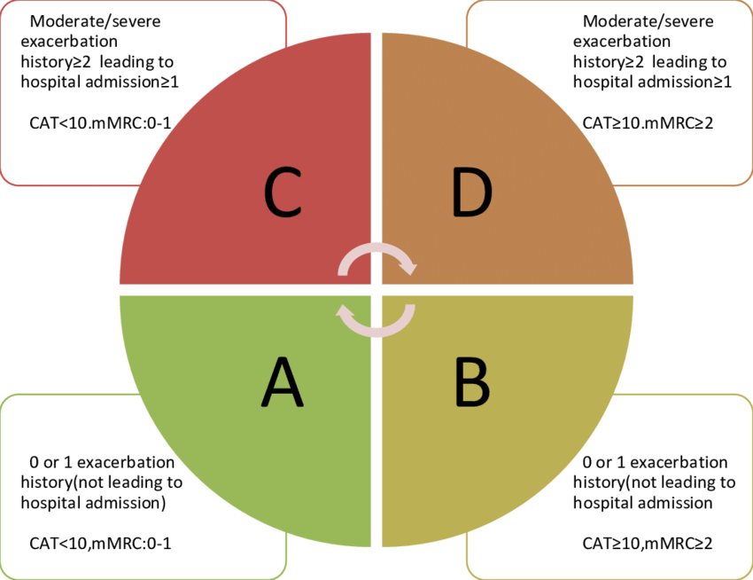
GLOBAL INITIATIVE FOR CHRONIC OBSTRUCTIVE LUNG DISEASE (GOLD) 2021

Slide 4
2023 GOLD Guidelines
ABE grouping: The old ABCD tool was replaced with an ABE grouping, where Group E includes patients with a history of more than two moderate exacerbations or one severe (hospitalization-requiring) exacerbation in the past year, regardless of symptom burden.

Slide 5
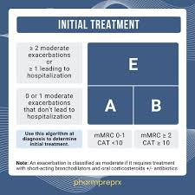
ABE grouping

Slide 6
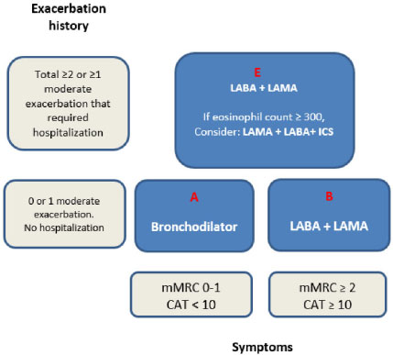
GOLD 2023 : Initial treatment
Notes:
Initial Treatment Adjustments:
Group B patients, previously on monotherapy, are now recommended for dual long-acting bronchodilator therapy (LABA/LAMA).
For Group E, initial treatment is also recommended to be LABA/LAMA, with triple therapy (LABA/LAMA/ICS) considered for patients with blood eosinophil count ≥ 300 cells/µL.
The use of LABA/ICS combinations is no longer encouraged, as triple therapy (LABA/LAMA/ICS) is preferred when ICS is indicated.

Slide 7
GOLD 2023
Initial Treatment Adjustments:
Group B patients, previously on monotherapy, are now recommended for dual long-acting bronchodilator therapy (LABA/LAMA).
For Group E, initial treatment is also recommended to be LABA/LAMA, with triple therapy (LABA/LAMA/ICS) considered for patients with blood eosinophil count ≥ 300 cells/µL.
The use of LABA/ICS combinations is no longer encouraged, as triple therapy (LABA/LAMA/ICS) is preferred when ICS is indicated.

Slide 8
GOLD :2023
Mortality as a Treatment Goal:
A new section was added: therapeutic interventions to reduce COPD mortality.
Evidence supporting the reduction of mortality with triple therapy in moderate-to-very-severe COPD patients with a history of exacerbations
Non-Pharmacological Interventions:
stress impact of pulmonary rehabilitation and long-term oxygen therapy, on mortality.
Comorbidity management & vaccines
Follow-up Treatment:
Follow-up is guided by "treatable traits" of either dyspnea or exacerbations.
For dyspnea, increasing to a LABA/LAMA combination is recommended.
For exacerbations, the blood eosinophil count guides treatment: LABA/LAMA for <300 cells/µL and triple therapy for ≥300 cells/µL.

Slide 9
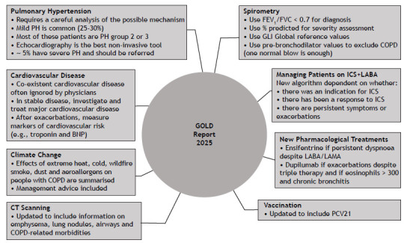
GOLD 2025

Slide 10
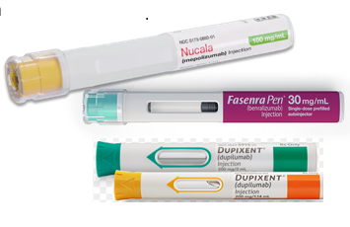
REFRACTORY COPD: NEW TREATMENTS
Add-on therapy for refractory COPD
For patients with COPD and peripheral eosinophilia (≥300 /mcL) who have recurrent exacerbations despite triple inhaled therapy >> addition of dupilumab or mepolizumab (Grade 2C).
anti-IL 5 monoclonal antibody mepolizumab (100 mg SQ monthly): reduction in moderate or severe exacerbations compared with placebo (0.80 versus 1.01 events per year), but no improvements in lung function or respiratory symptoms
Anti –IL 4 and IL-13 dupilumab : larger reduction in exacerbation rates and modest improvements in lung function and symptoms

Slide 11
REFRACTORY COPD
For patients without peripheral eosinophilia who have recurrent exacerbations despite LAMA-LABA-ICS therapy, addition of one of the following agents (Grade 2C):
Long-term azithromycin (an oral macrolide antibiotic)
Roflumilast (an oral phosphodiesterase- [PDE]-4 inhibitor)
Ensifentrine (a nebulized PDE-3/PDE-4 inhibitor)

Slide 12
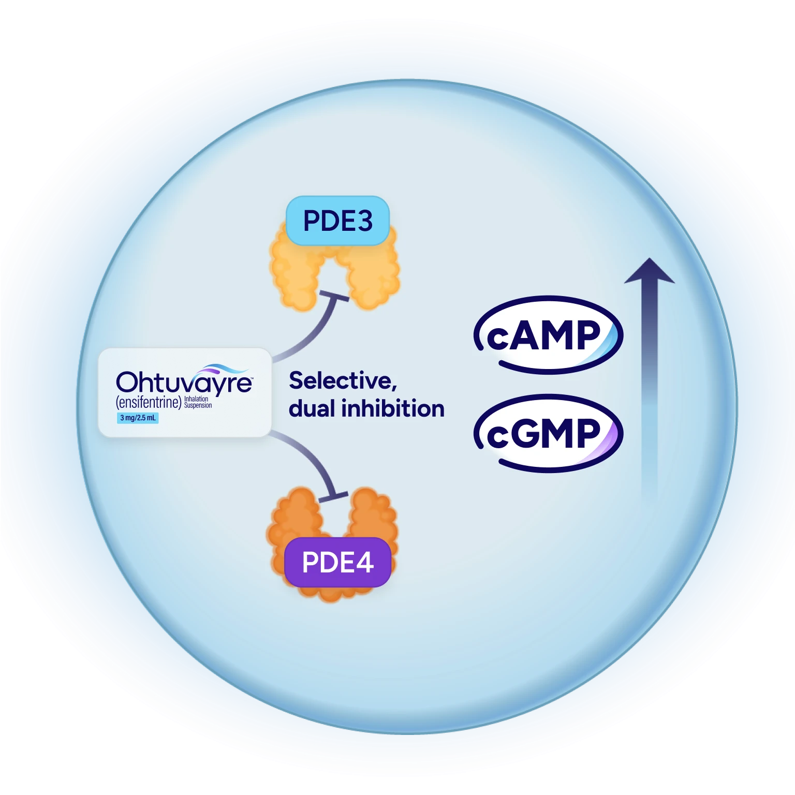
ENSIFENTRINE
a nebulized PDE-3/PDE-4 inhibitor
dose 3 mg twice daily via jet nebulizer.
Availability, cost, and insurance coverage may be barriers
Well tolerated

Slide 13
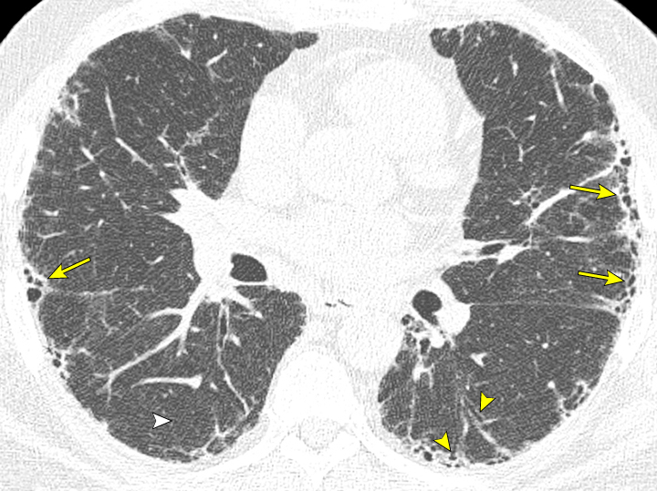
INTERSTITIAL LUNG DISEASE UPDATE
Diagnostic emphasis: HRCT pattern, multidisciplinary discussion, and early specialist referral.
bilateral subpleural reticulation, traction bronchiectasis (arrowheads), and honeycombing (arrows).

Slide 14
Oximetry in ILD
6MWT prognosis: Pulse oximetry desat < 88 % = median survival of 3.2 yrs , median survival of 6.6 yrs in those who did not desat < 89 %
Key variables :
6MWD (distance)
Degree of hypoxia
long-term benefit of supplemental oxygen not established with isolated exertional hypoxia and preserved O2 sat at rest
Long-Term Oxygen Treatment Trial Research Group, Albert et al. A Randomized Trial of Long-Term Oxygen for COPD with Moderate Desaturation. N Engl J Med 2016; 375:1617.
Overnight oximetry : clinical suspicion of nocturnal hypoxemia and/or sleep-disordered breathing

Slide 15
ILD : OTHER LUNG FIBROSIS
INBUILD STUDY : Progressive fibrosing phenotype concept beyond IPF; antifibrotics now used across fibrosing ILDs, nintedanib slows FVC decline
ATS/ERS/JRS/ALAT 2022 guideline update:
conditional recommendation for antifibrotics (nintedanib, pirfenidone).
Pulm Rehab recommended to improve quality of life and exercise capacity.

Slide 16
ILD & PR
Symptom burden: dyspnea, cough, exercise limitation — core rehab targets.
Growing evidence base for including ILD patients in tailored PR programs (benefit for dyspnea, QoL).
Implications:
Tailor exercise to desaturation risk; include education on energy conservation and oxygen use.
Close monitoring for exertional desaturation—use ambulatory oximetry and individualized pacing.
Coordinate timing of antifibrotic treatment and PR; manage cough and breathlessness with multimodal strategies.
Be aware of side effect profile of drugs –diarrhea, abdominal pain, photosensitivity

Slide 17
ASTHMA : WHAT’S NEW
Biologics targeting IL-5, IL-4/IL-13 pathways remain phenotype specific, while anti-TSLP (approved 2021) is broader acting.
Real-world registry studies (2023) show adherence and self-administration of biologics feasible in community practice.
Focus shifting to phenotype/endotype-guided biologic selection and reduction of exacerbations.
Self-administration options increased access (pre-filled pens).

Slide 18
ASTHMA : REHAB IMPLICATIONS
Assess exercise-induced bronchoconstriction and optimize pre-exercise bronchodilator use.
Education on trigger control, adherence, and action plans remains central.
Coordinate with prescribing team when patients start biologics — monitor functional gains over time.

Slide 19
LUNG CANCER SCREENING
USPSTF 2021 expanded screening to 50–80 years with ≥20 pack-years — increased eligible population
Programs should integrate smoking cessation, navigation, and equity-focused outreach.

Slide 20
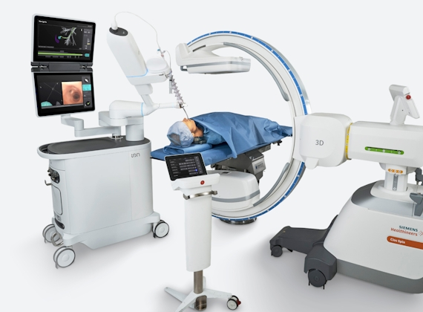
LUNG CANCER : DIAGNOSIS
Advanced Bronchoscopy: Robotic
possible to biopsy small, difficult-to-reach nodules in the peripheral lung
Integrated with mobile cone beam CT
Higher diagnostic yield , lower complication rates

Slide 21
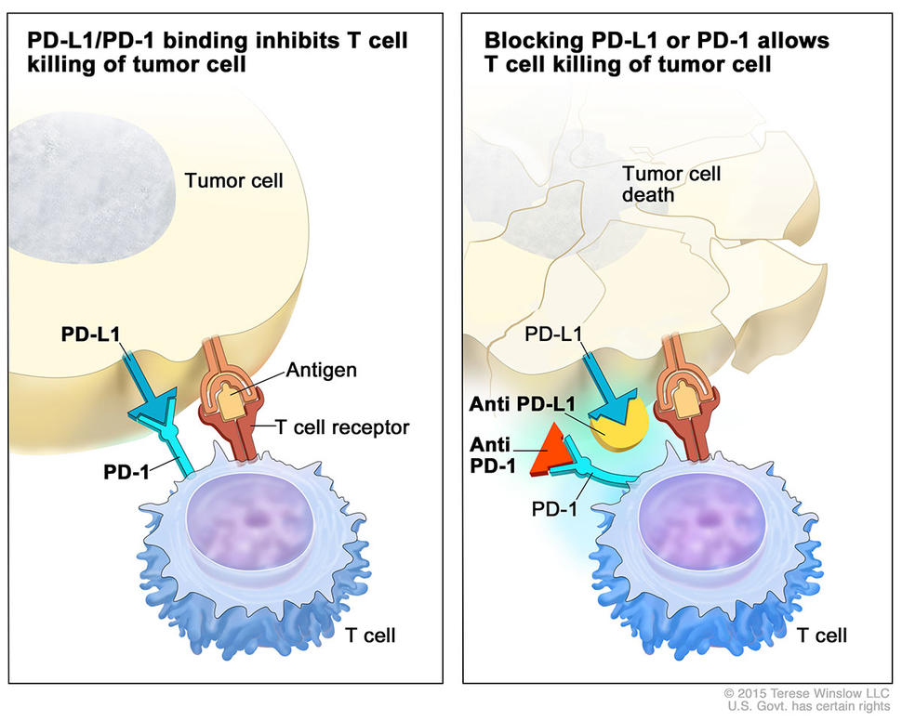
LUNG CANCER THERAPEUTICS
Neoadjuvant immunotherapy + chemo (CheckMate 816) improved pathological responses and event-free survival in resectable NSCLC
Targeted therapies expanded
EGFR : tumor cell growth
Immune Checkpoint Inhibitors (e.g., PD-1/PD-L1)
KRAS G12C inhibitors: sotorasib, adagrasib with approvals in 2021–2023

Slide 22
Lung Cancer : Rehab implications
Prehab and perioperative optimization improve functional reserve; incorporate inspiratory muscle training when indicated.
Postoperative rehab: early mobilization, dyspnea management, and fatigue mitigation.
Coordinate with oncology for timing around neoadjuvant/adjuvant therapies and immunotherapy side-effect monitoring.
Survivorship : Rehab teams play a role in symptom management (dyspnea, neuropathy, deconditioning) and QoL restoration.

Slide 23
LONG COVID
Post–COVID-19 condition (Long COVID): symptoms ≥2–3 months after acute infection, multi-system impact.
Epidemiology evolving; substantial functional impairment in a subset of patients
WHO living guidance and fact sheets define management and recommend early rehab referral
individualized, cautious rehabilitation approach
CBT and structured rehab can improve symptoms for some patients
Key caution: screen for post-exertional symptom exacerbation (PESE/POTS) and tailor exercise pacing.

Slide 24
LONG COVID: REHAB practical approach
Perform multidomain assessment (physical, cognitive, autonomic, mental health).
Start with low-intensity, symptom-guided activity; emphasize pacing and energy conservation.
Use multidisciplinary teams and coordinate with specialists (cardiology, neurology, ENT) as needed.

Slide 25
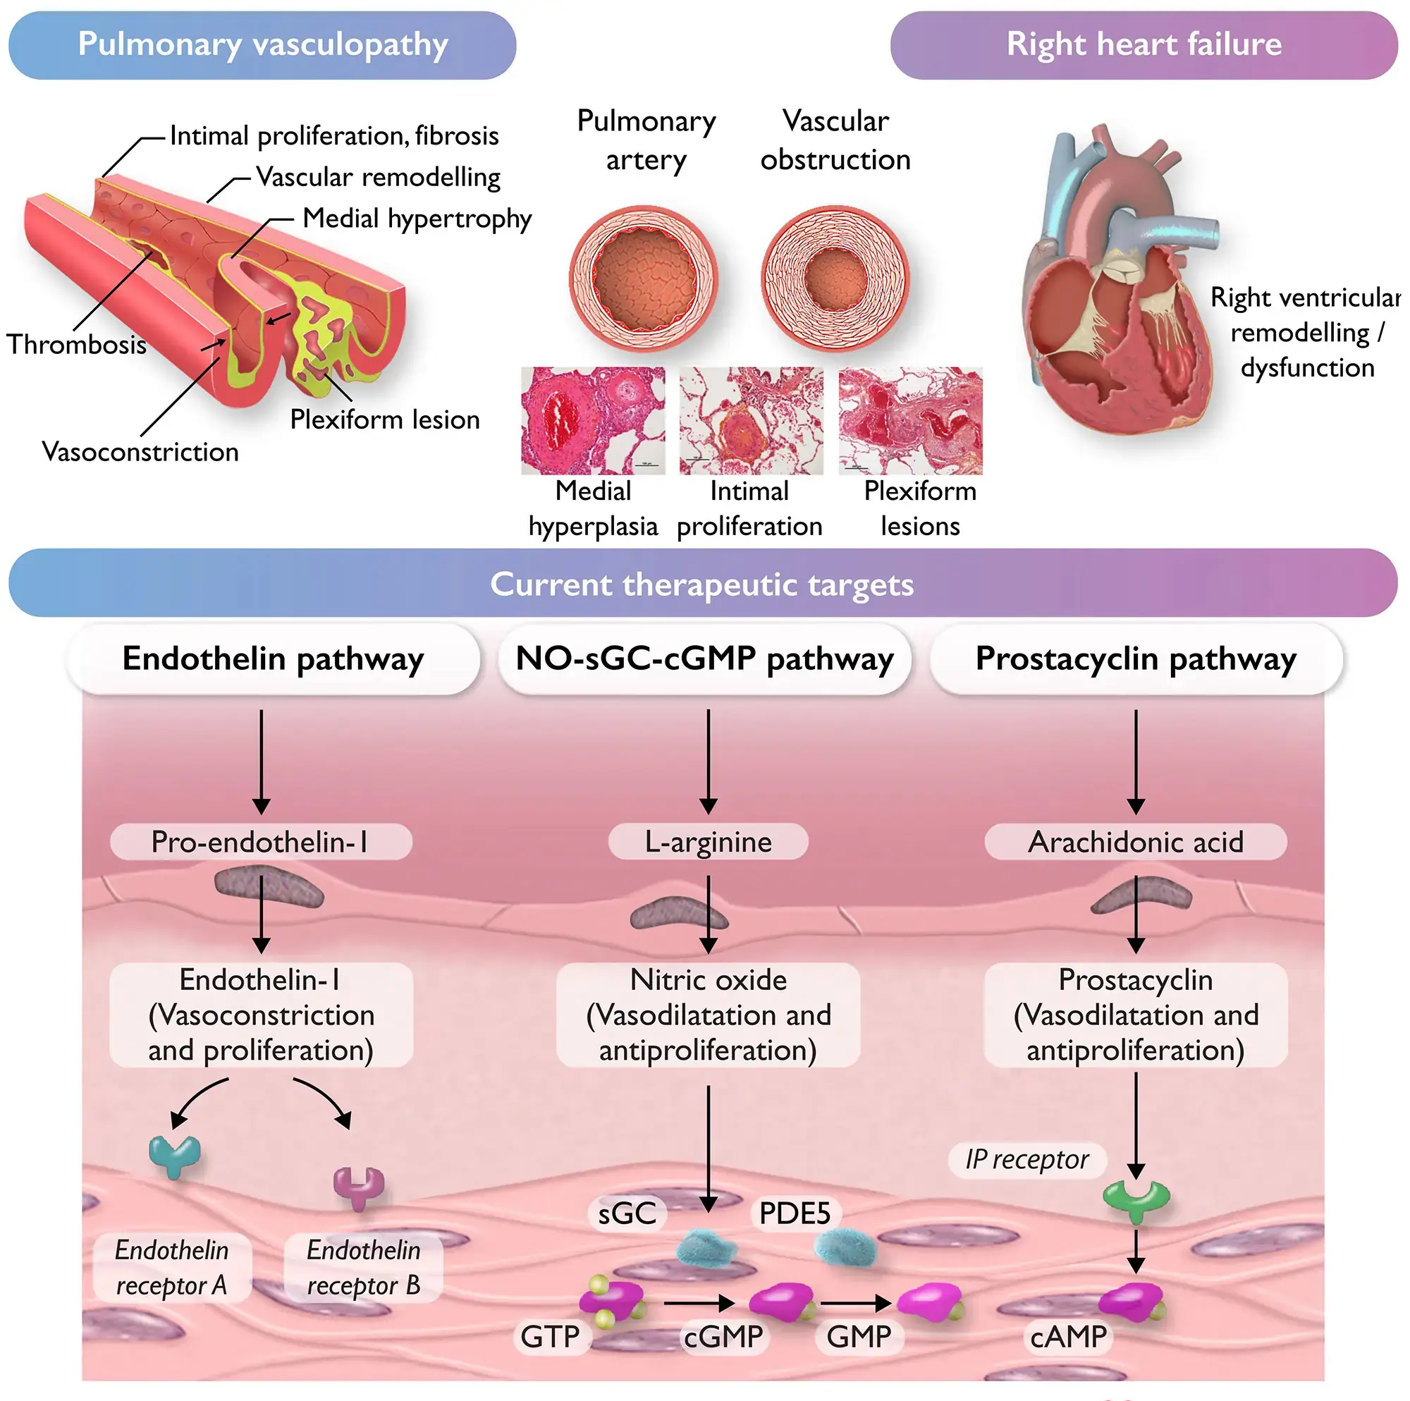
PULMONARY HYPERTENSION : OVERVIEW
WHO Group 1 PAH distinguished from secondary PH groups (left heart disease, lung disease, CTEPH).
Diagnosis: echocardiography screening → right heart catheterization for confirmation.
mPAP of 25 mm Hg or higher
Rehab professionals: recognize exertional dyspnea and fatigue as functional limitations.
Notes:
PH is classified into 5 WHO groups. Group 1 (PAH) is treated with targeted therapies, while groups 2–5 focus on underlying causes. RHC remains gold standard for diagnosis. (Simonneau G et al., Eur Respir J 2022; McLaughlin VV, NEJM 2021). Rehab implications: safety monitoring, desaturation risk, and careful exercise prescription.

Slide 26
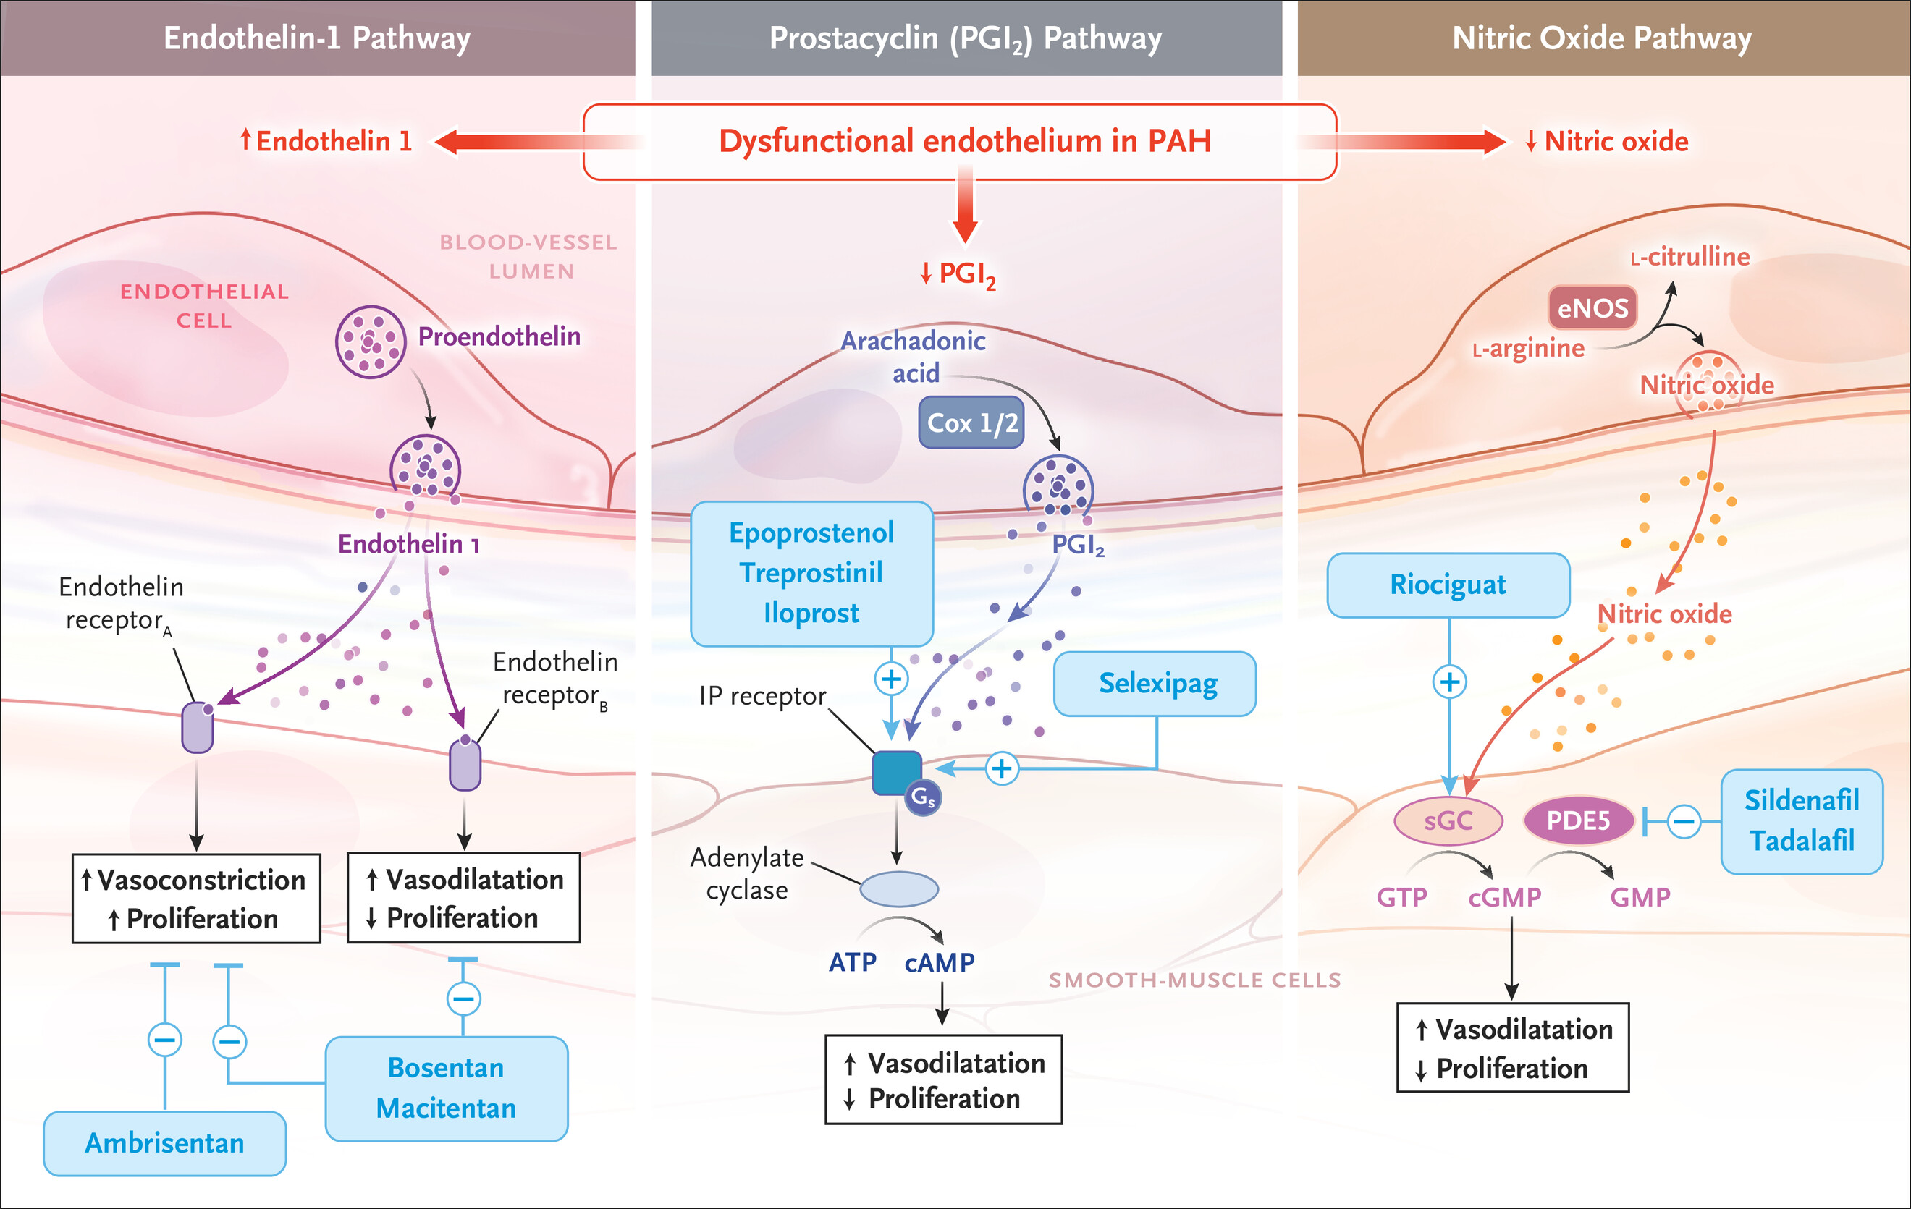
PH : THERAPY TARGETS
Notes:
Current targeted therapy is aimed at correcting endothelial dysfunction²⁷ by inhibiting the endothelin pathway and enhancing the prostacyclin (PGI₂) and NO pathways. Endothelin 1 (ET₁), which is increased in PAH, can bind to either the endothelin A (ET_{A}) receptor, causing vasoconstriction (of smooth-muscle cells) and cell proliferation, or the endothelin B (ET_{B}) receptor, causing vasodilatation and antiproliferation. Thus, there are dual ET_{A}–ET_{B} receptor antagonists (e.g., bosentan and macitentan) or selective ET_{A} receptor antagonists (e.g., ambrisentan), which leave the ET_{B} receptor functional. The expression and function of the PGI₂ and NO pathways are decreased in PAH, resulting, respectively, in diminished cyclic adenosine monophosphate (cAMP) and cyclic guanosine monophosphate (cGMP), which are second messengers responsible for vasodilatation and antiproliferation. Agents that increase cAMP include PGI₂ analogues given intravenously (e.g., epoprostenol and treprostinil), subcutaneously (e.g., treprostinil), by inhalation (e.g., iloprost and treprostinil), orally (treprostinil), or with the use of oral PGI₂ receptor (IP) agonists (e.g., selexipag). Increased cGMP release can be achieved with inhaled NO (used essentially in the cardiac catheterization laboratory or intensive care unit), which stimulates soluble guanylate cyclase (sGC), or by inhibiting phosphodiesterase type 5 (PDE5, which degrades cGMP into GMP) with the use of oral PDE5 inhibitors (sildenafil or tadalafil). Direct sGC stimulators (e.g., oral riociguat) can increase the release of cGMP independently of NO release. These drugs have been approved by the Food and Drug Administration for patients with PAH who have an mPAP of 25 mm Hg or higher.

Slide 27
PH : THERAPY UPDATE
ESC/ERS 2022 guideline: upfront combination therapy (ERA + PDE5i) for intermediate/high-risk patients, escalation with prostacyclins as needed.
Novel pathway: BMPR2 modulation
Gene therapy
Sotatercept (a first-in-class fusion protein binds the TGF-β ligand activin, restores balance of BMP/TGF-B pathway ) significantly improved 6MWD (~40 m) and reduced risk of clinical worsening in PAH.
STELLAR trial (Humbert M, NEJM 2023)
Notes:
Mutations in the BMPR2 gene are the most common genetic cause of heritable PAH and are also found in a significant portion of idiopathic (IPAH) cases. Targeting this pathway involves several approaches aimed at restoring proper signaling to prevent or reverse the vascular remodeling

Slide 28
PH : REHAB IMPLICATIONS
Exercise training shown to improve functional capacity and QoL in stable PAH (supervised programs).
Avoid high-intensity interval training; favor low-to-moderate endurance and strength training.
Close monitoring of oxygenation, heart rate, symptoms during sessions. Tele rehab not favored
Be aware of common side effects of drugs
headache and lightheadedness (esp start of treatment),
flushing and upper respiratory congestion,
hypotension
GI symptoms (e.g., bloating, nausea or vomiting, and diarrhea)
Fluid retention (e.g., pedal edema) –adjust diuretics.
cough (e.g., with inhaled treprostinil), elevation of aminotransferase levels (with bosentan)
Notes:
Several RCTs and meta-analyses (e.g., Ehlken N, Eur Heart J 2016; Babu AS, Pulm Circ 2022) confirm safety and benefit of supervised rehab in PH. Avoid unsupervised or overly vigorous training. Tele-rehab approaches being explored cautiously. Emphasis on multidisciplinary approach, psychosocial support, and gradual progression.

Slide 29
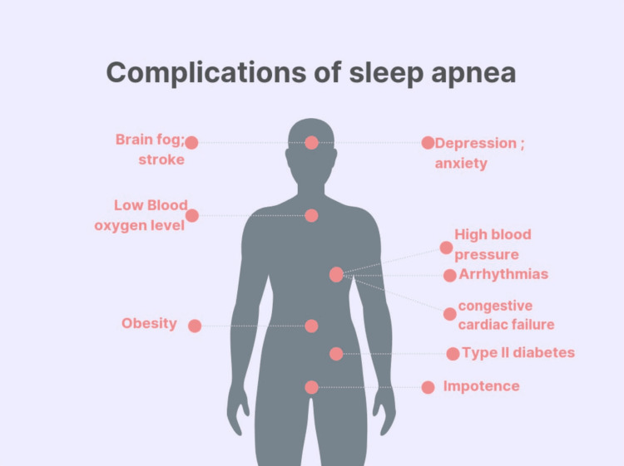

Slide 30
OSA: WHEN TO TEST
Symptomatic
Self referral : smart watches
Atrial fibrillation
Refractory hypertension
Nocturnal oximetry ?

Slide 31
Smart watch & OSA
track sleep quality and vital signs, serving as early indicators of sleep apnea
Variability in Features: some offer advanced features like O2 sat and snoring . Others >> HR, RR, Body position
Brands Matter: Apple Watch, Garmin, and Fitbit
Samsung Galaxy Watch sleep apnea feature receives FDA authorization : Feb 2024
Sleep apnea notification feature in Apple watch series 9/10 & Ultra 2

Slide 32
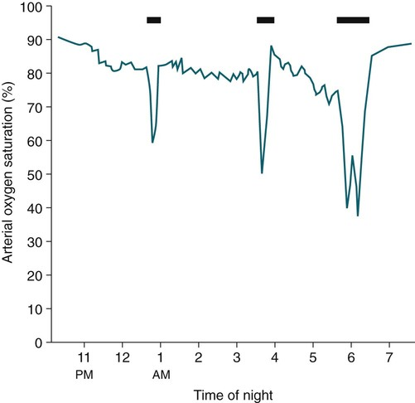
NOCTURNAL OXIMETRY PATTERNS : COPD

Slide 33
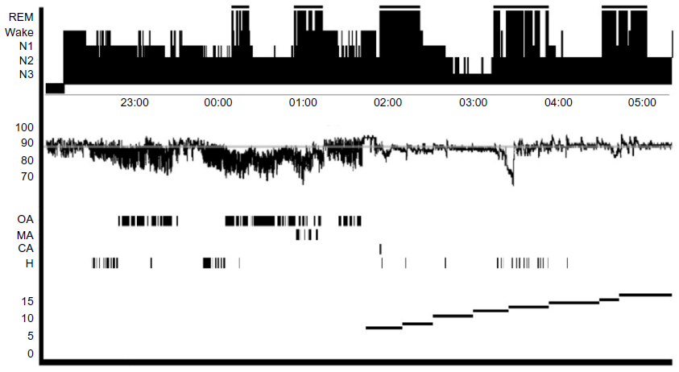
NOCTURNAL OXIMETRY PATTERNS : OSA

Slide 34
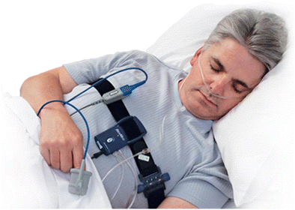
HSAT device components

Slide 35
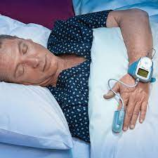
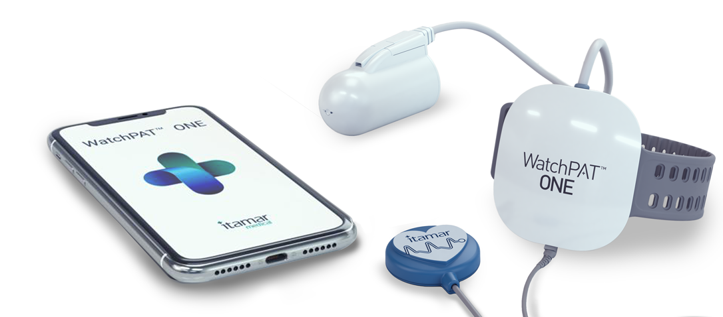
WATCHPAT

Slide 36
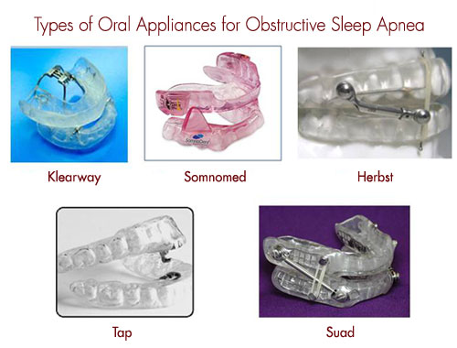
DEVICE SELECTION :Mandibular advancement splint vs Tongue retaining

Slide 37
Hypoglossal Nerve Stimulation Devices

Slide 38
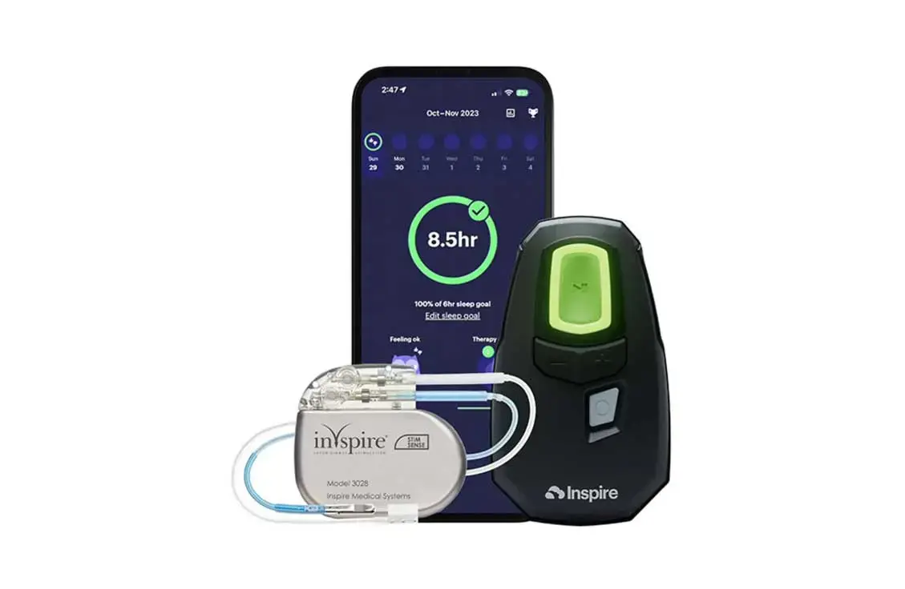
HNS CRITERIA

Slide 39
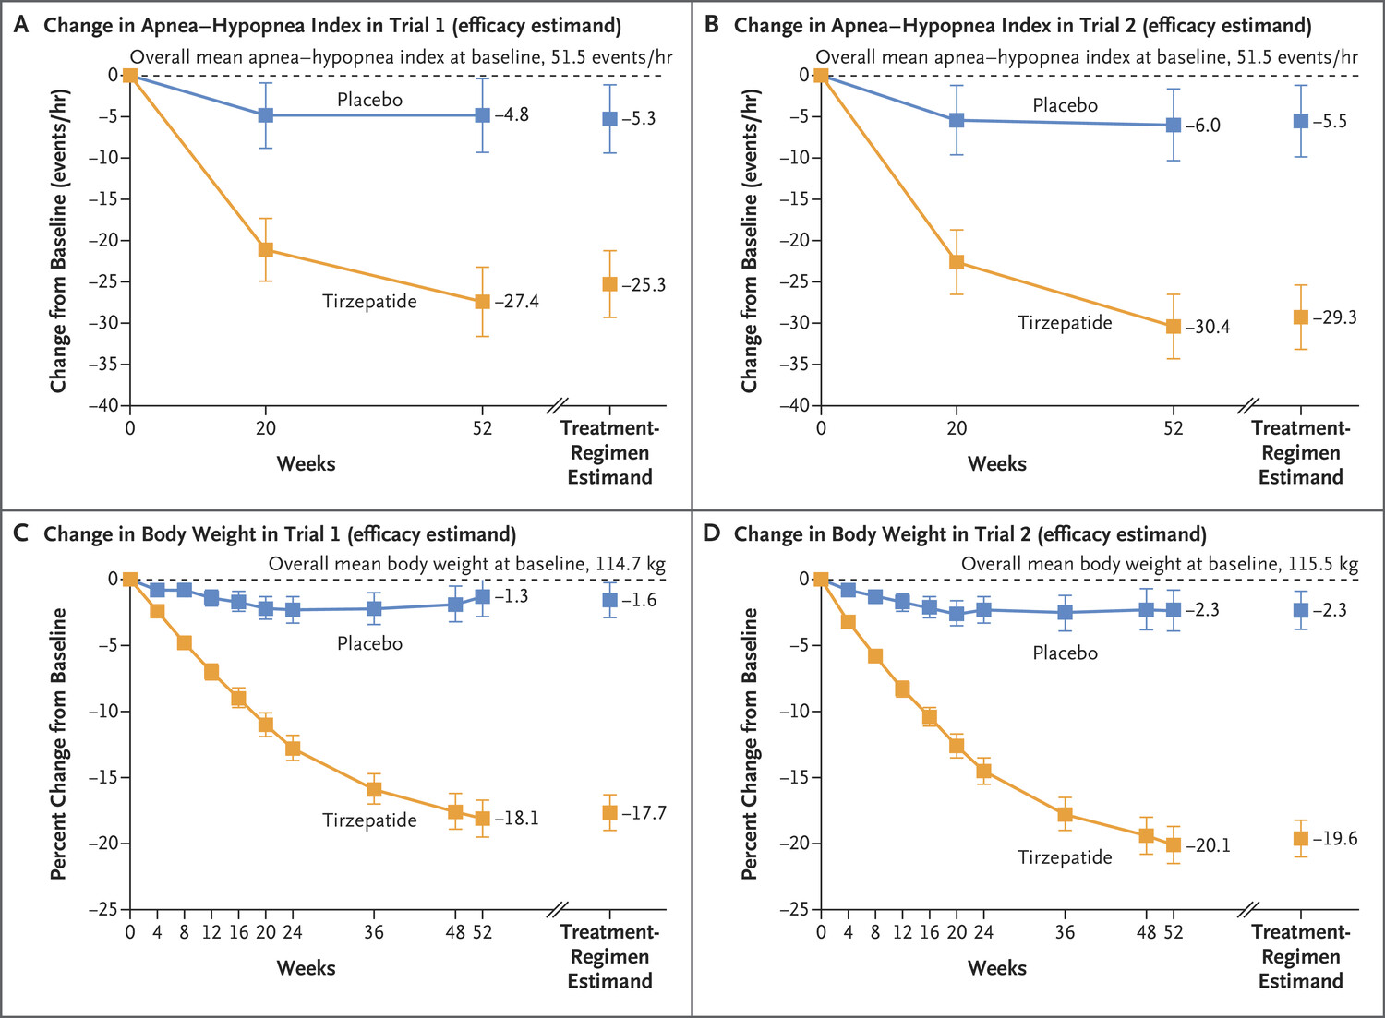
TIRZEPATIDE FOR RX OF OSA
Change in AHI & Body weight
Malhotra et al NEJM June 2024

Slide 40
OSA: Rehab implications
Screen cardiopulmonary rehab patients for OSA symptoms (STOP-BANG, ESS).
Incorporate OSA education, weight management, and CPAP adherence coaching into rehab programs.
Coordinate with sleep medicine for HSAT, PAP titration, and monitoring.

Slide 41
ATS PULMONARY REHAB GUIDELINES 2023
Strong recommendation:
Stable COPD
Post hospitalization for COPD
ILD
Delivery model : offer a choice between center based vs telerehab
Conditional :
Pulmonary hypertension (PH)
Maintenance program for COPD

Slide 42
PR program : CORE COMPONENTS
Exercise training
Self management education
Psychosocial support
Multidisciplinary team

Slide 43
PR GUIDELINES : SIGNIFICANCE
Expands eligibility: includes ILD & PH
Access ; PR is underutilized , issues related to access, referral & reimbursement
Telerehab : strong recommendation , effective delivery model, overcomes geographical barriers
Standardization: PR delivery

Slide 44
COMPARISON
Center Based PR
Telerehab
Setting : clinic, hospital, or rehab center.
Involves face-to-face, in-person sessions.
Supervision: in person, multi disc team, + equipment /emergency care
Outcomes: “gold standard”, exercise capacity, DOE & QOL
Program completetion : lower rates
Remote,from patient's home.
via video conf, telephone, or mobile apps
Remote: real time video vs phone check ins, remote monitoring vs unsupervised
Comparable , 6MW & QOL outcomes
Higher rates

Slide 45
COMPARISON
Center based PR
Telerehab
Access: distance, location, transport, fixed scheduling
Equipment : on site treadmills, bikes
Patient selection: complex medical needs, severe disease, structured env
Hybrid model : maximizes access & benefits !
Improves access, no transport, flexible schedule
Use own, bands , tablet. Needs reliable internet
For stable resp disease, comfort with technology

Slide 46
CARDIOPULMONARY REHAB UPDATE
Use standardized outcome measures (6MWT, ISWT, patient-reported outcomes) and document functional trajectories.
Integrate cognitive, nutritional, and psychological support where needed (esp. Long COVID).
Leverage technology (wearables, remote monitoring) cautiously — validate against clinic measures.
Implementation tips:
Screen referrals early; create rapid-access pathways post-exacerbation or surgery.
Train staff in safe Long COVID management (energy pacing, autonomic dysfunction awareness).
Collect program-level data to demonstrate value and support reimbursement.

Slide 47
ARTIFICIAL INTELLIGENCE
Machine Learning (ML) and Deep Learning (DL): AI models are trained using large datasets to identify patterns in medical images and patient data.
Natural Language Processing (NLP): analyze text from medical records to identify lung nodules or other clinical information.

Slide 48
AI APPLICATIONS
Diagnosis & Screening :
Radiological Imaging: CT pattern recognition for ILD, lung nodules, PE.
Early Disease Detection: AI-driven screening for lung cancer and COPD using imaging and patient data
Diagnostic Procedures: use in navigational and virtual bronchoscopy to improve procedure planning
Treatment & Management
Predictive Analytics: Forecasting medical events, complications, and mortality based on patient records eg sepsis, ARDS
Smart Weaning: AI-controlled ventilation that adjusts support to a patient's specific respiratory needs, shortening ventilation time and reducing complications.
Drug Discovery: AI's role in analyzing genomic and clinical trial data to find and predict the efficacy of new drugs

Slide 49
AI : SLEEP
Automated scoring of sleep studies with deep learning algorithms approved for clinical use.
AI-based Predictive algorithms can identify patients at risk for PAP nonadherence, enabling targeted coaching
Integration of wearable and consumer sleep technology into clinical workflows.

Slide 50
AI : REHAB IMPLICATIONS
Personalized Exercise Prescription: AI algorithms analyze data from wearables (like accelerometers and ECG sensors), functional capacity, and patient responses to create tailored, weekly exercise targets for step count, calorie expenditure, and moderate to vigorous physical activity.
Remote Monitoring: Wearable devices integrated with ML models can track functional capacity over time, predict walking distance and other key indicators, and allow for remote, home-based rehabilitation programs.
Automated Monitoring: Non-invasive methods using WiFi signals can estimate respiratory rate, while AI can enhance the accuracy of devices like pulse oximeters to monitor oxygen saturation levels, reflecting overall cardiopulmonary health
Smart Inhalers: AI-powered smart inhalers track usage, technique, and peak flow, providing immediate feedback to patients and improving treatment adherence for conditions like asthma and COPD
Ethical/practical concerns: bias, data privacy, need for clinician oversight.

Slide 51

“And that is the original processor!”

Slide 52

QUESTIONS

