Slide 1
Unlocking the Secrets to Maximize Pulmonary Medications
Jason Elder BS, RRT/RCP
Respiratory Therapy Director of Clinical Education
Catawba Valley Community College

Slide 2
Disclosures
I am a married.
I am a parent.
Monetarily I have none to make.

Slide 3
Objectives
Understand the role of various pulmonary medications.
Understand how to different medications work on the body.
Understand the differences in the delivery devices.
Understand when to use the medication types and device types for each patient.
Understand the need for proper education in regards to medications within your setting.

Slide 4
Are you paying attention?

Slide 5
Basics Review
Two main systems that affect us
Sympathetic Nervous System (Fight or Flight)
Parasympathetic Nervous System (Rest and Digest)
Medications can work to stimulate a system or to suppress a system.
These 2 systems work in tandem so effects can be caused from either side.

Slide 6
Basic Review: Receptors
Alpha receptors
Found in smooth muscle of blood vessels
Causes vasoconstriction
Beta receptors:
Beta₁
Found in Cardiac muscle
Stimulation = chronotropic, dromotropic & inotropic actions
Beta₂
Found within smooth muscles of the airways and certain blood vessels
Stimulation = vasodilation and bronchdilation

Slide 7
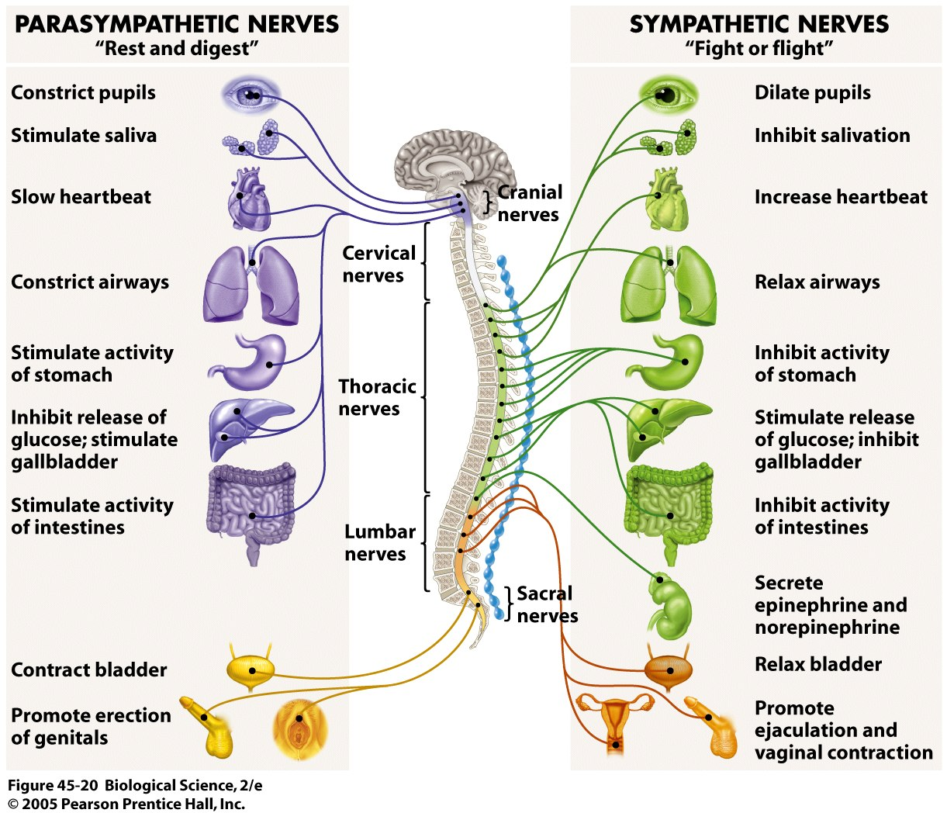

Slide 8
Tracheobronchial Tree
16 generations of conducting airways starting with
Gereation 0 – trachea
1 – Main stem
2 – Lobar Bronchi
3 – Segmental Bronchi
4-9 – Subsegmental bronchi
10-15 – Bronchioles
16-19 – Terminal bronioles
Generations 20-28 – beginning of gas exchanging function (respiratory bronchioles, alveolar ducts, alveolar sacs)

Slide 9
Particle Size and Deposition
Nose - >10 microns
Mouth - >15 microns
First 6 generations of the airway – 5-10 microns.
Last 5-6 generations – 1-5 microns

Slide 10
Size Can Be an Issue
Micron – one millionth of a meter.
Most aerosol generators produce particles in the 1-5 micron range.
<0.5 microns are so stable they may be exhaled out.
Neb design, and gas flow rates affect particle size.
Notes:
Patients should be careful taking equipment home from the hospital because their home units may not produce sufficient flow/drive pressure. Hospital based equipment is designed to run on specific FLOW RATES not pressures.

Slide 11
Inhalation Route Pros and Cons
Pros:
Quick acting
Minimizes systemic absorption
Less dosage of some drugs
Cons:
Technique, compliance, equipment, maintenance

Slide 12
Common Types of Medications
Bronchodilators
Beta Adrenergic
Short Acting (Albuterol, Xopenex)
Long Acting (Formoterol, Arformoterol, Serevent)
Anticholinergics (Atrovent, Spiriva)
Corticosteroids (Budesonide, Fluticisone)
Combination Medications (Advair, Symbicort, Dulera, Breo)

Slide 13
Technical Aspects
Stability – Tendency of the aerosol to remain in suspension. Want the drug to rain out in the lungs, 10 second breath hold.
Penetration – Size of particles, patient breathing pattern, disease state.
Deposition – Where the particles fall out of suspension.
Inertial impaction – When the particle hits something, it will impact.

Slide 14
Types of Devices
Nebulizer
Pros:
Efficient
Versatile
Cons:
Not very portable
Requires power source (gas or electric)
Patient must be able to take a good breath with a hold (5-10 seconds)
Notes:
Efficient - Gives a large dose of medication, Steady dose delivery,
Versatile - Can give a large variety of medications from the same device

Slide 15
Types of Devices
Metered Dose Inhaler (MDI)
Pros:
Convenient
Efficient
Versatile
Cons:
Propellant Based (HFA, Respimat)
Patient must be able to follow directions
Should ALWAYS be used with a Spacer
Notes:
Convenient - Small, Portable, able to be used in a variety of situations
Efficient - Provides proper particle size, works well with most patients
Versatile - Used in a large variety of different medications and can support many different medication types.
Propellant based - Propellants don’t like extreme temperature changes

Slide 16
Types of Devices
Dry Powder Inhalers (DPI)
Pros:
Convenient
Versatile
Cons:
Maintenance use only
Patient must be able to follow directions
Patient must be able to generate > 50LPM flow
Notes:
Convenient - Small, Portable , Keeps Track of Doses Remaining, No Timing Necessary
Versatile - Can be used in diverse environments, Can be used for various medications/medication types.

Slide 17
Education and Take Away Points
Education is one of the most important factors with ANY medication and unfortunately is also one of the largest items missing.
We have the privilege of being the key that fits this lock.
We see the patients in a setting that allows us the the unique opportunity to be that key.
Knowing and understanding this information and these devices allows us to be the difference to patients.

Slide 18
We help put the pieces together

Slide 19
Any Questions?

