Slide 1
Pulmonary CSI: Following the Evidence
Dr. Kimberly Clark
Clinical Associate Professor
MSRC Program Director Department of Kinesiology

Slide 2
Conflict of Interest Disclosure
I have no real or perceived conflicts of interest in providing this presentation.

Slide 3
Objectives
Identify relevant patient information in determining the status of patient with COPD.
Make pulmonary rehabilitation treatment plan recommendations for patients with COPD.
Present evidence-based recommendations and guidelines for pulmonary rehabilitation.

Slide 4
Case Study Investigation
70 y.o. woman admitted to the hospital with AECOPD
Progressive SOB x 3-5 years
Difficulty walking 2 blocks to the community center
Stopped driving 6 months ago
Stopped gardening 6 months ago
Does not leave house very often
Sister helps her with housework, outside chores, and drives her where she needs to go
A modest cough
1 tsp sputum/day
Smoked 2 packs/day x 20 years – quit 6 years ago
Takes albuterol MDI intermittently with no notice of improvement

Slide 5
What is the functional history?
70 y.o. woman admitted to the hospital with AECOPD
Progressive SOB x 3-5 years
Difficulty walking 2 blocks to the community center
Stopped driving 6 months ago
Stopped gardening 6 months ago
Does not leave house very often
Sister helps her with housework, outside chores, and drives her where she needs to go
A modest cough
1 tsp sputum/day
Smoked 2 packs/day x 20 years – quit 6 years ago
Takes albuterol MDI intermittently with no notice of improvement

Slide 6
Auscultation
What type of breath sounds would you expect to hear on this patient?
In a patient with COPD, you might expect to hear:
Most often, very decreased air entry/ breath sounds throughout;
Less frequently, may have some medium- or high-pitched wheezes;
May have early inspiratory crackles if diffuse airway obstruction.

Slide 7
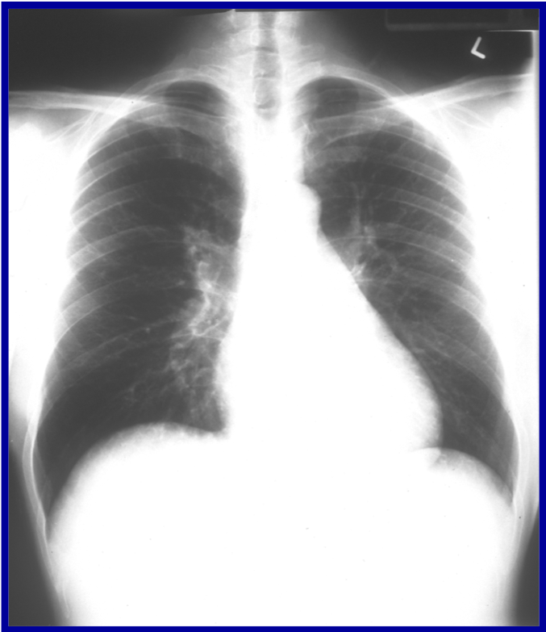
Chest X-Ray Healthy Person
What features indicate this person has healthy lungs?

Slide 8
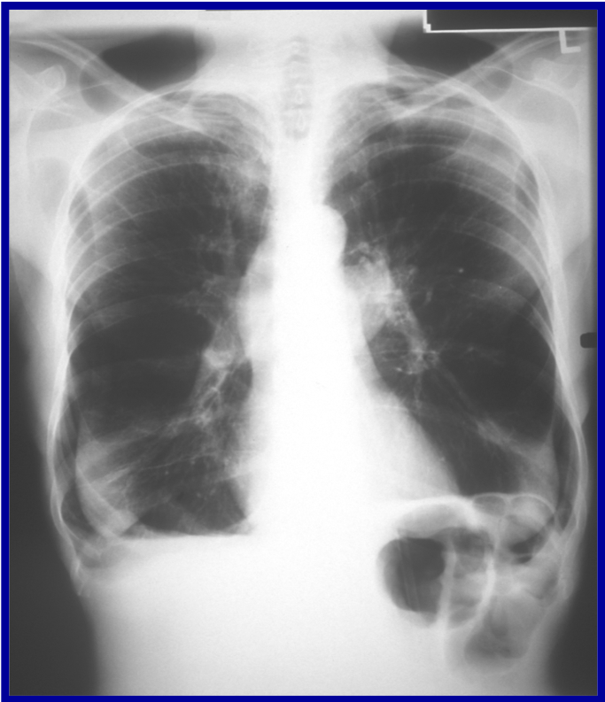
Chest X-Ray 70 y.o. COPD Patient
Are the lungs smaller or bigger than usual?
Which soft tissues are drastically altered?
Describe the x-ray findings that are consistent with COPD.

Slide 9
Arterial Blood Gases
AECOPD
pH | PaCO² | HCO₃- | PaO₂ | SpO₂
7.29 | 76 mmHg | 38 mEq/L | 45 mmHg | 83%
Stable COPD
pH | PaCO² | HCO₃- | PaO₂ | SpO₂
7.39 | 50 mmHg | 28 mEq/L | 61 mmHg | 92%

Slide 10
Pulmonary Function Tests
 |  | Pre |  | Post
 | Pred | Meas | % | Meas | % | % change
FVC (L) | 3.10 | 2.00 | 65 | 2.10 | 68 | 5
FEV1 (L) | 2.35 | 0.60 | 26 | 0.65 | 28 | 8
FEV1/FVC | 0.75 | 0.39 | 52 | 0.41 | 55 | 6
PEFR (L/s) | 5.7 | 2.71 | 48 | 2.57 | 45 | -5
FEF 25-75 (L/s) | 6.36 | 0.18 | 3 | 0.25 | 4 | 33

Slide 11
Exercise tests and muscle strength
Test Measure | Parameters of Test | Measured |  | % Predicted*
Cardiopulmonary Exercise Test (CPET) | Maximal Workload (watts) | 38 |  | 34
 | VO_{2Peak} (ml/kg/min) | 13.2 |  | 49
 | VE_{max} (L/min) | 21.3 |  | 44.4
 | HRmax (beats per min) | 118 |  | 79
 | Pred MVV (FEV₁ x 35) (L/min) | 22.75 |  | 82.25
 | SpO₂ (last exercise stage) | 90%
 | Dyspnea – 10 pt Borg Scale | 5
 | Leg Fatigue – 10 pt Borg Scale | 7
6MWT | Distance Walked (m) | 350 |  | 60
 | HR - end test (beats per min) | 118 |  | 79
 | SpO₂ – (end test) | 86% |  | -
 | Dyspnea – (end test) | 7 |  | -
 | Leg Fatigue | 4
 | Comments | The patient needed to rest once (for 30 sec) due to intolerable dyspnea
Quadriceps Strength | Hand held dynamometer (Kg) | 15 | 66
Inspiratory muscle strength | Maximal inspiratory pressure – measured at RV (cmH₂O) | 65 | 95
Ventilatory reserve = (MVV-VEmax)/MVVx100 should be >15% at peak exercise. VR for this patient is 6% (Strickland et al., 2012). We can conclude that this woman is ventilatory limited.

Slide 12
Problem List
Dyspnea
Irreversible airflow limitation
Decreased exercise tolerance
Hypoxemia during exercise
Possibly poor understanding of condition and how to self-manage

Slide 13
Treatment Plan
Dyspnea
Breathing control
purse lip breathing
relaxation positioning (lean forward position in sitting
energy conservation techniques or pacing strategies
Roller assist device during walking (if needed)
Irreversible airflow limitation
Need medications adjusted
Check proper MDI technique
Check PIFR for DPIs
Inspiratory muscle training?
Loads =/> 30% of max inspiratory pressure (PImax) increases inspiratory muscle strength & endurance

Slide 14
Walking Program
Initial training intensity:
80% of average 6MWT speed
6MWD = 350 m.
350 m × 0.80 ÷ 6 mins × 5 mins
= 233 m for 5 min interval
Initial Training Load
233 m during each 5 minute interval for 3 intervals and a total duration of 15 mins during her first session.
Progression:
aim to increase the timing to 20-30 minutes
Once 20-30 mins is achieved, can increase walking speed as tolerated
Monitoring:
SpO₂ regularly.
HR
Borg’s RPE and RBE
BP pre and post

Slide 15
Cycling Program
Initial training intensity:
60% of max workload CPET= 60% × 38 W ≅ 23 W)
Initial Training Load:
2 -3 5-minute interval for 3 intervals for a total duration of 15 mins
May tolerate continuous workload
Progression:
aim to increase the timing to 20-30 minutes
Once 20-30 mins is achieved, can increase intensity as tolerated
Monitoring:
SpO₂ regularly
HR
Borg’s RPE and RBE
BP pre, during, and post

Slide 16
Resistance Training
Assessment
individual muscles
Of limiting factors in patients daily life.
Initial Training
2 sets of 8 reps are usually tolerated
Low resistance by small dumbbells or theraband
Ensure breathing through lifts
Use mirror to help patients monitor appropriate posture and movement.
Progression
Add another set then progress resistance
Higher resistance by larger dumbbells or stiffer theraband
Monitoring:
Borg’s RPE and RBE
Observation of facial expression
Monitor pain and be especially vigilant if patient has had previous musculoskeletal injury

Slide 17
When should PR be Initiated?
Wedzicha et al. (2017) found that PR initiated within 3 weeks of discharge following AECOPD reduces hospital admissions and improve quality of life. PR initiated within 8 weeks of discharge increases exercise capacity.
Spruit et al. (2013) suggested resistance training of the lower extremity muscles during hospitalization for AECOPD is well tolerated, safe, and improves muscle strength and 6MWT.
Neuromuscular electrical stimulation (NMES) is an alternative safe and effective training method that can prevent muscle function decline and hastens recovery of mobility for hospitalized individuals, particularly in critical care (Spruit et al., 2013).

Slide 18
Endurance Training
ACSM’s FITT can be applied to PR. A high level of intensity of continuous exercise (60% maximal work rate) for 20 to 60 minutes per session maximizes physiologic benefits. A Borg dyspnea or fatigue score of 4 to 6 (moderate to very severe) or Rating of Perceived Exertion of 12 to 14 (somewhat hard) is often considered a target training intensity (Spruit et al., 2013).
Biking exercise places a greater specific load on the quadriceps muscles than walking and results in less exercise-induced oxygen desaturation.

Slide 19
Resistance Training
Resistance training has greater potential to improve muscle mass and strength than endurance training (Spruit et al., 2013)
Strength training results in less dyspnea during the exercise period, thereby making this strategy easier to tolerate than endurance constant-load training (Spruit et al., 2013).
Initial loads equivalent to either 60 to 70% of the one repetition maximum or one that evokes fatigue after 8 to 12 repetitions are appropriate (Spruit et al., 2013). ACSM (2013) guidelines suggest initial resistance equal to 40% to 50% of 1 repetition maximum (1RM).

Slide 20
Program Duration
Optimal program duration is not clearly defined but it is suggested that 4-12 weeks to detect clinically important changes in exercise capacity and quality of life (Spruit et al., 2013).
Evidence is emerging to suggest shorter outpatient PR in conjunction with home-based maintenance programs and community-based PR programs can improve exercise tolerance and quality of life.

Slide 21
Future Research Opportunities
Identify the most important components of PR, the ideal length of a program, the degree of supervision, the intensity of training required, and how long the benefits of the program last.
Evaluating the effectiveness of PR in the home and community settings supported by telehealth.
Managing chronic pulmonary illness in population health.
Determine meaningful patient-centered outcomes for COPD
Measure accuracy of tools that detect symptoms and severity of COPD

Slide 22
References
American College of Sports Medicine. ACSM's Guidelines for Exercise Testing and Prescription. 9th ed. Philadelphia, PA: Lippincott Williams and Wilkins; 2013:334–338
Spruit MA, Singh SJ, Garvey C, et al. An official American Thoracic Society/European Respiratory Society statement: key concepts and advances in pulmonary rehabilitation. Am J Respir Crit Care Med. 2013;188(8):e13–e64.
Stickland MK , Butcher SJ, Marciniuk DD, et al. Assessing Exercise Limitation Using Cardiopulmonary Exercise Testing. Pulmonary Medicine 2012; 2012: 824091. https://doi.org/10.1155/2012/824091.
Wedzicha JA, Miravitlles M, Hurst JR, et al. Management of COPD exacerbations: a European Respiratory Society/American Thoracic Society guideline. Eur Respir J 2017; 49: 1600791. https://doi.org/10.1183/13993003.00791-2016.

Slide 23
kmclark1@uncc.edu
Thank you!
Questions?

