Slide 1
“This patient has received a heart transplant or VAD
– what do I need to know?”
Clinical considerations for patients who have received heart transplant or mechanical circulatory support device
Jennifer Gatten, FNP-C, CCTC
Diane Holmes, MSN, FNP-BC, CHFN, CCTC
Heart Transplant / VAD Coordinators
Carolinas Medical Center Heart Transplant / VAD Program
Charlotte, NC

Slide 2
Objectives
Discuss why patients receive advanced heart failure therapies
Discuss the clinical course after surgery
Discuss patient precautions after heart transplantation
Discuss patient precautions after mechanical circulatory support implantation
***No disclosures

Slide 3
CMC Program History
1986: First VAD implant (pneumatic)
1986: First heart transplant
2003: First HeartMate XVE implanted
2008: First HeartMate II implanted
2013: First HeartWare implanted
2014: First TAH implanted
2015: First Heartmate 3 implanted
2017: 60 VAD implants (1 peds), 29 transplants (19 adults, 10 peds)

Slide 4
Heart Failure Facts & Survival Rate Associated With Hospital Admissions
Within the United States:
About 5.7 million adults in the United States have heart failure.¹
One in 9 deaths in 2009 included heart failure as contributing cause.¹
About half of people who develop heart failure die within 5 years of diagnosis.¹
Expected to double over the next 30 years
1. Mozzafarian D, Benjamin EJ, Go AS, et al. on behalf of the American Heart Association Statistics Committee and Stroke Statistics Subcommittee. Heart disease and stroke statistics—2016 update: a report from the American Heart Association. Circulation. 2016;133:e38-e360.

Slide 5
So what options are available for patients?

Slide 6
When Should the Discussion Begin
Jessup M, Brozena S.N Engl J Med 2003; 348: 2007-18

Slide 7
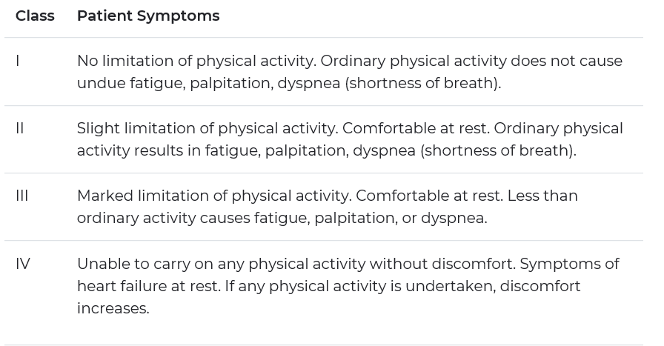
NYHA Classification

Slide 8
Evaluation Process
Right heart catheterization with appropriate hemodynamics, i.e., cardiac index <2.5, elevated filling pressures
Adequate funding and insurance approval
2 hour Coordinator education re: VAD and/or transplant
2 hour psychosocial evaluation with Transplant/VAD Social Worker
Cardiothoracic surgeon, pulmonologist, infectious disease consults
Psychiatry consult & Neuropsych testing if necessary
Imaging and labs

Slide 9
Evaluation Process
Once evaluation completed, patient presented to Heart Transplant Selection Committee:
  HF cardiologists
  Cardiac surgeon
  Transplant/VAD Coordinators
  Transplant Social Worker
  Transplant Financial Coordinator
  Transplant Pharmacist
  Transplant Dietitian
Once approved, wait for insurance approval to proceed with transplant listing or VAD implant

Slide 10
Heart Transplantation

Slide 11
History of Heart Transplant
Mississippi 1964: The first animal-to-human heart using a chimpanzee heart. The patient lived only an hour and a half because the heart was too small to keep him alive.
Cape Town, South Africa December 3, 1967: First human-to-human heart transplant was performed by Dr. Christiaan Bernard. Patient died of double pneumonia 18 days later.
Three days later the first heart transplant in the U.S. was performed on a pediatric patient, an 18 day old infant, though this was considered a failure as the infant died within six hours.

Slide 12
History of Heart Transplant
January 6, 1968: The first adult heart transplant in US, performed by Dr. Norman Shumway. Patient survived for 15 days.
May 1968: first “successful” US heart transplant. Patient survived for several months after transplantation.
170 heart transplants were performed between December 1967 and March 1971 with only a 15% one year survival, as the drugs used for immunosuppression often led to deadly infections.
The first heart transplant performed at CMC was in Jan 1986

Slide 13
History of Heart Transplant
Three landmark events significantly improved survival and propelled heart transplantation:
  Improvement in immunosuppression drugs with the development of cyclosporine in the mid 1970s, and tacrolimus in 1987.
  Development of endomyocardial biopsy forceps
  Histologic grading system for rejection

Slide 14
Heart Transplant Today
1 year survival 91.35%
3 year survival 84.97%
3 year survival at CMC 93.18%
Longest surviving heart transplant recipient at CMC 29 years out

Slide 15
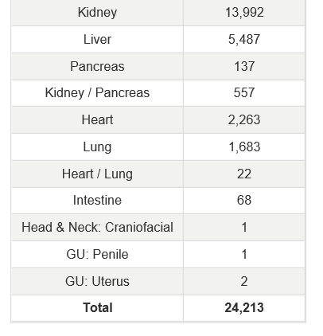
2018 Transplants by Organ Type
https://unos.org/data/transplant-trends/#transplants_by_organ_type+year+2018

Slide 16
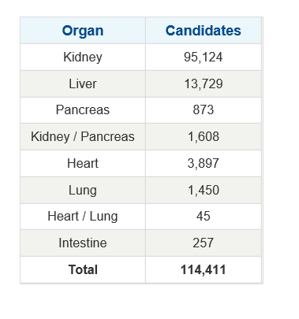
Current Waitlist Candidates by Organ Type
https://unos.org/data/transplant-trends/#waitlists_by_organ

Slide 17
Heart Transplant Today
133 transplant centers in the U.S. and Puerto Rico that perform heart transplants.
Four of these centers are located in NC:
  CMC
  Duke
  UNC
  Wake Forest/Baptist

Slide 18
Heart Transplant Today
There are 123 patients waiting for hearts in North Carolina.
10 patients in NC have died this year waiting for heart transplant.
29 adults on heart transplant waitlist at CMC.
24 of those patients have VAD/TAH.
Majority of heart transplant recipients at CMC are between 50-64 years of age
https://optn.transplant.hrsa.gov/data/view-data-reports/state-data/#

Slide 19
Heart Transplant Today
Median waiting time on the heart transplant list:
  Nationally: 8.5 months
  CMC: 7.8 months
  Wait times have increased over the years
Some of the factors that influence waiting time:
  Blood type (O, A, B, AB)
  Recipient size (height and weight)
  PRA (panel reactive antibodies)
  Status (IA, IB, 2)
  Number of people on the list at any given time
  SRTR.org

Slide 20
Wait List Status
Status 1A: highest priority on the list
  Patients hospitalized in the ICU
  Patients with life support measures (ventilated, IABP, ECMO, etc)
  Patients with Swan-Ganz catheters on inotropes
  Patients hospitalized with mechanical assist devices
  Patients granted exceptions for complications with MCA such as stroke, device malfunction, or on home inotropes
  30 days of VAD 1A wait time
Status 1B: next highest priority
  Patients stable at home or in the hospital on IV meds
  Patients stable at home on mechanical circulatory support

Slide 21
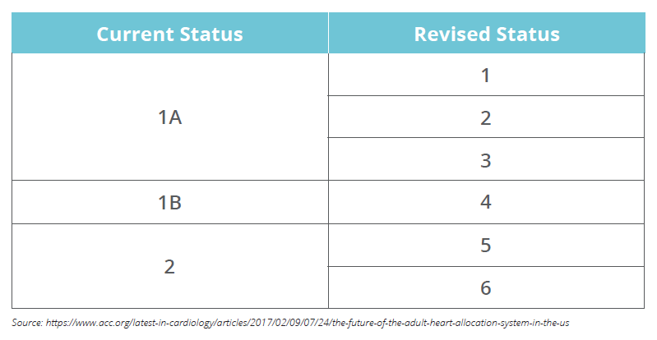
Wait List Status as of October 18

Slide 22
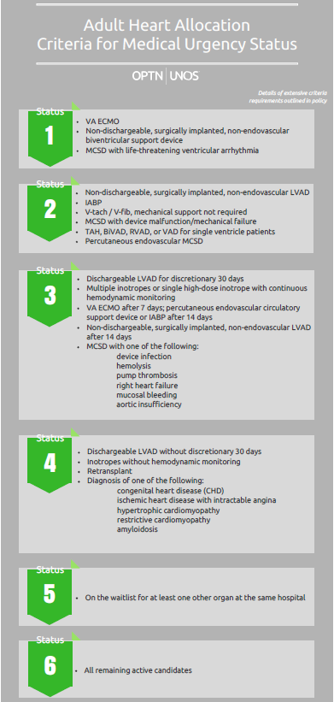
Wait List Status as of October 18

Slide 23
Transplant Surgery
The procedure is open heart surgery but is less intricate than actual bypass.
6-8 hour surgery, longer if recipient has had prior sternotomy.
Once the pericardium is opened, the patient is connected to the heart lung bypass machine by way of the SCV, IVC and ascending aorta.
The aorta, IVC and SVC are clamped allowing the heart lung machine to take over.

Slide 24
Transplant Surgery
The lower portion of the heart is cut, leaving behind the back wall of the atrium.
The aorta is cut between the clamp and the heart. Then the PA is cut where it emerges from the heart.
The rest of the heart is cut, leaving behind the back wall of the left atrium.

Slide 25
Transplant Surgery-
Biatrial Anastomosis

Slide 26
Transplant Surgery
Once heart sutured in place, clamps removed. Once blood flow restored, heart may start to contract immediately or may require defibrillation.
Ischemic time
  Time from donor clamp to organ reperfusion is ischemic time
  Should be <4 hours

Slide 27
Complications Post Transplant
Short term:
  Bleeding
  Dysrhythmias
  RV dysfunction
  Renal failure
Long term:
  Infection
  Rejection
  Coronary allograft disease
  HTN
  Chronic kidney disease

Slide 28
Infection
Infection
  Low grade fever
  Sicker quicker, sicker longer
  No live vaccines
  CMV- nausea, vomiting, diarrhea, abdominal cramping

Slide 29
Rejection
Rejection
  Patients can be asymptomatic
  Symptoms consistent with HF: SOB, fatigue, edema, palpitations, hypotension
  May have low grade fever
  Patients encouraged to call ASAP with symptoms
RV biopsy
  Access obtained through RIJ vein, samples of RV obtained.
  Tissue graded for rejection by pathologist
  Weekly for first month, then every other week through first 3 months, then monthly-every other month for first year.
  No scheduled biopsies after the first year.

Slide 30
Denervation of transplanted heart
HR higher than in non-transplant patients secondary to loss of vagal nerve inputs which have negative chronotropic effect.
Normal resting sinus rate post-transplant usually >80 bpm and may exceed 100 bpm in hearts transplanted from young donors.
No HR response to hypovolemia, vasodilation, or exercise
Partial reinnervation of cardiac sympathetic nerves after transplant occurs in about 1/3 of patients at one year. The process of reinnervation continues gradually for up to 15 years.
Prolonged denervation with biatrial anastomosis compared with bicaval anastomosis.

Slide 31
Post-transplant
Recovery process similar to that any patient who has had sternotomy:
Sternotomy precautions
Early ambulation
PT/OT
No driving for at least 3 weeks

Slide 32
Mechanical Circulatory Support (MCS)

Slide 33
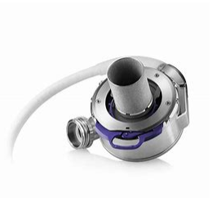
Mechanical Circulatory Assist Devices
HeartMate II HeartWare HeartMate 3
Heartmate II, HeartWare, Total Artificial Heart website images

Slide 34
Ventricular Assist Device (VAD)
A VAD is a mechanical circulatory device that is used to partially or completely replace the function of a failing heart.
Goal of device: to shunt blood away from the failing ventricle (Left or Right) and provide flow to the circulation (Systemic or Pulmonary)
Bridge to transplantation (BTT)
  Typically referred for transplant but to ill to survive until transplantation
Destination therapy (DT)
  Advancing heart failure despite maximum medical and device therapy
  Does not qualify and/or desire transplantation

Slide 35
Total Artificial Heart (TAH)
Indicated for biventricular heart failure
FDA approved only as bridge to transplant (BTT)
Small portion of R/L atrium left in place to attach artificial ventricles
Ventricles sutured to PA and aorta

Slide 36
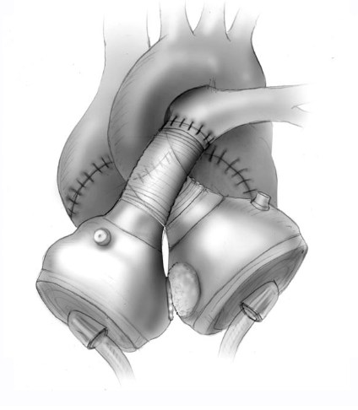
TAH
https://syncardia.com/clinicians/home/

Slide 37
Benefits
Able to return to work/school
Improved functional capacity
Reduction of symptoms
Ability to travel
Bridge to transplantation / decision
LVADs are a good option for patients who may not want or qualify for transplantation
VADS and Total Artificial Hearts are evolving quickly to become one of the primary therapies of advance heart failure

Slide 38
Benefits continued…
The Interagency Registry For Mechanical Circulatory Support (INTERMACS) fourth annual report of more that 10,000 primary left ventricular assist device implants reported survival rates:
89% at 3 months
85% at 6 months
79% at 1 year
67% at 2 years
57% at 3 years
40% at 5 years
- The longest supported HM2 has been on device for 12 going on 13 years and was in the original trial.
- The longest supported HeartWare patient in the US was implanted Feb 2009 and internationally there is a patient who has been supported 9 going on 10 years.
- Syncardia has 9 patient who have been on device for more than 3 years. One of those patients is at CMC who has had his device from 4 years and 8 months.

Slide 39
Short & Long Term Complications
RV Dysfunction
  Seen in 20 -50% of cases post operatively
  Optimize management of RV preload and afterload with inotropic support
  - Nitric Oxide, Primacor
  Minimize blood transfusions
  Low threshold for temporary RVAD (Abiomed, Centrimag)
  Prescribe Revatio and continue in the outpatient setting
  Repeat right heart catheterizations for optimization while on therapy
  Cardiomems implant

Slide 40
Short & Long Term Complications continued…
GI Bleed
20 – 30% incidence
Anticoagulation
Loss of pulsatile flow
von Willebrand syndrome - continuous-flow VADs may create high shear forces in the blood flow that change the shape of the von Willebrand factor molecules, which the blood needs to coagulate normally.
Treatment:
Hold coumadin, ASA
Consult GI team
Tagged Red Scan
EGD/Colonoscopy
Small bowel enteroscopy

Slide 41
Short and Long Term Complications continued…
Hemolysis
Shearing effect of RBC’s crossing rotor
Thrombus formation in pump
Presentation:
Tea or dark colored urine
Shortness of breath
Elevated LDH, bilirubin, haptoglobin
Treatment:
IV Heparin, Integrilin, IC TPA
Lower pump speed
Pump exchange or turn off LVAD

Slide 42
Short & Long Term Complications continued…
Driveline infection
Trauma
Culture site
Infectious Disease Consult
Antibiotic/antifungal treatment
Surgery
  washout with wound vac placement
  pump exchange
Re-education on care of the driveline site

Slide 43
Considerations
Will need Coumadin and Aspirin as long as they are on the device – INR goals may vary (unless significant history of GI bleeding, then anticoagulation discontinued)
No Vitamin K unless directed by HF/Transplant physicians – risk outweighs the benefit
No submerging in water
Avoid activities that can cause trauma to the device or driveline
Avoid static discharge
Need continuous power supply

Slide 44
Further Considerations
No palpable pulse with left ventricular assist devices (continuous flow concept)
Unable to obtain an accurate cuff blood pressure, need a doppler. Average MAP goal is 70-85.
CPR is possible for VAD patients, no CPR for TAH patients
External defibrillation is possible
No EKG for Total Artifical Heart Patients
No MRIs – can get Xrays and CT scans

Slide 45
Further Considerations
Patients should always have a back up controller and 2 extra fully charged batteries with them
Patients & caregivers are extensively trained prior to discharge from their implant
Fire/EMS/Medic/First Responder/Electric company notifications
Fluid or diuretics is not always the answer! – contact the team

Slide 46
Questions?

