Slide 1
Helping You Transform Patient Care.

Slide 2
Welcome
NCCRA Piedmont Regional Meeting
Notes:
Thank you for being here today! Welcome to the NCCRA Piedmont meeting.
My name is Hannah Wofford and I represent the Piedmont Region on our BOD.
A brief introduction, I work at Novant Health as well as UNC-Charlotte.

Slide 3
Schedule
Notes:
I know we are used to being on our feet and moving around all day, so I scheduled breaks throughout the day. I will do my best to keep us on schedule. Restrooms are located out the door, to the left, just around the corner.
I will also provide you with the certificate of completion for your continuing education credits at the end of the day.

Slide 4
Thank you to the NCCRA Board of Directors & Membership Committee
Notes:
First of all, I want like to start off by saying Thank You to several people
The board of directors and the membership committee, I believe Christine and Bridge are here. They have done a lot to increase NCCRA’s visibility and if you are a NCCRA member make sure you get your cool swag before you leave. Thank you for the time you invest into our state affiliate.

Slide 5
Helping You Transform Patient Care.
Notes:
Next, is a big thank you to our sponsors for the day.
Patrick Trombetta and the team at Scottcare couldn’t be here but were still happy to provide our lunch today!

Slide 6
Speakers
Kim Clark - EdD, RRT-NPS
Carl King – EdD, MAACVPR
Jan Wagoner – MA
John Pasquini – MD
Notes:
Kim Clark
Dr. Clark is a clinical associate professor and MS in Respiratory Care program director in the Department of Kinesiology at UNC Charlotte. She has a variety of respiratory therapy professional experiences including working in trauma, acute care, long-term acute care, home care, pulmonary rehabilitation, community health initiatives, and education. Her educational training includes respiratory therapy, business administration, educational leadership, public health, and kinesiology.
Carl King
Education (Health Sciences and Exercise Physiology)
Wake Forest- BS ASU-MA Virginia Tech-EdD
Experience: 30 years of experience in Cardiovascular Disease, Management, Preventive Cardiology, Cardiac Rehabilitation and Cardiovascular Research
Past President of the North Carolina Cardiopulmonary Rehabilitation Association
Past President of the American Association of Cardiovascular and Pulmonary Rehabilitation
Presently, President and CEO, Cardiovascular Consulting
Married to Cindy; 4 children; six grandchildren
Dr. Pasquini and Jan Wagoner
John Pasquini is a cardiologist who has practiced interventional and preventive cardiology for over 35 years. He has been actively engaged in cardiac rehab, prevention and lifestyle medicine throughout his career. He has been a key partner with our Novant Health programs and now serves as our medical director.
Jan Wagoner is an exercise physiologist by training and has worked in cardiac rehab for over 35 years. She has served as the director of Cardio-Pulmonary Rehab at Novant Health for 33 years.
Together they will share an update on the role of cardiac rehab in the health of our patients and healthcare systems.

Slide 7
Notes:
A thank you to the professionals who had to rearrange their schedules to be here!
Now that I am a student again, it is amazing for me to circle around and realize how my journey since my masters program has been so heavily influenced by professional such as yourselves who took the time to invest in me and still do.
A special shout out to the students who are here today.
I hope you get a chance to network during the breaks and I know you will learn a lot from the speakers!

Slide 8
Coastal Meeting
October 19th, 2019
Carolina East Healthcare System
New Bern, NC

Slide 9
40th Annual NCCRA Symposium
April 4-th, 2019
Friday Center
Chapel Hill, NC

Slide 10
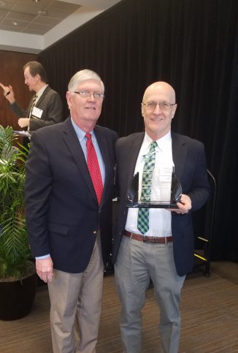
Carl King Award
The Carl King Award has been developed to honor his dedication and commitment to the development of Cardiopulmonary Rehabilitation. Carl King has worked tirelessly to promote cardiopulmonary rehabilitation; to educate people and health organizations of its importance; and to embrace the lifestyle promoted by Cardiopulmonary Rehabilitation. Carl King’s vision and guidance has helped to make Cardiopulmonary Rehabilitation in North Carolina what it is today. A review of Carol King’s professional history can be found on the NCCRA website.
To be eligible for the Carl King Award, a nominee must:
Hold a current NCCRA membership.
Support the on-going vision of cardiopulmonary rehabilitation.
Demonstrate commitment of the prevention of cardiac and/or pulmonary disease.
Exemplify the healthy lifestyle promoted by cardiopulmonary rehabilitation.
Professionals meeting the criteria may be nominated for the award by completing this form and submitting it to the NCCRA president by January 1st. The NCCRA Board of Directors will make the final determination of this award and the recipient will be announced at the annual NCCRA symposium.

Slide 11
AACVPR – 33rd Annual Meeting
http://newsandviews.aacvpr.org/blogs/nv-editor/2018/09/25/everything-33rd-annual-meeting
http://www.aacvpr.org/2018-Handouts

Slide 12
Notes:
The Aim of the Million Hearts Initiative is to prevent one million or more heart attacks and strokes over the next 5 years (2020). This is a joint effort by the CDC and CMS with partners across federal and state agencies and private organizations.

Slide 15
https://millionhearts.hhs.gov/tools-protocols/index.html
Notes:
Increase awareness of the value of CR among health systems, clinicians, patients and families, employers, payers
• Increase use of best practices for referral, enrollment, and participation
Use Data to Drive improvement in Referrals to CR
• Build equity in CR referral, participation, and program staffing
Identify Populations at Risk for Low Engagement
• Increase sustainability, affordability, and accessibility through innovations in program design, delivery, and payment
Identify Populations at Risk for Low Engagement
• Measure, monitor, and report progress toward the CRC aim

Slide 17
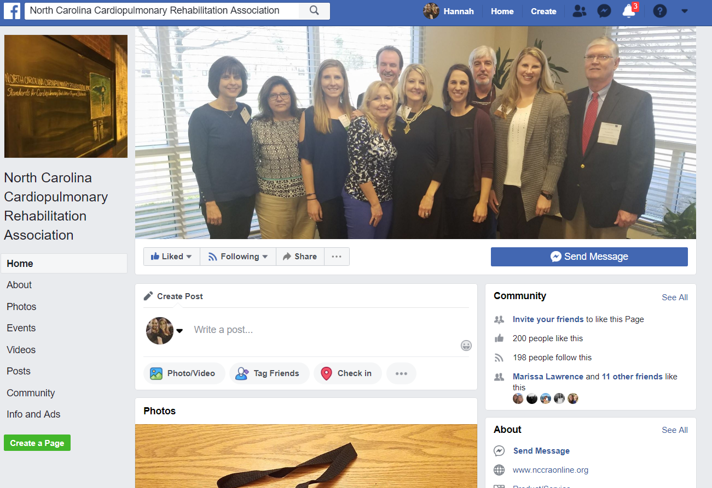
Stay Connected with NCCRA

