Slide 1
The New Cholesterol Guidelines:
Beauty is in the Eye of the Beholder
Brian Asbill, MD
Asheville Cardiology Associates

Slide 2
Overview
NHLBI, ACC, AHA expert panel convened 2008
First new guidelines since ATP III guideline update in 2004
Used only evidence from RCTs, systematic reviews and meta-analyses from RCTs
NHLBI dropped out. NLA also out
Review the most important changes presented in these guidelines
  No longer have therapeutic targets for LDL-C and non-HDL-C
  High and moderate intensity statins only
  Four groups identified for treatment
  New risk calculator
  Non-statin therapy markedly de-emphasized

Slide 3
Overview
Focuses on ages 40-75 (not enough evidence in RCTs for guidelines outside of this range)
Questions and controversy

Slide 4
High intensity versus low intensity statin therapy
High intensity statin therapy is defined as > 50% reduction of LDL with daily statin (only atorva and rosuva at high doses)
Moderate intensity statin therapy is defined as 30-50% reduction with daily statin (basically anything besides simva 10 or prava 10-20 or lowest dose fluva or lova)

Slide 5
Comparing statin efficacy
Atorvastatin
Rosuvastatin
Simvastatin
−28
−37
Mean % Change in LDL-C from Untreated Baseline Value
−46†
−7
14% with
3 titrations
−4
18% with
3 titrations
−6
−7
−5
−3
−6*
9% with
2 titrations
−3*
*P < 0.001 vs. atorvastatin 10 mg and simvastatin 20 mg and 40 mg
†P = 0.026 vs. atorvastatin 20 mg
LDL–C=low-density lipoprotein cholesterol
Jones PH, et al. Am J Cardiol. 2003;92:152–160.
Notes:
5
The Initial Statin Dose Produces Most of the LDL-C Lowering
The Statin Therapies for Elevated Lipid Levels Compared Across Doses to Rosuvastatin Trial, or STELLAR Trial, established the concept that most of the reduction in low-density lipoprotein cholesterol (LDL-C) is effected by the initial statin dose.
As this graph shows, every doubling of the statin dose provides only an additional 3% to 7% decrease in LDL-C levels.
The primary consideration is: when initiating statin therapy, one should start with the dose that is most likely to balance efficacy and safety because the likelihood of adverse drug events increases with higher doses. If greater LDL-C lowering is needed, another option is to add another lipid-lowering agent rather than to increase the statin dose.
Reference:
Jones PH, Davidson MH, Stein EA, et al, for the STELLAR Study Group. Comparison of the efficacy and safety of rosuvastatin versus atorvastatin, simvastatin, and pravastatin across doses (STELLAR* Trial). Am J Cardiol. 2003;92:152-160.

Slide 6
2013 ACC/AHA Guideline on Lifestyle for CVD Prevention
Eat a dietary pattern that is rich in fruit, vegetables, whole grains, fish, low-fat dairy, lean poultry, nuts, legumes, and non-tropical vegetable oils consistent with a Mediterranean or DASH-type diet.
Restrict consumption of saturated fats, trans fats, sweets, sugar-sweetened beverages, and sodium.
Engage in aerobic physical activity of moderate to vigorous intensity lasting 40 minutes per session three to four times per week

Slide 8
Four major statin treatment groups
Clinical ASCVD (now includes CVA)
  High dose statin (atorva 40-80 or rosuva 20-40)
LDL-C >190
  High dose statin
Diabetics ages 40-75
  Moderate dose statin (LDL reduction of 30-50%)
  High dose if 10 yr risk >7.5%
Those 40-75 yo without DM and with LDL-C 70-190 AND 10 year risk of ASCVD event >7.5%
  Moderate dose statin

Slide 9
1. Patients with clinical ASCVD
Coronary artery disease
Acute coronary syndromes
Coronary or other arterial revascularization
Stroke or TIA
PAD presumed to be atherosclerotic

Slide 10
Patients with clinical ASCVD
Advantages
  Statin at highest tolerated dose as first line treatment
  All pts with ASCVD identified as high risk
  Without targets, treatment is simplified
Limitations
  f/u LDL-C only to monitor compliance?
  Ignore pathophysiology of CAD and evidence of residual risk in pts on statin therapy
  Undermines new therapies

Slide 11
Patients with clinical ASCVD
Case 1
  55 yo man with non-obstructive CAD
  Non-smoker, no DM
  TC 290,LDL-C 180
  After atorvastatin 80 mg for two months, TC 180 and LDL-C 110
  Or maybe LDL-C 90 and one year later NSTEMI?

Slide 12
2. LDL >190 mg/dl
Advantages
  Recommend statin at highest tolerated dose
Limitations
  FH pts usually require multidrug therapy, LDL apheresis, etc.
  NLA must have really hated this

Slide 13
3. Diabetics age 40-75 years
Advantages
  High dose statins have shown benefit in RCTs
Limitations
  ? <40 or >75?
  Higher residual risk on statin therapy than others. What about the high TG, low HDL phenotypes?

Slide 14
Diabetics age 40-75 years
Diabetics with > 7.5% 10 year risk get high intensity statin therapy
Diabetics with < 7.5% 10 year risk of CAD get moderate intensity statin therapy
Statin indicated in all patients with diabetes

Slide 15
4. Age 40-75 with 10 year risk of >7.5 %
Advantages
  Reduces risk of ASCVD events for high risk pts
  Simple to use the calculator which looks at ALL ASCVD events
  Promotes discussion between pt and provider!!!
Limitations
  The calculator?
  Overtreatment potential?, particularly in elderly
  Undertreatment?, particularly young with high LDL
  <40 or >75

Slide 16
The pooled cohort cardiovascular risk calculator
Based on data from five NHLBI sponsored large cohort trials
Now provide sex and race specific estimates of risk and include CVA as an outcome
Initial concern of overestimation of risk when applied to MESA-possibly due to higher statin use. Fared better in REGARDS trial.
Heavily weighted to age and sex
Not tested in prospective study to show that it reduces events
~13 million more pts in US eligible for statins (~87% of men 60-75 yo are eligible and 54% of women. 80% of these are primary-prevention pts)

Slide 17
CV Risk Calculator
Risk factors used in calculation
  Sex
  Age
  Race
  Total Cholesterol
  HDL
  BP-treated or not
  Diabetes
  Smoker
http://my.americanheart.org/cvriskcalculator
Apple App store: ASCVD risk

Slide 18
CV Risk Calculator
10 year risk of ASCVD event
10 year risk of someone the same age with optimal risk factors
Lifetime risk of ASCVD
Lifetime risk of someone with optimal risk factor levels

Slide 19
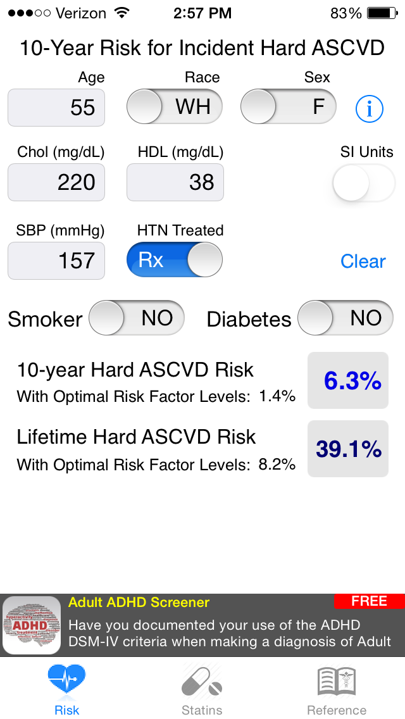

Slide 20
CV Risk Calculator
Case 2
  65 yo AA male, no DM, no HTN, non-smoker
  TC 180, HDL 70, LDL 84
  10 year risk?
Case 3
  26 yo WM with no medical history. Father died of MI at 42 yo
  TC 307, HDL 48, TG 390, LDL 188
  …14 years later, 10 year risk?
7.5%
3.1%

Slide 21
What if you don’t fall into one of the 4 categories where statins are indicated?
There are no recommendations for treatment in selected individuals who are not in the 4 statin benefit treatment groups (moderate dose statin instead of high dose for pts with ASCVD >75)
In those individuals whose 10 year risk is less than 7.5%, or when the decision is unclear (<40, >75, “healthy” 60 something) other factors should be considered

Slide 22
Factors to be considered when uncertain
Family history of premature CAD
LDL > 160 mg/dl
Increased CRP greater than 2.0
CAC score greater than 300
ABI < 0.9
CIMT?

Slide 23
Controversies
Not following LDL is problematic
  Challenge for pts and providers
  Does not fit in well with “know your numbers”
  Public health vs individual pt
  What about statin intolerant pts?
Lack of data from RCTs is not evidence of lack of benefit
  Consider pathophysiology of vascular disease
  Add on therapy to statins in pts with high LDL not tested
    HPS-2 and AIM-HIGH added niacin to pts with low LDL

Slide 25
Non-statin therapies
Non-statin therapies, alone or in combination with statins, do not clearly provide acceptable risk reduction benefits compared to adverse effects and addition may lead to reduction in statin dose
These include:
  Zetia (IMPROVE-IT is ongoing)
  Fibrates (what about pts with high TGs?)
  Fish oil (ditto)
  Niacin (AIM-HIGH and HPS2-THRIVE looked only at pts on statin with controlled LDL-C)
Consider for treatment of high risk pts with
  Less than anticipated statin response
  Statin intolerance (to recommended intensity or complete)

Slide 26
How should we handle statin intolerance?
Look at potential drug interactions
Decrease the dose of statin after washout
Try another statin after washout period (prava, rosuva)
Check vitamin D levels and replace if <30
CoQ-10 100 mg BID (ubiquinol)
Consider evaluation for other conditions that may cause muscle weakness

Slide 27
No guidance for many
No indication for starting or discontinuing statins in the following:
  NYHA class 2-4
  ESRD on dialysis
  HIV patients
  Solid organ transplant patients
  Insufficient data from RCT or limited trials have shown no benefit

Slide 28
Summary
New guidelines no longer recommend targets for cholesterol levels
Know the 4 high risk groups
Use medications proven to reduce risk, ie statins
Encourage healthy lifestyle
Understand the pros and cons of the new guidelines.
Consider a “hybrid” approach for now

Slide 29
Questions remain
How do we incorporate new drugs into this guideline?
Treatment of hypertriglyceridemia
Use of non-HDL in decision making
Whether on-treatment markers such as Apo B, Lp(a), or LDL particles are useful to guide treatment
Best approaches to using noninvasive imaging for refining risk estimates (especially CAC)

Slide 30


Slide 31

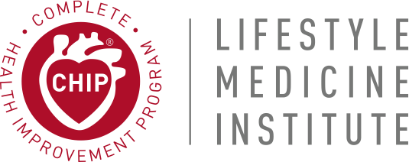
A Solution For Today’s Health Care Dilemma

Slide 32


Obesity,
the common denominator of chronic disease
Overweight – 32%
Obese - 34%
Morbidly Obese - 6%
Obese men use 5.9 sick days
Obese women use 9.4 sick days
Obese men cost an extra $1152 in medical cost
Obese women cost an extra $3613 in medical costs
Source: Begley, Sharon. As America’s Waistline Expands, Costs Soar, Reuters, 2012

Slide 33

Diabetes Trend (US 1945 to 2010)
25%
age 60+
900%
20%
15%
10%
age 40-59
5%
1945
1965
1985
2005
cdc.gov/diabetes/stats
Notes:
The rise in diabetes in just the past 15 years is staggering; it could become the biggest threat to our health care costs in the future and it generally precedes heart disease in many individuals.

Slide 34

Heart Disease… Less Than 100 Years Ago
“You can expect one heart attack per year in an average
hospital in an average sized town”.
Prevalence of Coronary Heart Disease in North America, 1928
Medical Textbook by Sir William Osler, MD
Today, the number of heart attacks in the US is
1,460,000 a year!
Notes:
Sir William Osler was a famous Canadian doctor. He has been called “the most influential physician in modern history” and was a co-founding professor at Johns Hopkins Hospital.

Slide 35
Bypass Surgery
  400,000/year
  Averaging $60,000+ each
  37-46% of vein grafts failed (75% narrowing) within 12 to 18 months
  NEJM 2009, 361 (3) 235
Angioplasties & Stents
  1,000,000/year
  Averaging $35,000 each
Heart Disease Today…
Notes:
And the number of procedures are increasing and costs are going up every year!

Slide 36
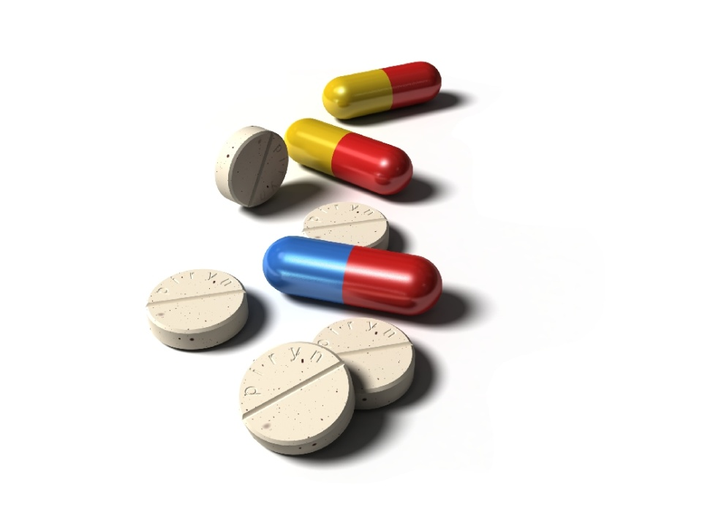
Prescription Drugs
Are NOT the Answer
180,000* serious or fatal adverse drug reactions reported to the FDA,
making drugs a significant % of US deaths
    *Properly or improperly prescribed
FDA, reported in 2011
Notes:
We average 13 prescriptions per person in the U.S. per year. That’s over 4 billion scripts written in a year. It costs our health care system over $330 billion a year, up from $40 billion in 1990! More scripts are definitely not the answer.

Slide 37
Which of the following statements is true about adverse drug reactions?
Total cost for ADRs ranks 6th on annual national health care expenditures
Total costs for hospital patients with an ADR are 5 times those of patients without an ADR
ADRs are responsible for 1 in 25 injuries or deaths per year in the hospital
Hospitalized patients with an ADR have the same mortality as those without an ADR
The annual costs for ADRs are greater than total costs for cardiovascular or diabetic care

Slide 38
Which of the following statements is true?
ADRs are responsible for fewer deaths than pulmonary disease, DM, and pneumonia
There are enough prescriptions filled yearly in the US to average 10 prescriptions for every person in the US
On average, an increase in the number of concomitant drugs does not increase the risk of an interaction until 6 are given at the same time
47% of patient visits result in a prescription
In general, patients have little concern about potential drug interactions

Slide 39
Disease Influenced
by Lifestyle
Type 2 Diabetes
High Blood Pressure
Overweight and Obesity
Depression
Cancer
High Cholesterol
Coronary Disease
Arthritis
Notes:
Over the past 20 years the CHIP program has demonstrated that it can prevent, arrest, and even reverse many of these diseases.

Slide 40
What is CHIP?

Slide 41

Overview
Lifestyle intervention education program
100% evidence based
community based (not residential)
Regular group sessions over several weeks
Blood draws and Health Risk Assessments
Education, practical experience, reinforcement
“Whole of Health” approach
60,000+ participants over 25 years and counting…
25+ peer reviewed articles in medical journals

Slide 42

A typical CHIP session
25 – 45 minutes of content delivery
25 - 45 minutes of facilitated group discussion,
based on these recurring questions:
    What was new to me?
    What did I like?
    What did I not like?
    What will I change from now on?
Food Sampling/cooking demos/
exercise (some lectures)

Slide 43
Program Content

Slide 44
Phase 1
Lifestyle is the best medicine
    Session 1 The rise and rise of chronic disease
    Session 2 Lifestyle is the best medicine
    Session 3 The common denominator of chronic disease

Slide 45
Phase 2
Optimal Lifestyle
    Session 4 Optimal Lifestyle
    Session 5 Eat more, weigh less
    Session 6 Fiber, your new best friend
    Session 7 Disarming Diabetes
    Session 8 The heart of the matter – heart healthy
    Session 9 Blood Pressure and & discovering protein
    Session 10 Bone health essentials
    Session 11 Cancer Prevention

Slide 46
Phase 3
Pause & Reflect
    Session 12 Understand your results & take action

Slide 47
Phase 4
Get Set for Success
    Session 13 Become what you believe
    Your DNA is NOT your destiny
    Session 14 Anger Management – practicing forgiveness
    Session 15 Re-engineer your environment

Slide 48
Phase 5
From Health to Happiness
    Session 16 Stress relieving strategies
    Session 17 Fix how you feel
    Session 18 From surviving to thriving

Slide 49

The Participant
Tool Kit
Text Book
Work Book
Cook Book
Pedometer
Water Bottle
Live More
Learn More
Eat More
Walk More
Drink More

Slide 50

CHIP
Food Philosophy

Slide 51
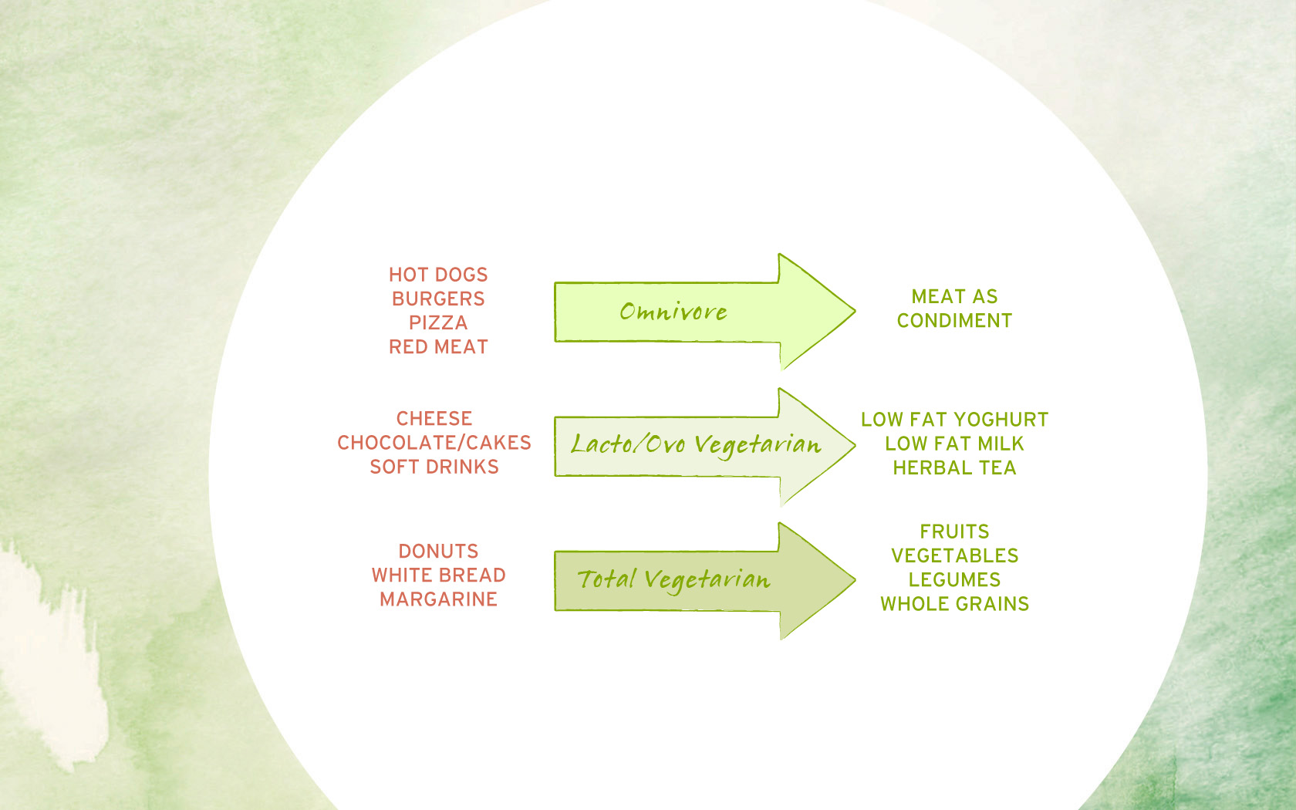
CHIP is not a vegan program!
It is about making good choices.
It seeks to help people move from the left side
of the spectrum to the right side.
NOTE: The science indicates that for disease reversal, plant based eating gives the best outcomes.

Slide 52
CHIP
Efficacy

Slide 53
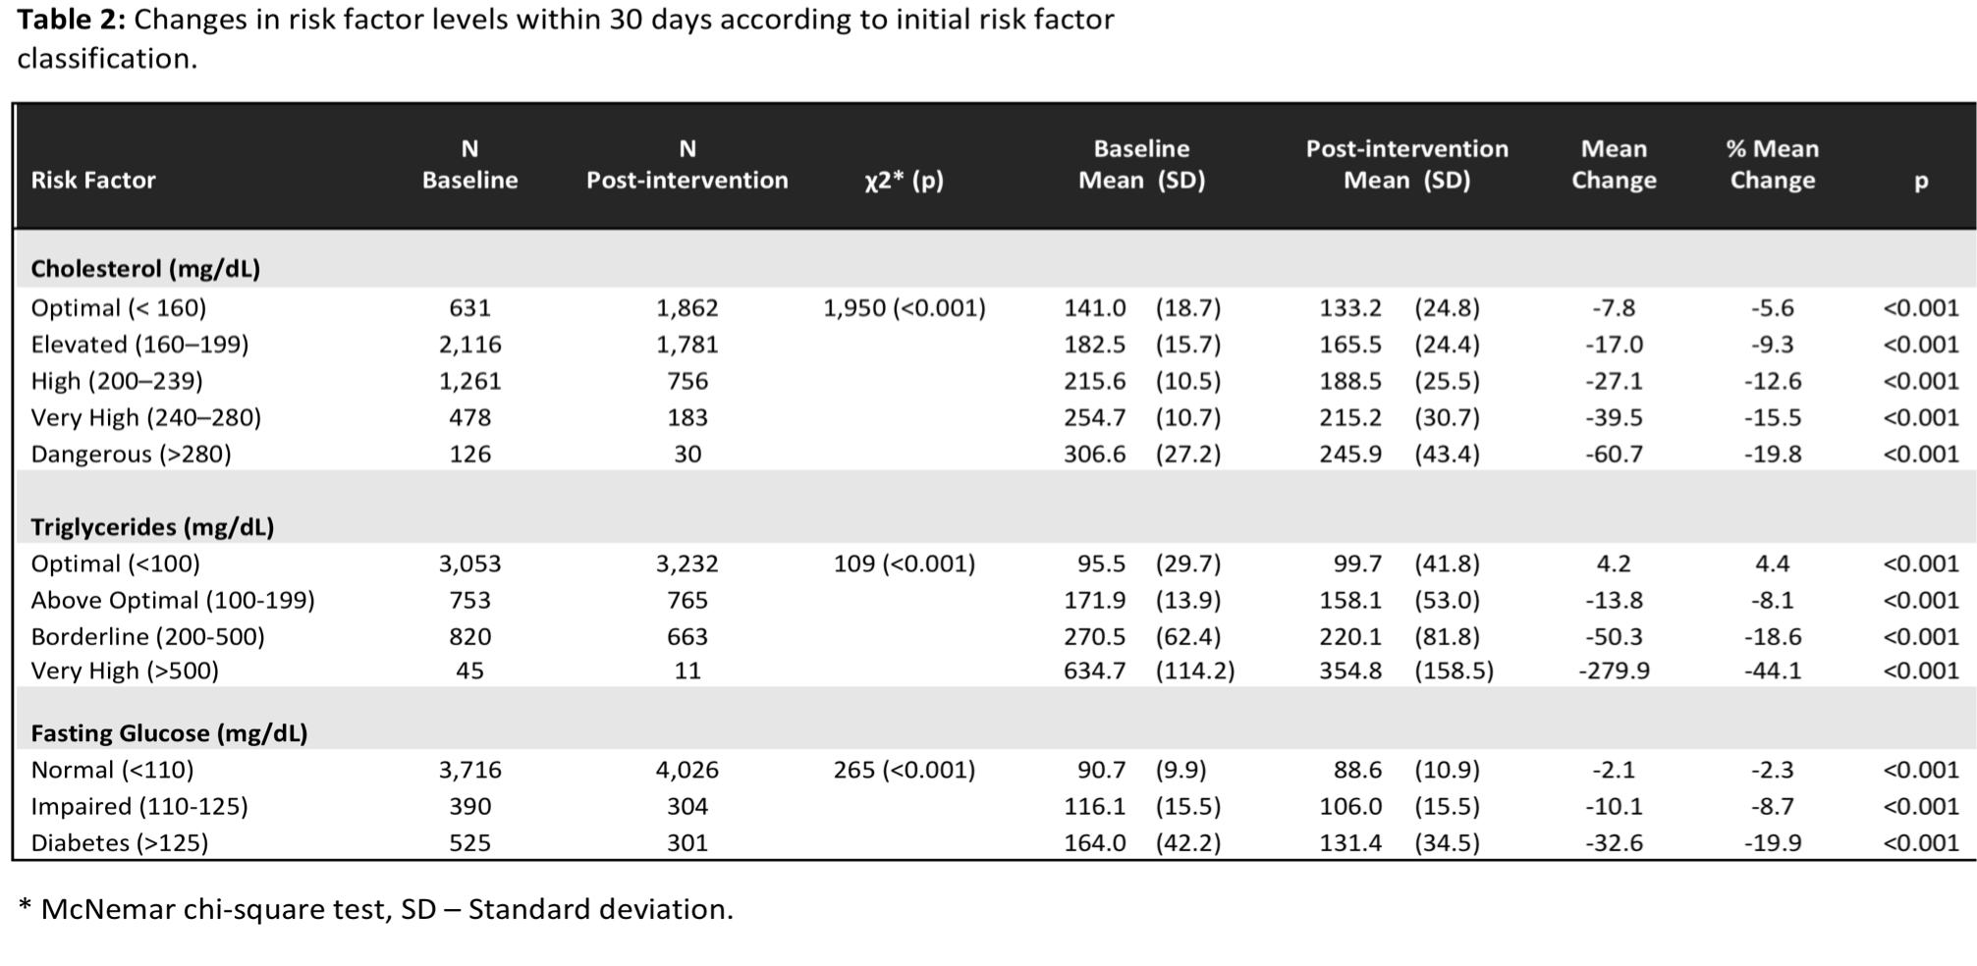
Rankin et al. Am J Cardiol. In press.
Notes:
In 2012 The American Journal of Cardiology showed significant risk reductions by a group of over 5000 CHIP participants. The last line of this chart shows that 301 of the 525 Type 2 diabetics actually reversed their disease state in just 30 days!

Slide 54
Live Healthy Asheville

Slide 55
