Slide 1
End stage Lung Disease: What is it and what are some treatment options?
NC Cardiopulmonary Rehabilitation Association Meeting
March 14, 2014; 1.45-2.15
Peadar G Noone MD FCCP FRCPI
Associate Professor Medicine
Medical Director Lung Transplant Program
UNC Chapel Hill

Slide 2
Severe Lung disease: Treatment options
Overview
Defining severe disease
Physiology
Managing severe lung disease
Medical / Surgical / Smoking cessation
Pulmonary Rehabilitation

Slide 3
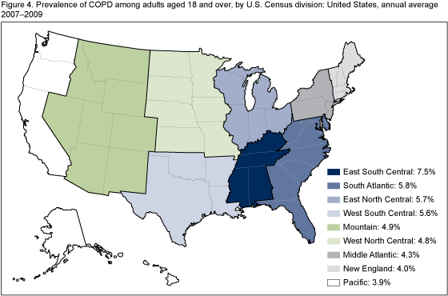
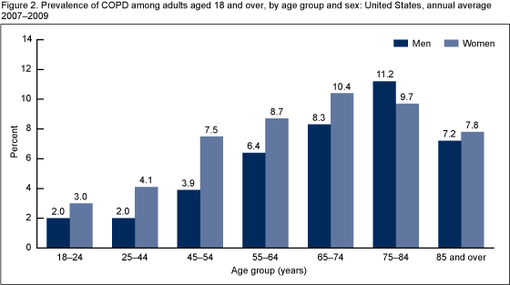
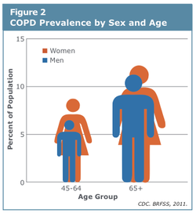
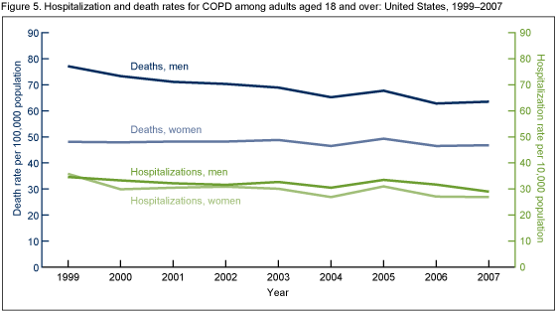
COPD: Statistics

Slide 4
COPD: Profile
25-35%

Slide 5
What is severe disease?
Simple but complex..“moving target”
Traditionally airflow measures - FEV1 (< 25-35% pred., cor pulmonale)
Now broader – includes measures of dyspnea (respiratory questionnaires), six min walk, “systemic” disease – BMI
Outcomes in response to treatment: FEV1, dyspnea, functional status, hosp / exacerbation rates (“BODE” index; BMI, Airflow Obstruction, Dyspnea, Exercise capacity)
The Body-Mass Index, Airflow Obstruction, Dyspnea, and Exercise Capacity Index in Chronic Obstructive Pulmonary Disease; Bartolome R. Celli, M.D., et al N Engl J Med 2004; 350:1005-1012March 4, 2004
Notes:
BODE better than FEVB1 at predicting deaths in COPD

Slide 6
COPD: QOL
25-35%

Slide 7
Why measures airflow (FEV1)?
Would one treat HTN without a BP reading? (Tom Petty)
Identifies at risk, allows classification of severity (clinical purposes / research)
Predicts health status
Utilization of resources, cost of meds, proof of concept relates to severity
Exacerbation rates, mortality
Important: Population based, but individual always somewhat different

Slide 8
GOLD stages 1- 4
Mild COPD
Symptoms / increasing exacerbations
FEV1
Post-BD
Severe COPD / Resp failure
25-35%
Increased risk of death
Time (yr)
Decline in lung function to point of very severe disease, or transplant or death;
The GOLD classification
http://pulmccm.org/2013/review-articles/new-gold-guidelines-2013-better-than-the-old-gold/

Slide 9
COPD Classification Using GOLD 2011
Previous versions of the GOLD guidelines classified patients by FEV1 only:
mild/GOLD 1 (>=80%), moderate/GOLD 2 (50-79%), severe/GOLD 3 (30-49%),
and very severe/GOLD 4 (<30%).
The new GOLD guidelines now grade patients (A-D) based on symptoms,
airflow obstruction, and exacerbation history as follows:
Symptom burden (QOL measures).
A = Low risk, low symptom burden
Low symptom burden (mMRCof 0-1 OR CAT score < 10) AND
FEV1 of 50% or greater (old GOLD 1-2) AND low exacerbation rate (0-1/year)
B = Low risk, higher symptom burden
Higher symptom burden (mMRC of 2 or more OR CAT of 10 or more) AND
FEV1 of 50% or greater (old GOLD 1-2) AND low exacerbation rate (0-1/year)
C = High risk, low symptom burden
Low symptom burden (mMRCof 0-1 OR CAT score < 10) AND
FEV1 < 50% (old GOLD 3-4) AND/OR high exacerbation rate (2 or more/year)
D = High risk, higher symptom burden
Higher symptom burden (mMRC of 2 or more OR CAT of 10 or more) AND
FEV1 < 50% (old GOLD 3-4) AND/OR high exacerbation rate (2 or more/year)

Slide 10
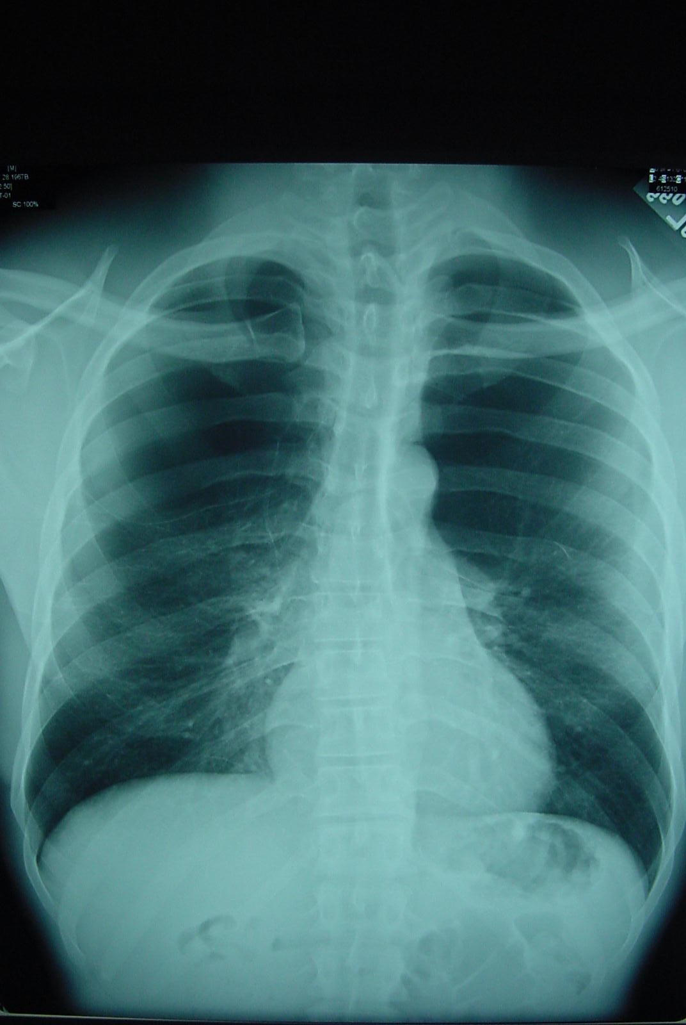
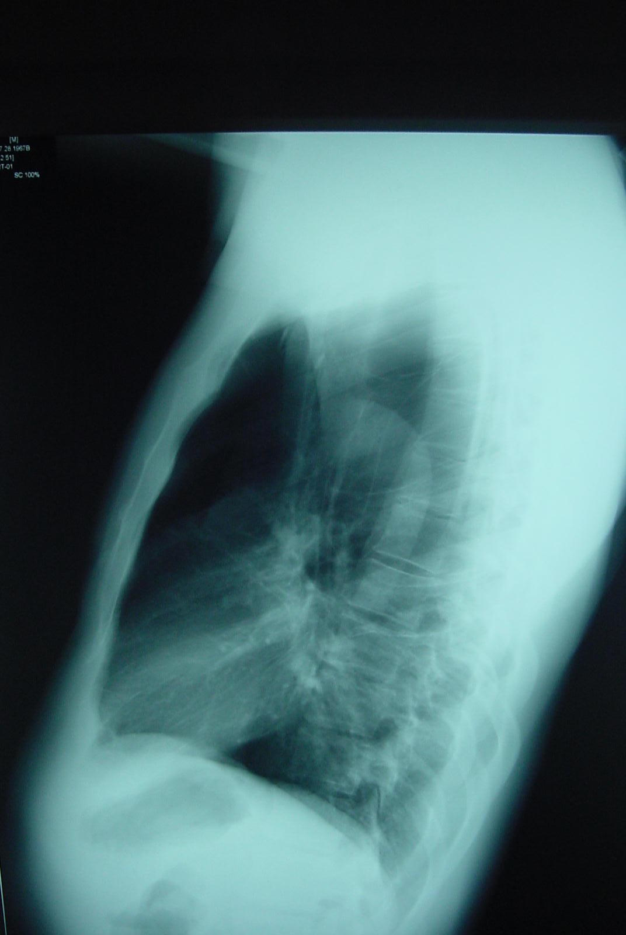
Emphysema, hyper-lucent lungs, flattened diaphragms,
and big retro-sternal space

Slide 11
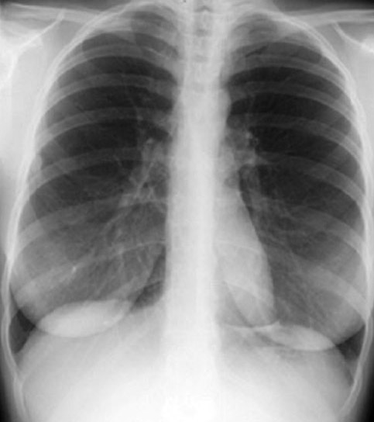
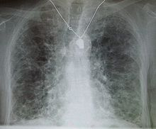
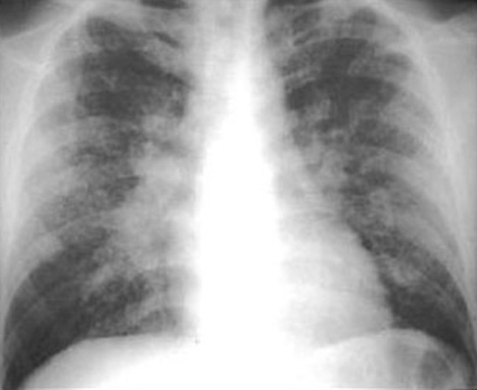
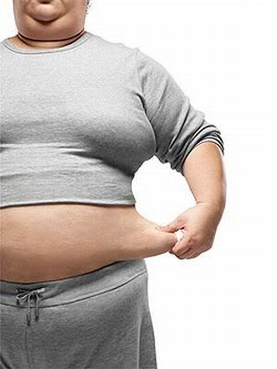
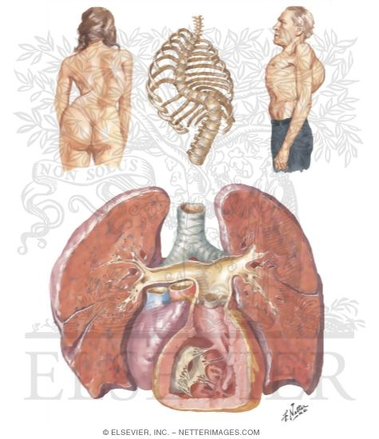
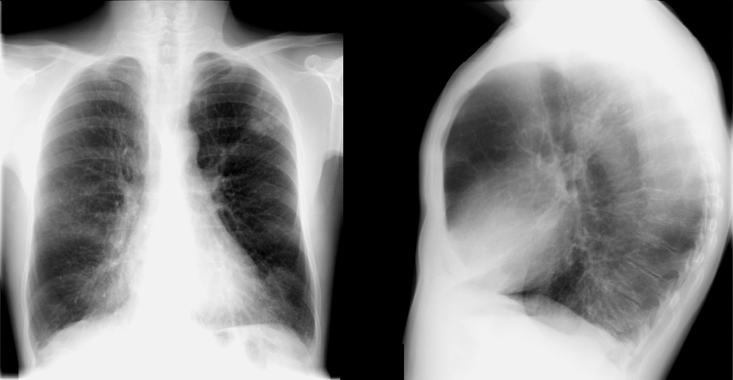
Pressure volume curve (Lung vol)
TLC
Lung compliance
Emphysema
ILD
Chest wall
Muscles
Airways
Volume
FRC
Airways disease
Obesity
RV
Airways disease
Muscles
Pressure (muscles)

Slide 12
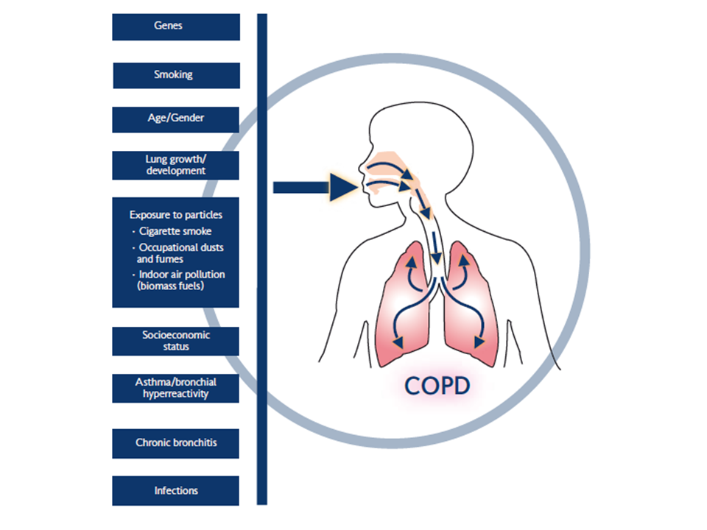
Risk factors; prevention

Slide 13
COPD vs other lung disease; select tests (CT scan etc)
Asthma
CHF
Bronchiectasis
TB / NTM
OB
Other

Slide 14
General approach to managing severe lung disease; COPD as prototype
Drugs have not changed that much
Approach / dose / timing has
Traditional view of COPD dominated by “nihilism” but now much more “optimism” (GOLD, other initiatives)
Step wise plan: FEV1, symptoms /ex tolerance / health status, monitor response, complications / exacerbation rates - reduce mortality incl. rehab)

Slide 15
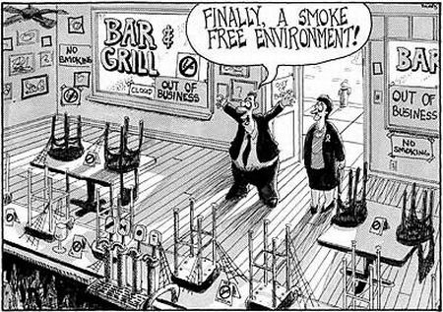
Smoking bans increasing

Slide 16
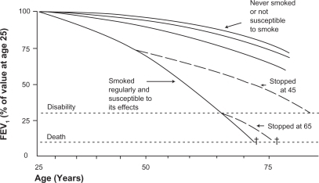
Smoking cessation

Slide 17
Summary treatment plan for COPD

Slide 18
COPD: O2
25-35%
Time (yr)

Slide 19
Pulmonary rehabilitation
ATS and BTS statement
Established modality scientifically
Widely accepted, practiced internationally
“The goal of pulmonary rehabilitation is not to achieve maximum exercise tolerance, but to ultimately transfer the responsibility of care from the clinic or hospital to self care in the home; a comprehensive intervention based on a thorough patient assessment, followed by tailored therapies that include exercise training, education, behavious change, designed to improve the physical and psychological condition of patients with chronic respiratory disease….”

Slide 20
Pulmonary rehabilitation
Upper and lower extremity exercise conditioning
Breathing retraining
Education, psychosocial support
Smoking cessation, O2 therapy
Nutrition
Alongside optimal medical Rx
Outcomes observed and measured.

Slide 21
Pulmonary rehabilitation
(Up to Date 2014; Bart Celli)
Improves: Dyspnea, increases exercise performance, improves QOL (Breaks the “cycle of increasing inactivity with worsening dyspnea”)
Reduces:
Hospitalizations and health care costs (although itself expensive)
COPD patients comprise largest group, but other chronic respiratory diseases also benefit
They are all (generally) associated with
Poor nutrition, cardiac de-conditioning
Peripheral muscle function,
Psychological dysfunction (anxiety),
Poor coping / self management plans

Slide 22
Rehab contd /….
Exercise training
Duration / frequency / intensity / specificity / targets
BMI / body composition – caloric supplements, physiologic interventions, pharmacologic interventions
Obesity management
Self management: increased understanding of underlying disease, prevent / reduce exacerbations, breathing strategies, airway clearance / hygiene, end of life decisions
Social / psychological considerations: depression / anxiety, support system, sexuality
Outcomes assessment: Symptoms, performance, exercise capacity, QOL, hospitalizations, mortality

Slide 23
Adherence
Incorporate patient goals
Make small, obtainable goals to achieve success
Limit # of exercises -- keep it simple
Recognize & address fears
Acknowledge patient learning styles/preferences
Address advance care planning

Slide 24
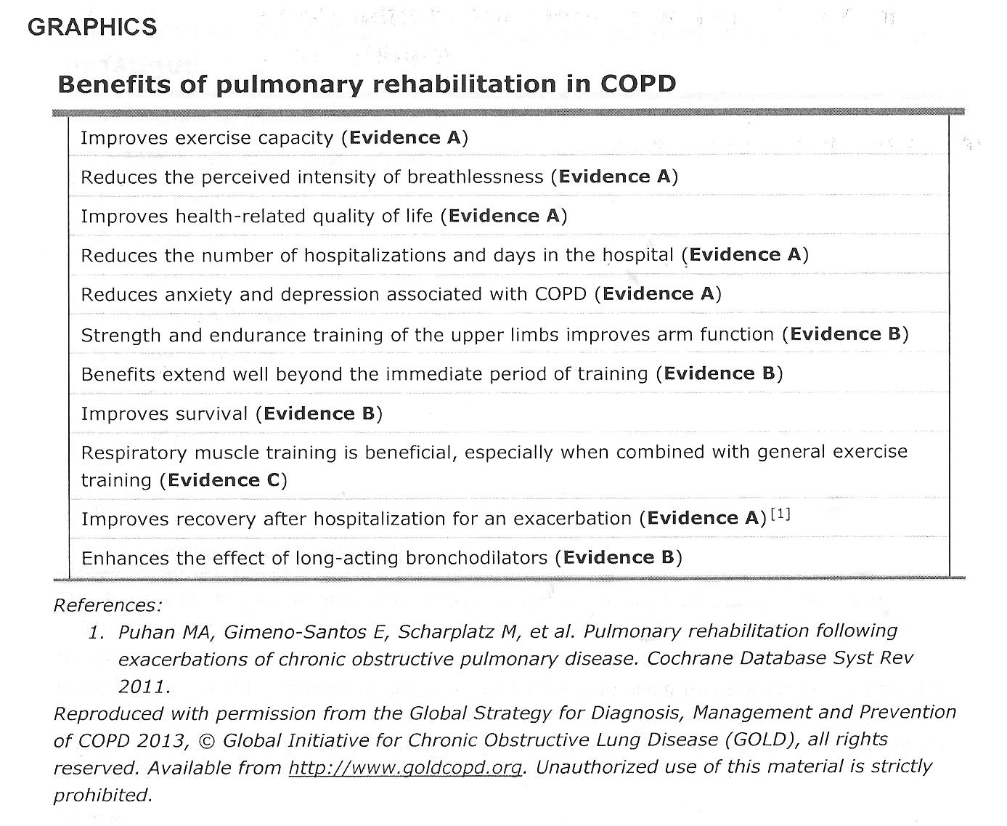
COPD: Rehab
25-35%

Slide 25
Summary: Options for severe lung disease:
Evaluate disease carefully, diagnosis (is it really COPD?); co-morbidities
Confirm “stage” of disease - lung function (GOLD / BODE), microbiology, PT, oxygen
Optimize medical treatment plan
Identify areas that might be targeted – e.g. airway obstruction, smoking, microbiology, airway clearance, inflammation, rehabilitation, oxygen therapy, NIV
Engage in careful surveillance / monitoring or responses to treatments

Slide 26
Select refs:
MacNee W, Calverley P Management of COPD Thorax 2003; 58: 261-5
Celli, MacNee ERJ June 2004: ATS / ERS position paper on COPD
Global strategy for the diagnosis, management and prevention of COPD (GOLD summary). AJRCCM 2007;176:532-555
An official American Thoracic Society/European Respiratory Society statement: key concepts and advances in pulmonary rehabilitation. Spruit MA et al; ATS/ERS Task Force on Pulmonary Rehabilitation. Am J Respir Crit Care Med. 2013 Oct 15;188(8)

Slide 27
Questions??

