Slide 1
Opportunity Knocks: Are You Listening?
Jody Hereford, BSN, MS, MAACVPR
Friday, March 14, 2013
NCCRA
2014 Annual Symposium

Slide 2
op·por·tu·ni·ty, [op-er-too-ni-tee, -tyoo-] noun, plural op·por·tu·ni·ties
A good position, chance, or prospect, as for advancement or success.

Slide 3
What Business Are You In?

Slide 5
The Challenge of Chronic Illness in Health Care Reform
“We have a sick care system when we desperately need a well care system.”
--Senator Tom Harkin, Iowa
“Why preventive care is becoming the new cultural norm.”
--Dr. Harvey Fineberg, President, Institute of Medicine
JAMA, 2013

Slide 6
Payment Models Uncertain, Yet Inevitable
Old System | Emerging System
Fee For Service (FFS) | Shared Savings Programs (SSP) Bundling, Episodes, Acute Care Episodes (ACE)
Pay for admissions, readmissions, DRGs | Penalties, nonpayment
Pay for volume, quantity | Pay for value, quality
Pay for illness | Pay for health
Pay for process | Pay for outcome

Slide 7
Opportunity is here
(BETTER) QUALITY
Safe, Evidence-Based Best Practices
Coordinate Care Across Continuum
Patient Service Experience
Value
(LOWER) COST
Eliminate Unneeded Care
Efficient Workflows
Practice at Top of License
“Provide patients with everything they need, and nothing that they don’t.”
Slide Credit to Zack Klint and Vanderbilt ACS Bundle Team

Slide 8
“The thorn in the side, of course, is declining reimbursement. Cardiology is facing a transition from a procedure-based specialty to one that will be more focused on prevention and wellness. The question providers must ask themselves is: ‘How do we keep our cardiology patients healthy and free of hospital stays?’”

Slide 9
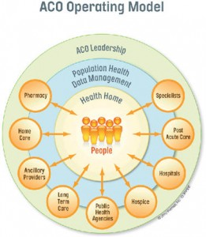
New Payment Models are Driving New Organizational Structures Accountable Care Organizations (ACOs) Patient Centered Medical Homes (PCMHs)
CR/PR
In the Medical Neighborhood, everyone becomes accountable to, and paid for, outcomes.

Slide 10
New Organizational Models New Organizational Goals: The Triple Aim
Cost | Quality | Experience
Reducing per capita costs | Improving health status of populations | Improving individual experience of care
How much do we cost? cost/case What is the value we produce? Are there more efficient ways to deliver our services that may improve quality and experience? | Evidence and science!! Who is/are our ‘population(s)?” Care Management. Care Coordination and the medical neighborhood. Patient engagement, activation, self management. | Patient Centered. Business case? More than mere satisfaction/HCAHPS. May include: Interactions. Perceptions. Continuum of care, access. Culture.

Slide 11
The Challenge of Chronic Illness The 80-80-80 Rule
80% of health care dollars are spent on chronic illness.
80% of these dollars are spent on high cost (and OFTEN preventable) services, i.e., hospitalizations, rehospitalizations, ED visits.
80% of care is self care.

Slide 12
Outcomes = Measured Success
Quality
Cost
Experience
Health
Clinical
Morbidity
Mortality
HRQOL
BP
Lipids
Weight
A1c
Behavior
(Actions)
Adherence to treatment regimens
Health related lifestyle changes
Behavior Change Specialist
Health Coaching
To impact

Slide 13
Outcomes = Measured Success
20-30% reduction in all-cause mortality rates
Reduces 5-year mortality by 25% to 46%
Decreases recurrent nonfatal myocardial infarction by 31%
Reduced symptoms (angina, dyspnea, fatigue)
Improves adherence to medication regimens
Improves lifestyle recommendations
Increased exercise performance
Improved lipid panel
Increased knowledge about cardiac disease and its management
Enhanced ability to perform activities of daily living
Improved health-related quality of life
Improved psychosocial symptoms (reversal of anxiety and depression, increased self-efficacy)
Reduced hospitalizations and use of medical resources
Return to work or leisure activities

Slide 14
There is an increasing and critical need in health care:
Behavior Change Specialist
a.k.a., Patient Engagement/Activation Specialist,
Health Coach
Care Coordinator
Care Manager
Case Manager
Navigator

Slide 15
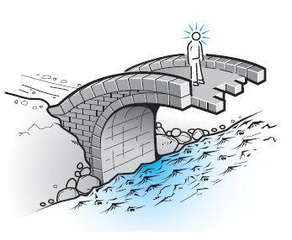
Opportunity Window For CR/PR: Centers of Excellence for the Prevention and Management of Chronic Illness
= Improved Individual and Population Outcomes

Slide 16
Essential Elements of Success
Old Model | New Model
Patients | Participants and families
Cardiac and Pulmonary | People living with chronic illness
Rehabilitation | Prevention and Health Management of Chronic Illness
“Program” | System of Services
Waiting list | Welcome
Graduation | Transition

Slide 17
Transformation of CR/PR into Centers for Health and Prevention
Health Prevention Continuum/Stream
Upstream
Downstream
Primary Prevention
Keeping the well, well
Secondary Prevention
Traditional CR/PR
Tertiary/Quaternary Prevention
The sickest of the sick

Slide 18
AHA/AACVPR Core Components
Patient Assessment
Nutritional Counseling
Weight Management
BP Management
Lipid Management
Diabetes Management
Tobacco Cessation
Psychosocial Management
Physical Activity Counseling
Exercise Training

Slide 19
“The way in which you talk with patients about their health can substantially influence their personal motivation for behavior change.”
— Rollnick, Miller, Butler, MI in Health Care

Slide 20
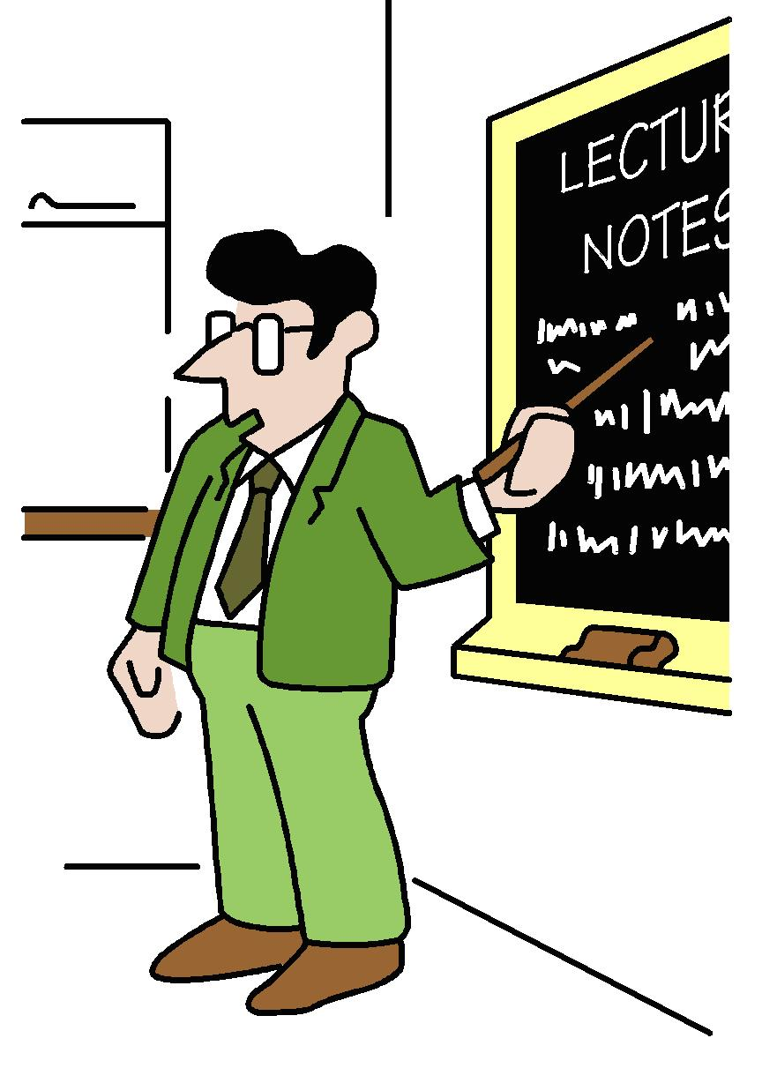
What we’re doing isn’t working

Slide 21
What We’re Doing Isn’t Working
40%-80% of the medical information patients receive is forgotten immediately.
30 – 50% of patients leave their provider visits without understanding their treatment plan.
Nearly half of the information retained is incorrect.
Hospitalized patients retain only 10% of their discharge teaching instructions.
25% (that’s the low estimate!) don’t fill prescriptions.
25% don’t take medications even after they fill the prescription.
J Gen Int Med, online February 4, 2010
Bodenheimer, T. Transforming Practice, N Eng J Med 359;20, November 13, 2008
http://www.nchealthliteracy.org/toolkit/tool5.pdf

Slide 22
The Real Failure in Heart Failure
Causes of HF Readmissions
Diet non-adherence
24%
Rx non-adherence
24%
16%
Inappropriate
Rx
17%
Other
19%
Failure to Seek
Care
Vinson J Am Geriatric Soc 1990;38:1290-5

Slide 23
Health Expert - Health Coaching

Slide 24
“People are generally better persuaded by the reasons which they have themselves discovered, than by those which have come into the mind of others.”
-- Pascal’s Pensees (17th Century))

Slide 25
Health Coaching
Emerging Field
Chronic illness
Cardiac and Pulmonary Rehabilitation
Built upon solid foundation

Slide 26
The Science of Behavior Change
Humanistic Psychology (Carl Rogers)
Self-Efficacy (Albert Bandura)
Transtheoretical Model (J. Prochaska)
Positive Psychology (Martin Seligman)
Appreciative Inquiry (D. Cooperrider)
Motivational Interviewing (Miller & Rollnick)

Slide 27
Where does that leave us?
Where does that leave you?

Slide 28
What business are we in?

