Slide 1
The AACVPR National CR Registry
Carl N. King, EdD, FAACVPR
President and CEO
Cardiovascular Consulting

Slide 2
Disclosures
Consultant for AACVPR Registry Project
Consultant for LSI

Slide 3
Objectives
Review the AACVPR National CR Registry
Discuss how CR Registry will impact your CR program
Notes:
[The 5 slides after this can be deleted if the speaker wants to individualize to the audience. Provide some brief background on why data and registries are important]
review the national cardiac rehab registry project and aspects of the registry that will impact your program.

Slide 4

Quality Health Care
“…the degree to which health service for individuals and populations increases the likelihood of desired health outcomes and are consistent with current professional knowledge.”
Lohr, et al. NEJM, 1990
Notes:
Quality health care has been defined as the degree to which our treatments in rehab increase the likelihood of positive and desired outcomes and are consistent with our current knowledge.
That knowledge is developed through clinical research studies and our day-to-day experiences in working with our patients.

Slide 5
Outcomes perspectives
PATIENT:
Am I better off now after having rehab?
What happened to my patient as a result of my care?
CLINICIAN:
PROGRAM:
What happens to our patients and how does this compare to other programs?
PROFESSION:
What happens to populations of patients as a result of standardized care based on evidence-based guidelines?
Notes:
Measurement and analysis of outcomes are a natural part of health care.
Patient’s perspective: The patient will judge whether he or she is better off after going through your program.
From the clinician’s perspective, want to know what happens to our patients when we care for them. Are their outcomes in line with others in the program?
At the next level, programs want to know whether the total effects of their services impact patient health and outcomes, and how these outcomes compare with other programs.
And finally, we get to the level of the profession, where we’re interested in understanding whether populations of patients who receive standardized levels of care have better outcomes than if they didn’t participate. This is where the importance of a large-scale, multi-site registry lies.

Slide 6
Outcomes
Value =
Costs
Notes:
Ultimately, the value of our services will be determined by the outcomes we achieve relative to the costs required to get those outcomes. Though we think of value as being determined by health care administrators or health care insurers, it is ultimately the patient who weighs the costs involved in getting the treatment, either in time, convenience, or money, with the possible outcomes.
We need to have a complete understanding and appreciation for the possible outcomes of CR and PR, and all those factors that affect outcomes, to understand the value of our services and to provide the highest quality of care.

Slide 7

If you don’t measure it, you can’t improve it.
Notes:
Plain and simple, you don’t know whether you’re providing quality care unless you measure the results of that care.

Slide 8

Research tells us what we can do.
Guidelines tell us what we should do.
Registries tell us what we’re actually doing.
Notes:
We collect a lot of information in caring for patients, don’t we? Blood pressures, weights, lipids, blood glucose. We use each number, each data point, to assess current care and improve care step by step.
Results from research studies tell us what is possible, what outcomes we can expect if we follow a specific protocol in a specific patient population.
If we take the results from numerous studies, distill them and come up with general conclusions about what works and what doesn’t, we get evidence-based guidelines. Guidelines advise us on what we should do for patient care to have positive outcomes.
Unlike research that is highly controlled, and unlike guidelines that are recommendations on paper, registries collect “real world” information and tell us what we’re actually doing. And that’s where we’re headed—national registries for cardiac and pulmonary rehab outcomes. It is time that we gather evidence on our current practices to demonstrate the importance of our treatments and to use that knowledge to improve patient care and patient outcomes for all patients.

Slide 9
AACVPR Registry Committee
Mark Vitcenda, Chair
Michael McNamara and Bonnie Anderson, Directors
Steven Lichtman, Chris Garvey, Gerene Bauldoff, Mark Senn, Randal Thomas, Anne Gavic, Ken Eichenauer, Justin Rimmer (Cissec)
Joanne Ray, Rod Stiegman, Krista Betts
(Smith Bucklin)
Notes:
rehab registry has been several years in the making.
now a full-fledged committee of AACVPR.
highly competent, dedicated and influential people in cardiac and pulmonary rehab research and clinical practice make up committee.
expertly supported by staff members of Smith Bucklin who are providing numerous resources for our projects.

Slide 10
Corporate Sponsor
Life Systems International
Notes:
Recognize Life Systems International for their very generous, unrestricted financial support of this project.
[Add other sponsors as they come on board with funding]

Slide 11
Corporate Sponsor

Slide 12
  An organized system that uses observational study methods to collect uniform data (clinical and other) to evaluate specified outcomes for a population defined by a particular disease, condition, or exposure, and that serves one or more predetermined scientific, clinical or policy purposes.
Agency for Healthcare Research and Quality (2007)
Notes:
A registry defined by AHRQ as: [Read and comment as desired]

Slide 13


Existing Registries for CAD
American College of Cardiology
American Heart Association
  The Guidelines Advantage
Notes:
over 1000 registries listed through NIH trials.
ACC supports the ACTION-Get With The Guidelines registry (inpatient MI outcomes) and the PINNACLE registry (outpatient outcomes)
AHA manages the Guidelines Advantage registry which focuses on outpatient primary care practices and management of heart disease, diabetes and cancer risk factors.

Slide 14
Inpatient
Outcomes
CR Outcomes
Outpatient
Outcomes
Notes:
why is AACVPR developing a registry?
goal to bridge the knowledge gap between registries that measure inpatient care and outcomes and those that measure care at the physician’s office.
we know what happens when the heart patient leaves the hospital (ACTION-GWTG registry), and we know where patients are when they get to their cardiologist (PINNACLE), but don’t have the data on what happens between these 2 points in time; this is where a CR outcomes registry will be beneficial.

Slide 15
Provide evidence to our customers that cardiac rehabilitation produces improvements in the patient’s risk factor profile and health status beyond what can be expected or achieved through “usual care”.
Mission
Notes:
Our defined purpose of the registry is to [read and comment as needed]

Slide 16
Notes:
16
For programs, the registry will be a tool that will allow you to dig deeper into your outcomes data, to track and manage patient outcomes and monitor program performance for improving and assuring high quality patient care.

Slide 17
Construction Timeline
Launch date: June, 2012*
Data tables and interface development completed
Beta testing: Winter 2012 with 8-12 selected programs
Improvements based on beta testing
Notes:
Launch date was put off for June of next year because cert/recert changes are being implemented during the November/February timeframe, and we didn’t want to overwhelm programs, our professional volunteers, or SmithBucklin staff with all these changes at the same time.
Data set has been defined, though some change expected as we go through testing.
Interface being developed and tested through fall, with beta testing of working application through the winter.
Programs can enroll now as “early adopters”, which gives them first access to registry news and updates, and 50% discount on membership if paid before January 1 of next year. Enrollment through AACVPR web site (Go to Resources/Outpatient Cardiac Rehab Registry page) [NB: if giving presentation after Jan 1, 2012, delete last bullet on slide]

Slide 18
How will it work?
Membership application through AACVPR site
  Do not need to be an AACVPR member or be a certified program to participate
Program agrees to comply with data definitions
Program must have signed Participation Agreement on file
Notes:
Membership will be online through AACVPR site; program does not need to be AACVPR-certified, principle user (see below) or staff do not need to be AACVPR members.
Program will conform to data definitions so that all programs are measuring same thing
As a part of the application process, programs must have a Participation Agreement signed by their hospital administration.

Slide 19
How will it work?
Data entered on every patient enrolled
Patient record can be edited at any time
Real-time entry or batch uploads via third-party apps
Reports can be printed at any time
Notes:
A record will be started for each patient who enrolls in the program. “Enrolled” defined as having at least 1 billable CR session.
Records can be edited and updated at any time.
Data can be entered in real-time via the web site or via uploads from other applications like telemetry programs. Will be allowing (as much as possible) third-party or customized database integration, but it will be necessary to conform data definitions to registry standards.
Reporting features will be available at any time.
19

Slide 20
How will it work?
Data validated at database level
Data transfers secured via SSL/encryption
Data and security meet HIPAA requirements
Notes:
All numeric data that is entered into the registry will be validated at the database level, so users will get warning messages if the data does not conform to field definitions or is outside of valid ranges.
Data transactions over the Internet will be highly secure and will use encryption techniques to ensure security. The procedures used for securing data privacy will meet all HIPAA requirements.
20

Slide 21
Proposed Measures
Demographic information
  Unique patient identifiers
  (MR#, SSN – last 4 digits, Last name)
  DOB (age)
  Sex
  Race/ethnicity
  Admitting diagnoses/procedures/dates
  Tobacco use status
  Comorbidities (used for “risk adjustment”)
Notes:
next show list of some of the proposed outcomes measures for the registry. We may add or subtract measures after we do our initial testing.
Demographics covered include [may read list]
Comorbid conditions will be tracked; using Charlson Comorbidity Index as a means of quantifying “risk” and possibly adjusting outcomes based on risk level.
Note that there are approximately 10-15 fields out of the 100 or so that are “required”, meaning the field has to have something entered before the record can be saved. Programs can enter as few or as many of the other fields as their resources and experience allow.
[NB: Ask Registry Committee for updates on data set; most of the currently listed variables will not change.]

Slide 22
Proposed Measures
Clinical
  HT/WT/BMI
  Waist Circumference
  Blood pressure
  Lipids
  FBG, A1c (DM only)
  Estim exercise capacity (METs)
  Functional Status
  +/- depressive symptoms
Notes:
These are the clinical measures.

Slide 23
Proposed Measures
Behavioral
  Adherence to:
    Exercise/Physical activity
    Medications (ASA, BB, ACEI, statin)
    Tobacco cessation
    Influenza vaccination
Notes:
We are including several measures for behavioral outcomes, including adherence to exercise, medications, tobacco cessation and vaccination status.

Slide 24
Registry Instruments
Dietary | % saturated fat Servings Fruits/vegetables per day
Physical Activity | Pedometer (steps/day)* Duke Activity Status Index IPAQ
HRQL | MacNew Quality of Life* SF-36 v2* Ferrans & Powers QLI Dartmouth COOP
Depression | PHQ-9
* Requires licensing fee
Notes:
Lastly, we are including fields for the scores of several assessment tools. These tools were selected because they have been shown to be valid, reliable and sensitive to change during CR. Where we could, we selected tools that were free for use.
Will not be providing these tools for users, so it will be necessary for each program to purchase a license fee or otherwise get the tool if they want to use it for the registry.
Note that we don’t have a specific dietary assessment tool. We decided on focusing on saturated fat and fruit/vegetable intake as the outcomes of dietary behaviors. How you get these values is up to programs, but the Block Alive tool, the Diet Habit Survey, the MEDFICTS instrument or a 3 day or 7 day food record can be used to get these data.

Slide 25
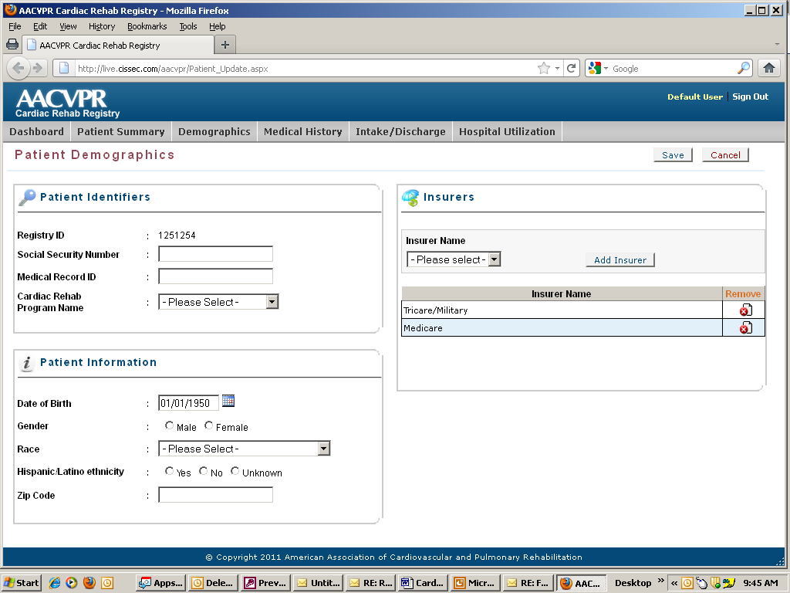
Notes:
An example of the user interface (Demographics section).
Points: Interface will be easy to navigate, data entry easy and quick, general theme/look similar to the certification interface.
[NB: Ask Registry Committee member for any updates to user interface and associated graphics for presentation.]

Slide 26
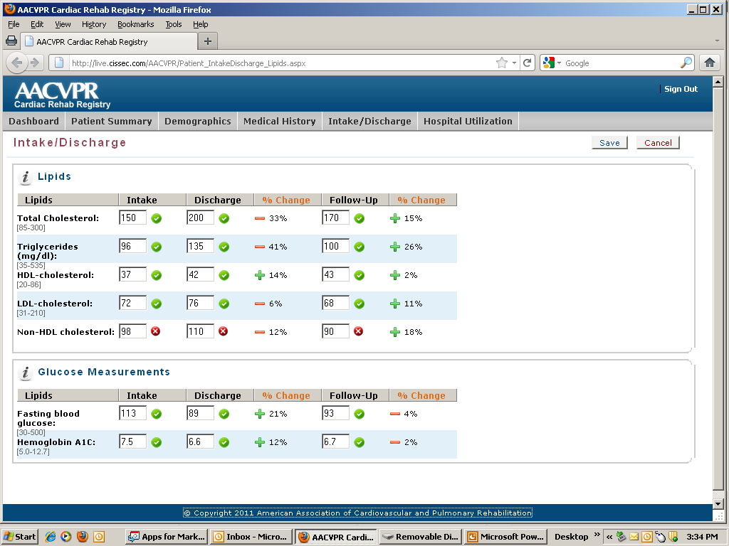
Notes:
Example of clinical information section.
Points: Will provide lots of feedback on data accuracy and validity (is it within expected valid ranges? is it correct format? is it correct number of characters?); whether the data is at goals/targets, and the percent change in the outcome from entry to discharge to FU.
Once in working order, the interface will be tested by selected sites around the country. Feedback will be used to make further improvements.

Slide 27
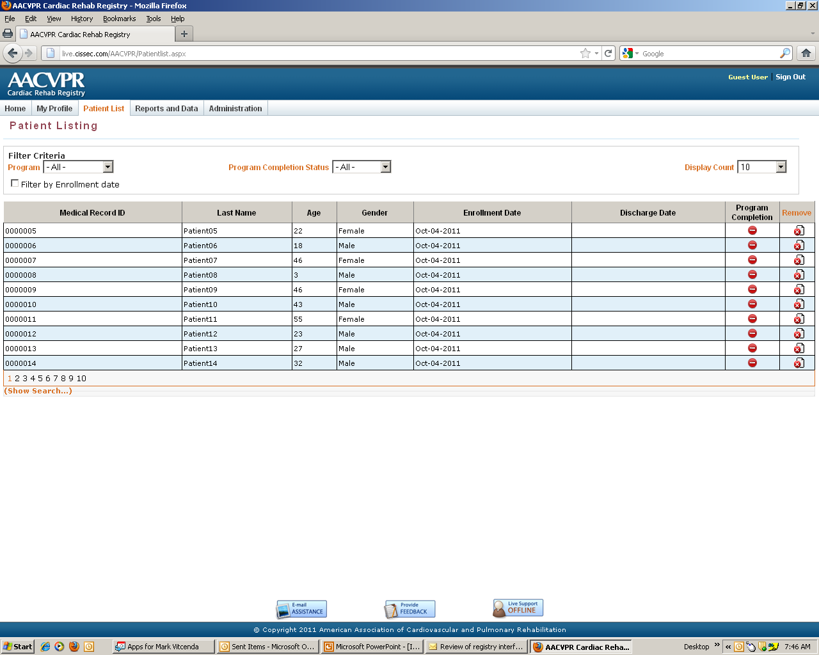
Notes:
Patient records list: Will be able to filter by various criteria, sort by column headers.

Slide 28
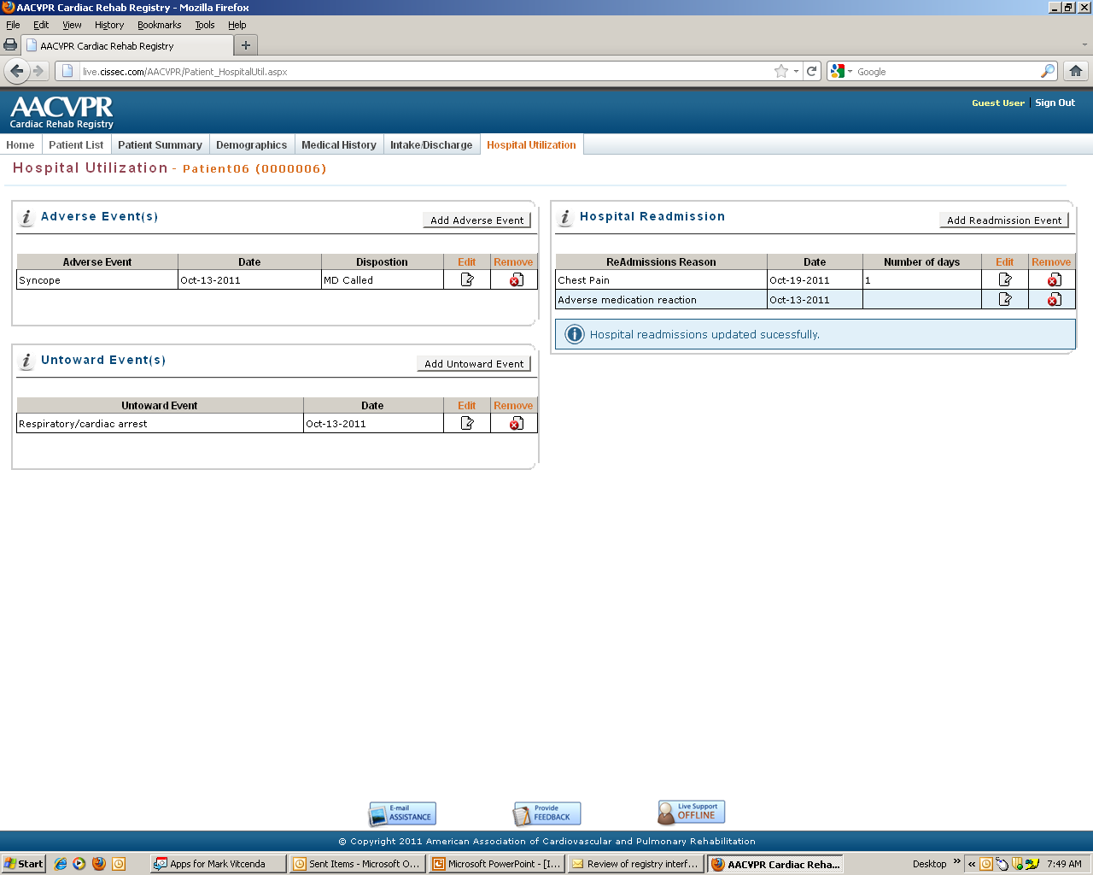
Notes:
Hospital utilization: Will be able to record adverse events (things that happen that require physician notification), untoward events (MI, arrest), and hospital admissions.

Slide 29
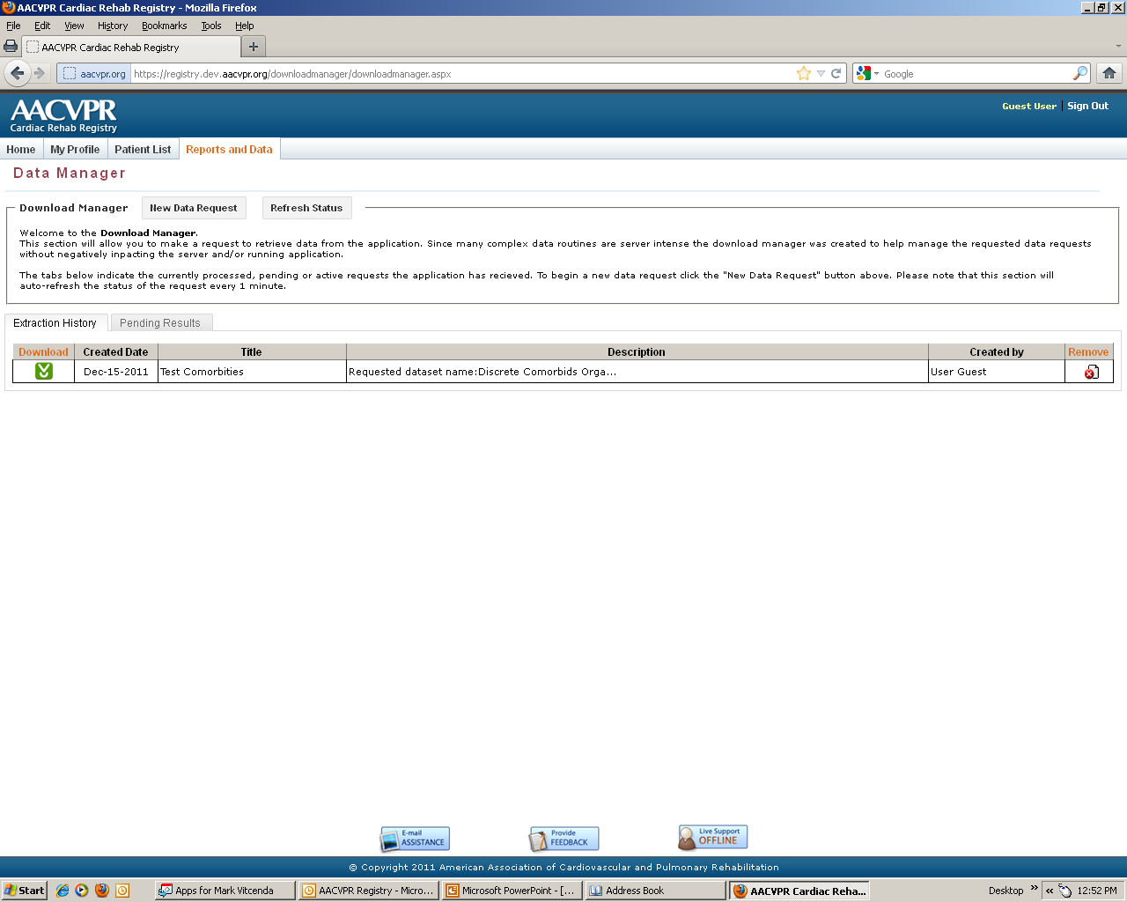
Notes:
You also have complete access to your data at any time. The “Data Manager” allows programs to create customized data sets that can be updated at any time with current data.

Slide 30
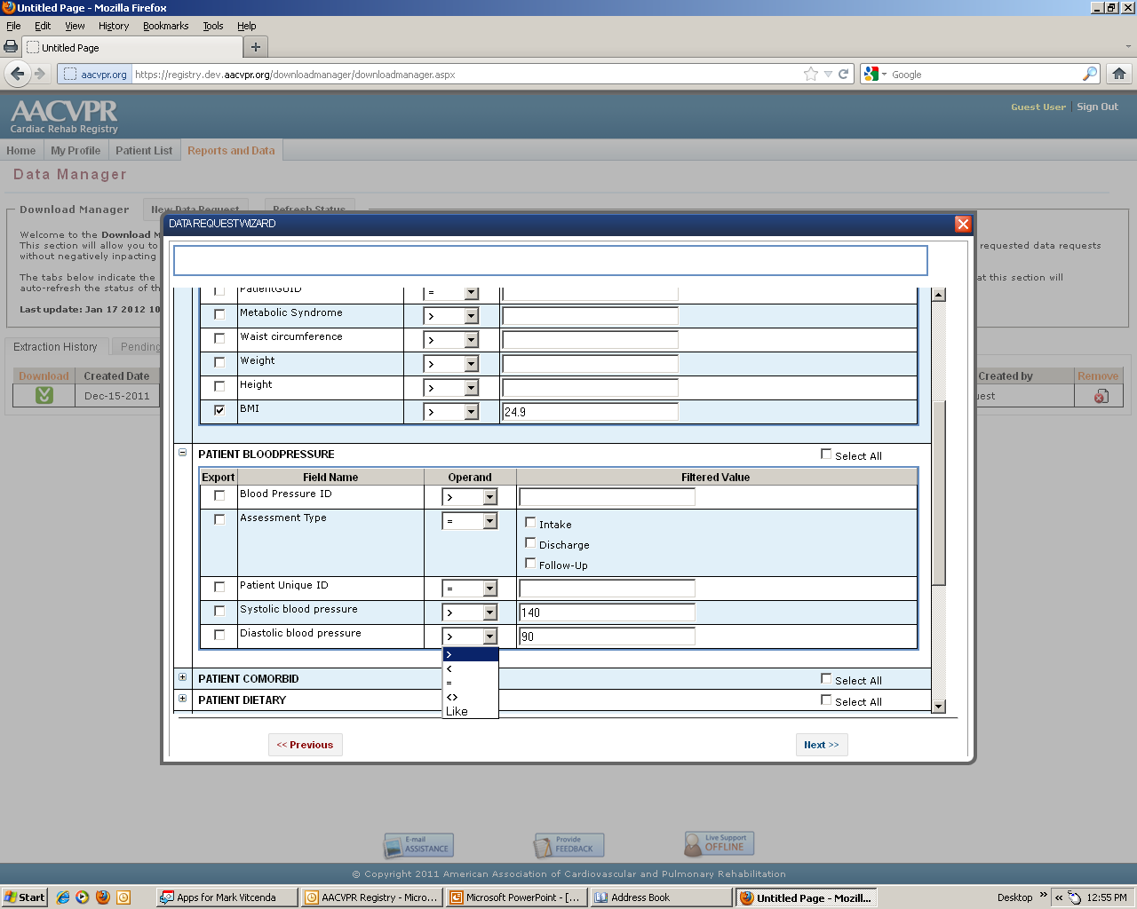
Notes:
For example, let’s say you wanted to find records on all patients who were overweight or obese at entry and who had hypertension. You could select these variables or any other field in the Data Manager and create a recordset for saving and downloading.

Slide 31
Registry Reporting
Individual patient outcomes
Aggregated outcomes for program
Program performance based on guidelines
Program performance based on registry aggregates
  Benchmarking to like-size and state
User-defined queries
Notes:
Feedback is the meat of the registry. You enter the data so you can see what it all means. We are striving for robust reporting features, including several pre-formatted reports, and also providing users with a tool for looking at individual outcomes based on selected criteria.

Slide 32
Registry Reporting
Only your program will have access to your data and results
Results can be used to manage care of patients, to track individual patient outcomes or general program performance
Notes:
Only the program will have access to their own data and reports unless they wish to share them with administrators, physicians, etc. Any data used for research or QI will be aggregated and will not include patient or program identifiers unless specifically permitted by the participating program.
Will be able to use reports to manage care of patients, track progress of individual patients or general program performance.
32

Slide 33
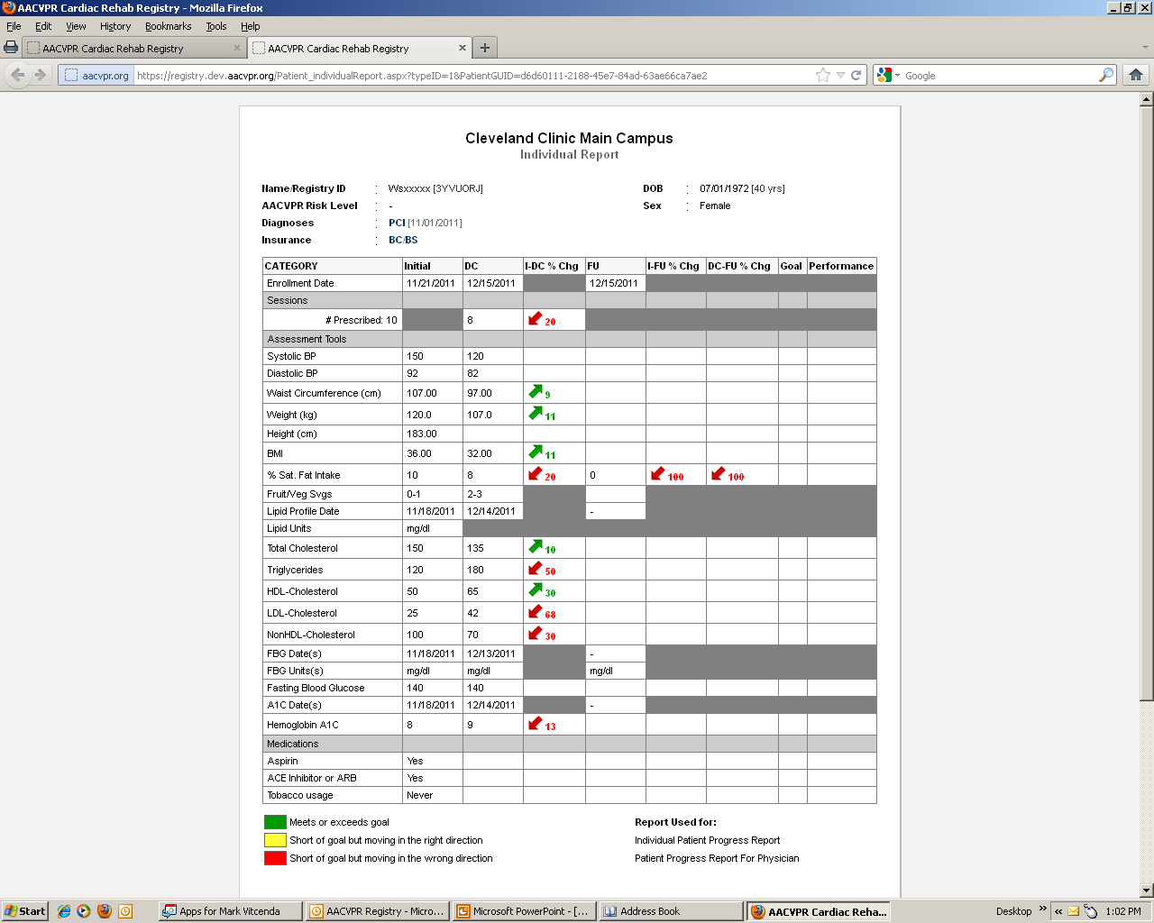
Notes:
An example of proposed individual patient outcomes summary report.
Trying to develop reports that are easy to read, provide high-quality feedback, and print on one page. [Note colors and representation of good/bad/at goal. Will be formatting graphics for B/W printers and getting more feedback during beta testing regarding report display.]
[NB: Ask Registry Committee for updates to reporting features or graphics of reports, depending on when presentation is made.]

Slide 34
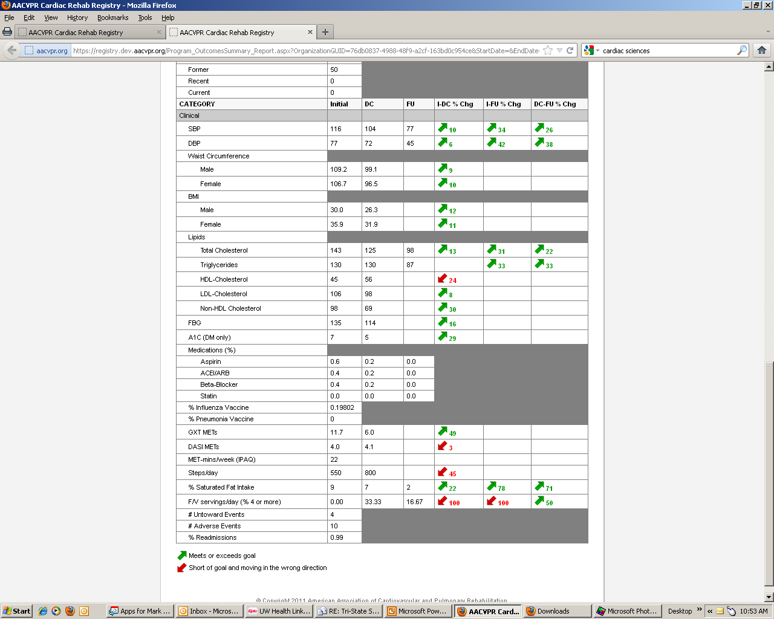
Notes:
An example of a performance report…

Slide 35
HIPAA, PHI and the Registry
Use of Protected Health Information (PHI)
  Minimum amount of patient identifiers used for connection to ACC registries, Medicare administrative databases
Will require Participation Agreement between AACVPR and your program
PA will include Business Associate Agreement and limited Data Use Agreement
Review by Mayo Clinic IRB
Notes:
Two issues unique to registry that will impact programs are the use of protected health information and concerns with connecting to the registry through other outcomes applications. First, let’s address the issues surrounding the use of PHI and why we decided to include patient identifiers in the registry. [Let the audience know that this area probably will be the great unknown in terms of what we’ll eventually end up with when we go live, depending on the beta tests and IRB review]:
The real value of the registry lies in tying into existing registries, either those of ACC or Medicare administrative databases.
Participating programs will need to sign a Participation Agreement with AACVPR. The PA will include BAA (needed when parties are using PHI) and DUA (needed if and when data is used for internal or external research). AACVPR is working with SmithBucklin legal team to develop standard language that can be inserted into your consent forms if this is needed.
[This last note is dependent on what happens; check with Registry Committee before presentation]
We hope to have an IRB review by Mayo Clinic to ensure the legal aspects and accuracy of the Registry. We also hope this will offset the need of having programs go through IRB review at their institutions.
Keep up to date on these aspects of the Registry by visiting the AACVPR Registry site frequently, where we will have updated FAQs available on these and other topics.

Slide 36
Connecting to the Registry:
Application Programming Interface (API)
Allows 3rd party applications to upload local data to registry
AACVPR working with LSI, ScottCare and Cardiac Sciences on creating uploading methods from their applications to registry
Home-made databases may require custom solutions
Notes:
What if your program is currently using some other outcomes management application, for instance, applications that come with your telemetry system?
A very important aspect of the registry is understanding that no one wants to enter something more than once. We are developing APIs [programming code] that will allow third parties to upload data from their sources to the registry. We are in contact with our industry’s telemetry companies so they can develop their side of these data bridges. If you have a home-grown or customized database, we may have to provide directions on how to upload that information to the registry manually.
[Programs should contact their telemetry vendor for details.]

Slide 37

Program
Certification
Registries
Data
Notes:
We are also tying the program certification database into the registry database so that any data that is needed for program certification from the registry database can be automatically pulled into the program certification application and vice versa, thereby saving time for users.

Slide 38
Training and support
Education
Promotion
Funding support
Training/support
Education
Promotion
Funding support
Notes:
The registry is not just about data collection. There are many other aspects of the project we’re working on. These include:
Training and support of users in using the registry effectively and correctly
Promotion of the registry to our members and customers (physicians, administrators, health care payers, regulators, corporate partners)
Using the data to educate professionals and public about the importance of CR
Acquiring financial support from industry and professional partners to maintain and improve the project

Slide 39
Training and Education
Each program to designate “Principal User”
Training required to ensure accurate data collection and reporting
On-line help and technical support through AACVPR and Cissec.
Notes:
RE Training and Education
Each program will identify a “principle user” who will be trained to use the registry, enter data. Their job will be to ensure that the data entered by the program is accurate and conforms to registry definitions.
Training supplied through webcasts, podcasts, online user manual
Plenty of online support for users through AACVPR and Cissec

Slide 40
Training and Education
AACVPR will provide outcomes education through webinars, podcasts, articles
  How to analyze Registry data
  How to use data to improve patient care
  How to do QI projects to improve program performance
Notes:
Training and education through webinars, podcasts, News & Views:
How to analyze your data and results from the registry
How to use your results to improve patient care
How to use results to do QI and improve performance
40

Slide 41
Membership fees
Annual user fee: $100-$150
Based on program size
Notes:
There will be a small annual user or membership fee based on program size. We’ve surveyed many programs and found that $100-150 is appropriate.

Slide 42
Key Points

Slide 43
Value
Quality
Functionality
Scope
Notes:
Trying to combine value (the experience and the feedback of the registry should be important to programs), functionality (data entry and reporting features should be easy to use and understand), scope (the registry should track outcomes that are sufficiently important and inclusive for most patients in CR), and quality (the overall experience should meet the high clinical standards of AACVPR, registry participants, and customers.)

Slide 44
Key Points
June, 2012 launch date for CR registry
Beta testing ongoing with selected sites
Notes:
[Speaker can create own notes for these “key point” slides, but these are general points to emphasize for the conclusion of the presentation.]

Slide 45
Key Points
Participation not required, but encouraged
Notes:
Note: Some programs/affiliates may be participating in other projects such as WiCORE or the Montana Project. These projects may be closed once the Registry gets momentum, or may be less actively supported; contact project managers of your particular project for what the future will bring.

Slide 46
Key Points
Do not need to be an AACVPR member or be AACVPR-certified to participate

Slide 47
Key Points
Registry membership/subscription will be on-line through AACVPR

Slide 48
Key Points
Membership cost minimal--$100-150

Slide 49
Key Points
AACVPR will provide lots of training, education and support as needed
“We’re here for you!”

Slide 50
Key Points
Data bridges/pipelines (APIs) from telemetry vendors and other data sources planned to make data entry easier

Slide 51
Key Points
Will require adjustments to program protocols for maximal benefit

Slide 52
Key Points
Certification and Registry applications linked for easy data transfer between both applications

Slide 53
Key Points
The CR Registry will help programs manage and analyze their outcomes data and promote improvements in patient outcomes, improvements in program procedures, and overall improved utilization and recognition of CR services.

Slide 54
Key Points
Note: The National PR Registry will launch in June, 2013. This is to give time for us to learn from the CR Registry and make improvements as needed to the PR Registry.
Notes:
[This slide can be deleted/hidden if needed, depending on the audience. The PR Registry will be designed to look and act much like the CR Registry, with data set specific to PR outcomes.]

Slide 55
Thank you

Slide 56
?
questions

