Slide 1

Cardiac Rehabilitation: the Value Proposition
John Pasquini, MD & Jan Wagoner, MA
Joyce Bumgarner, BSN
October 5, 2018

Slide 2
Objectives
Atherosclerotic disease and pathophysiology
Lifestyle and cardiovascular health
ROI of cardiac rehab to healthcare systems
Opportunities for improvement:
  Million Hearts Initiative

Slide 3
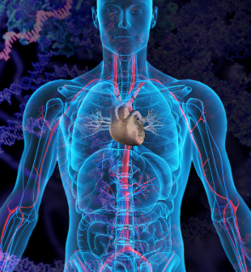
The science of the disease
History
Discuss pathophysiology of atherosclerosis
Groundbreaking Clinical Research

Slide 4

History
Hippocrates (460-377 BC) “walking is man’s best medicine”
Heberden 1772: described a patient with angina “set himself a task of sawing wood for half an hour every day, and was nearly cured”
Framingham Heart study 1948-current
Seven Countries study 1958-1970
Interheart study 1998-2004

Slide 5
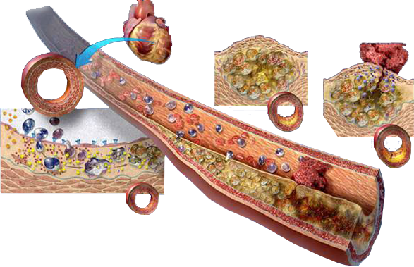

Atherothrombosis: An Interaction Between Lipids, Inflammation, and Thrombosis
Lipid-filled
plaque
Ruptured plaque
with thrombus
1
2
Early atherothrombosis
3
4
5
2
STRIVE
TM
Adapted with permission from Libby P. Sci Am. 2002;286:46-55.
Notes:
Atherothrombosis—atherosclerosis superimposed by thrombosis—usually develops over many years or decades.
Excess low-density lipoprotein (LDL) particles build up in the arterial wall and undergo changes that stimulate endothelial cells into forming adhesion molecules (1), which, in turn, adhere to monocytes and T cells. These cells are influenced by chemokines to emigrate to the intima (2).
Within the intima, monocytes transform into macrophages. The macrophages and T cells produce many inflammatory mediators, including cytokines and factors that trigger cell division and inflammatory processes. The macrophages also display scavenger receptors, which help them ingest LDLs.
Upon engulfing LDLs, the macrophages become fatty foam cells (3). The resulting “fatty streak” constitutes the earliest stage of atherosclerotic plaque.
Under inflammatory conditions, the plaque progresses and a tough, fibrous cap (derived from matrix produced by medial smooth muscle cells) forms over the lipid core (4). The cap insulates the lipid core from circulating platelets and blood factors.
However, the protection may not last because the foam cells retain their properties as macrophages, including the ability to digest matrix and simultaneously attack smooth muscle cells, thus disrupting regeneration of the fibrous cap (5). The weakened plaque may rupture, permitting tissue factor to interact with circulating thrombogenic elements and platelets.
The resulting thrombus formation can occlude a coronary vessel, producing an acute coronary syndrome that, if not resolved spontaneously or through intervention, can result in myocardial necrosis.
This atherothrombotic cascade is a far more common underlying cause of myocardial infarction than is overgrowth of intact plaque that fills the lumen.
Libby P. Atherosclerosis: the new view. Sci Am. 2002;286:46-55.

Slide 6
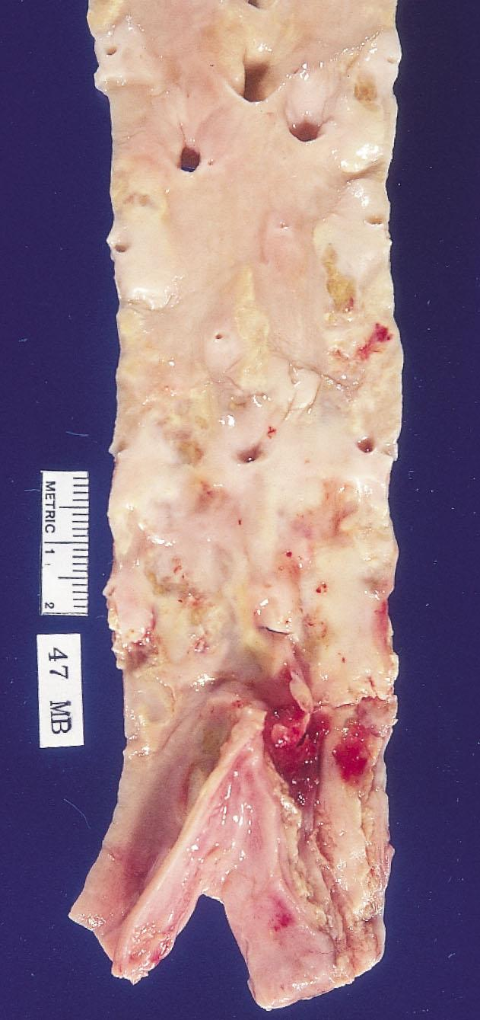

Slide 7
Cardiovascular Disease
Different Clinical Manifestations of
SAME Atherothrombosis pathology
  BRAIN:
  Ischemic stroke
  Transient ischemic attack
  HEART:
  Sudden Cardiac Death
  Heart attack / Myocardial infarction
  Angina pectoris (stable or unstable)
  PERIPHERAL ARTERY DISEASE:
  Aneurism, ischemia or claudication
SAME risk factors
  SAME Pathology
Heart Failure
Notes:
7
Vascular disease is the result of a generalized process that may affect any of several vascular beds involving the cerebral, coronary, and peripheral arteries¹.
Cerebrovascular disease in cerebral arteries may precipitate a transient ischemic attack (TIA) or an ischemic stroke. A TIA, by definition, lasts for fewer than 24 hours. The majority clear within 1 hour. A TIA may be a warning of an impending stroke, with the risk for a stroke being 4% to 8% during the first month following a TIA and 24% to 29% during the next 5 years.¹
Coronary vascular disease produces a spectrum of ischemic coronary syndromes that include stable angina, unstable angina, non–ST-segment elevation myocardial infarction (NSTEMI; also known as non–Q-wave MI), and ST-segment elevation (STEMI; also known as Q-wave MI).²
Peripheral arterial disease (PAD) produces a variety of symptoms ranging from intermittent claudication to pain at rest.³ Patients with the most serious form of PAD
develop a critical limb ischemia that produces pain at rest and threatens the viability of the limb by increasing the risk for gangrene and necrosis.³ PAD is a strong marker for cardiovascular disease.
References
¹ Feinberg WM, Albers GW, Barnett HJ, et al. Guidelines for the management of transient ischemic attacks. Circulation. 1994;89:2950-2965.
² American Heart Association. Heart Disease and Stroke Statistics–2003 Update.
Available at: http://www.americanheart.org/presenter.jhtml?identifier=1928.
³ Weitz JI, Byrne J, Clagett GP, et al. Diagnosis and treatment of chronic arterial insufficiency of the lower extremities: a critical review. Circulation. 1996;94:3026-3049.

Slide 8
A Case Not Too Uncommon
A 64 year old woman presented with non-STEMI. This was her first manifestation of coronary heart disease
Past medical history: type 2 diabetes, BMI 30, microalbuminuria. Outpatient meds: metformin, low-dose simvastatin, ACE inhibitor
On admission: LDL-C 96 mg/dL, HDL-C 47 mg/dL, triglycerides 134 mg/dL, HbA1c 6.9%
Initial treatment with anti-platelet agents, heparin, beta-blocker, and nitrates with relief of symptoms. High-dose statin therapy initiated
Taken to cath lab. Successful PCI of a critical proximal RCA lesion. A 60% stenosis of LAD is noted, but not treated. LVEF 52%
Patient is discharged home on second hospital day
Notes:
8

Slide 9
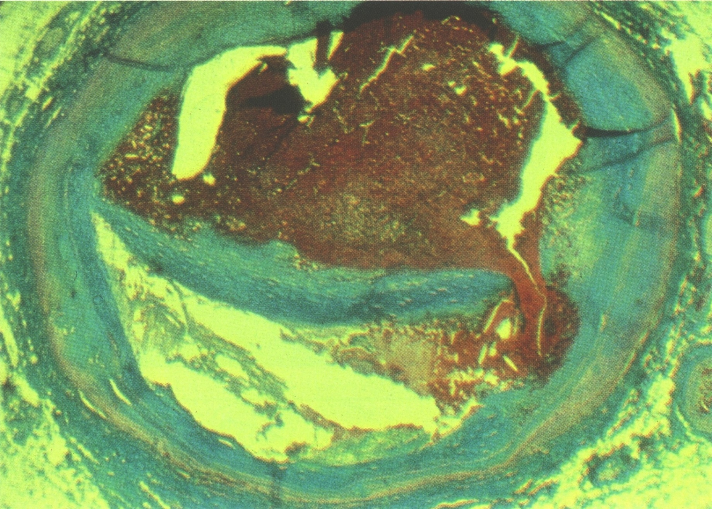
Cross-Section of LAD Two Months Later

Slide 10
STEMI: Acute Therapy
40 y.o. RN, 3 hours of chest & left arm pain
H/O hypercholesterolemia first diagnosed as a teenager (TC 295, HDLc 46, LDLc 229, TG 101)
Has taken meds intermittently
ST elevation in the inferior leads, 2 mm with reciprocal changes ~ Code STEMI!
Discharged day 2 and started cardiac rehab
Recent lipids (April, 2018): TC 134, HDLc 43, LDLc 72, TG 77

Slide 11
Microanatomy of Coronary
Arterial Thrombosis
Libby & Theroux. Circ. 2005; 111: 3484,Fig 3

Slide 12
Response to Retention: Model of Atherosclerosis
Tabas et al. Circ. 2007;116:1833

Slide 13
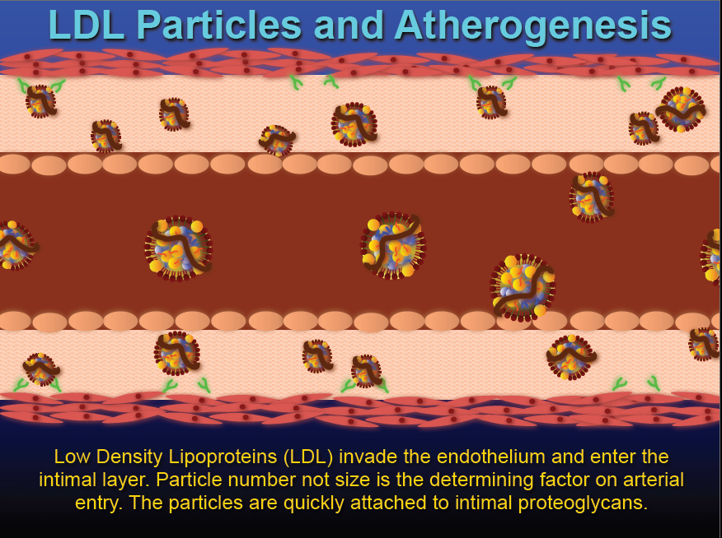

Slide 14

Evidence: Epidemiology: Framingham
Started 1948 with 5,000 residents
One of the largest studies of C-V epidemiology
CVD rate associated with risk factors
▪ Previously thought to be due to aging
▪ Diet heart hypothesis
▪ Age, gender, dyslipoproteinemia, HTN, DM,
smoking

Slide 15
CVD Epidemiology: Seven Countries
Seven Countries: 10 fold variation C-V mortality between countries
11,575 males in 7 countries studied
Average cholesterol associated with CHD mortality
Dietary saturated fat and cholesterol intake closely associated with blood cholesterol levels
Populations with high CHD had increased ASD in arteries
Link between diet total cholesterol and death
Increased saturated fat associated with increased total cholesterol and increased death
Mediterranean diet most protective
Steinberg. J. Lipid Res 2005; 45:179-190

Slide 16
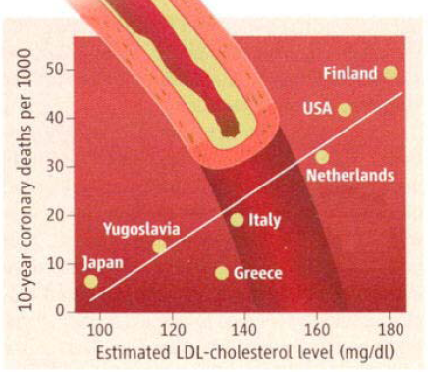
Seven Country Study: Death Rates
Brown, M., Goldstein, J. Science 2006; 311:1721-1723

Slide 17
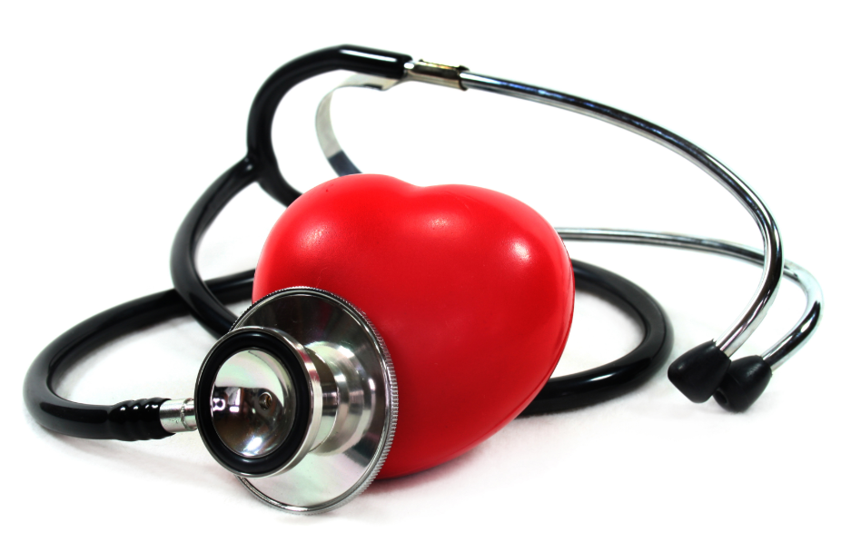
Interheart Study
52 countries
Case control structure
15,151 enrolled with first MI (with age matched controls)
75% of events related to lipid abnormalities, smoking, diabetes and hypertension

Slide 18
INTERHEART Study “nine potentially modifiable risk factors account for over 90% of the risk of an initial acute myocardial infarction” Population attributable risk fractions
DIET explains 50%+ CHD events
Salim Yusuf et al . Effect of potentially modifiable risk factors associated with myocardial infarction in 52 countries (the INTERHEART study). Lancet 2004 364 9437

Slide 19
Effect of Lowering LDL-C on CHD Events
POSCH-PL
Primary prevention trials
4S-PL
25
Secondary prevention trials
POSCH-Rx
20
CARE-PL
HPS
4S-Rx
15
LIPID-PL
TNT-10A
Statin trials
% Patients with CHD Event
10
CARE-Rx
HPS-PL
WOSCOPS-PL
Non statin trials
LIPID-Rx
TNT-80A
HPS-Rx
WOSCOPS-Rx
5
LRC-PL
ASCOT-PL
LRC-Rx
ASCOT-Rx
AFCAPS-PL
0
AFCAPS-Rx
50
70
90
110
130
150
170
190
210
LDL-C achieved mg/dL
PL = placebo
Rx = active treatment
Ballantyne CM. Am J Cardiol. 1998;82:737-743.
O’Keefe JH, et al, J Am Coll Cardiol. 2004;43:2142-2146.
Notes:
Populations with low cholesterol levels (≤150 mg/dL) and low LDL-C levels (≤70 mg/dL) have a low incidence of coronary artery disease. Epidemiological studies show that lowering plasma cholesterol levels results in a progressive decrease in cardiovascular events.¹⁻⁴ Combined data from the Air Force/Texas Coronary Atherosclerosis Prevention Study
(AFCAPS/TexCAPS) and West of Scotland Coronary Prevention Study (WOSCOPS) trials suggest that reducing cholesterol levels from 285 mg/dL to 190 mg/dL decreases the incidence of CHD events from 170/1,000 patients in 10 years to 70/1,000 patients in 10 years.^{3,4}
Physicians today are under increasing pressure to attain LDL-C goals below 100 mg/dL,⁵ and these targets could be reduced still further in the light of findings from ongoing clinical trials. Statins can achieve LDL-C reductions of up to 50–60% when used in high doses,⁶ however, statins in monotherapy are unable to reduce LDL-C levels beyond this level, leaving many
hypercholesterolaemic patients at significant risk of coronary events. Strategies that combine lipid modifying agents with complementary mechanisms of action may further enhance the benefits of statin therapy.⁷
References
1. Castelli WP. Epidemiology of coronary heart disease: the Framingham study. Am J Med 1984; 76: 4–12.
2. Sacks FM, Pfeffer MA, Moye LA et al., for the Cholesterol and Recurrent Events Trial Investigators. The effect of
pravastatin on coronary events after myocardial infarction in patients with average cholesterol levels. N Engl J Med
1996; 335: 1001–9.
3. Shepherd J, Cobbe SM, Ford I et al., for the West of Scotland Coronary Prevention Study Group. Prevention of coronary heart disease with pravastatin in men with hypercholesterolemia. N Engl J Med 1995; 333: 1301–7.
4. Downs JR, Clearfield M, Weis S et al., for the AFCAPS/TexCAPS Research Group. Primary prevention of acute coronary events with lovastatin in men and women with average cholesterol levels: results of AFCAPS/TexCAPS. JAMA 1998; 279: 1615–22.
5. Expert Panel on Detection, Evaluation, and Treatment of High Blood Cholesterol in Adults. Executive Summary of the Third Report of the National Cholesterol Education Program (NCEP) Expert Panel on Detection, Evaluation, and Treatment of High Blood Cholesterol in Adults (Adult Treatment Panel III). JAMA 2001; 285: 2486–97.
6. Grundy SM. Statin trials and goals of cholesterol-lowering therapy. Circulation 1998; 97: 1436–9.
7. Izzat NN, Deshazer ME, Loose-Mitchell DS. New molecular targets for cholesterol-lowering therapy. J Pharmacol Exp Ther 2000; 293: 315–20.

Slide 20
β Coefficients = % fall in CHD mortality per unit decrease in risk factor
(from meta-analyses & cohorts)
Cholesterol lowering PSC 2007
  ⇓ 0.1mmol/l population mean cholesterol ≅
  ⇓ 4% reduction in CHD mortality
Blood pressure PSC Lancet 2003
  ⇓ 1 mm Hg Systolic BP ≅ ⇓2% CHD deaths
Smoking InterHEART, 2004
  1% ⇓ Smoking prevalence ≅ ⇓1% CHD deaths
Obesity Bodgers, 2007
  0.1 Kg/M² ⇓ BMI ≅ ⇓ 0.25% CHD deaths
Ford et al, NEJM 2007 356 : 2388-

Slide 21
Lyon Diet Heart Study
Randomized Single-Blind Secondary Prevention of Coronary Heart Disease
Compared Mediterranean-Type Diet with Prudent Western-Type Diet
Consecutive Patients Who Survived 1st MI
Had to be < 70 Years of Age & Clinically Stable
Follow-Up of 60 Months but Actually Terminated at 27 Months
Michel de Lorgeril M.D., et al, Circ 1999;99:779-85
Notes:
Lyon Diet

Slide 22
Lyon Diet Heart Trial: Results of All Primary & Secondary End Points
Michel de Lorgeril M.D., et al, Circ 1999;99:779-85

Slide 23
Relations of Lifestyle, Risk Factors & C-V Disease
Mozaffarian et al, Circulation. 2008;117:3031-3038

Slide 24
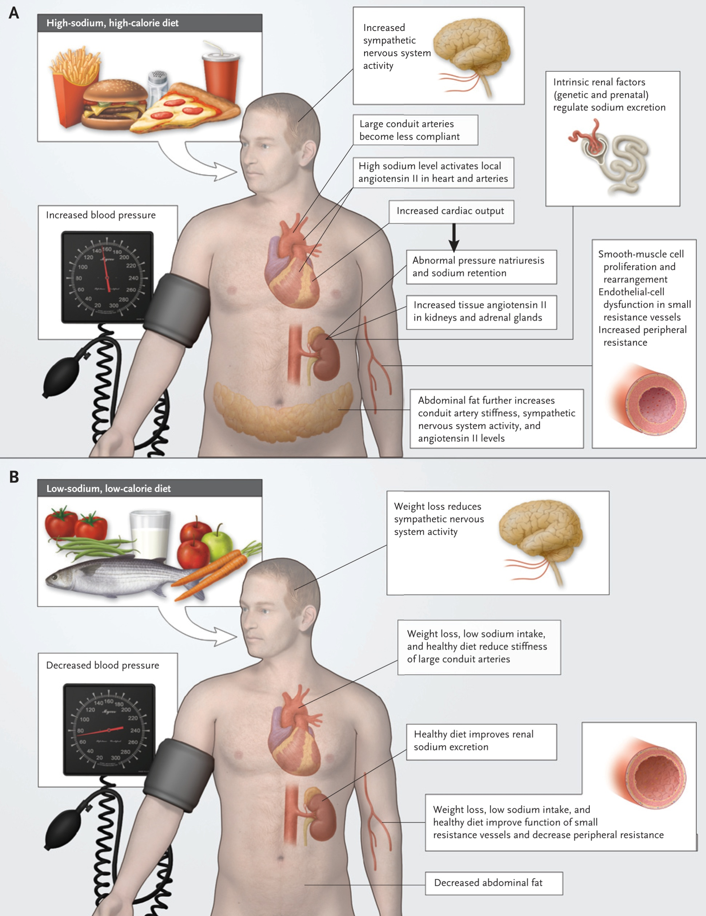
Risk-Factor Modification: Lifestyle
Sacks FM, et al. N Engl J Med. 2010;362:2102-2112.

Slide 25
Risk-Factor Modification: Lifestyle
Sacks FM, et al. N Engl J Med. 2010;362:2102-2112.

Slide 26

Risk-Factor Modification: Lifestyle
Sacks FM, et al. N Engl J Med. 2010;362:2102-2112.

Slide 27

Cardiac Rehab: from Science to Value Proposition
Science speaks volumes
Cardiac Rehab is the application of science to patients
Explore current and potential value of cardiac rehab to our communities

Slide 28
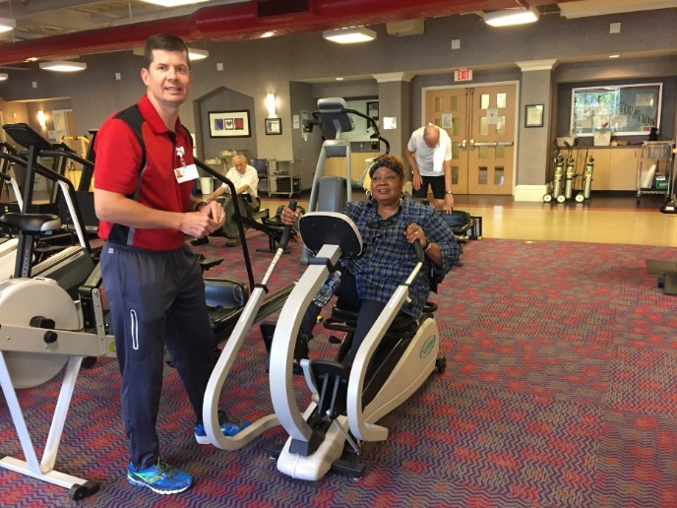
Cardiac Rehab Definition
CR is multi-disciplinary program
  Medically supervised exercise
  Education
  Nutrition coaching
  Psychosocial intervention
  Smoking cessation
  12 weeks
  Post cardiac rehab “fitness” program is
  important to support adherence/compliance

Slide 29

Indications for Cardiac Rehab
Coronary artery bypass grafting
MI in past 12 months
PTCA or intervention
Chronic stable angina
Heart valve repair or replacement
Heart Failure (chronic, stable, EF<35%)
Heart or heart & lung transplant
PAD

Slide 30
Benefits of Cardiac Rehab
Patient care enhanced
Early discovery of medical concerns
Marketing
Rehab patients experience:
  Improved quality of life
  Increased capacity for physical exercise
  Increased independence
  Decreased shortness of breath
  Fewer hospitalizations (25%)
  Reduced mortality (12 week program results in ↓25-35% mortality with each ↑1 MET FC)
Only 12%-37% of patients participate in rehab!
Notes:
http://circ.ahajournals.org/content/123/21/2344.long

Slide 31
2017 Scorecard Readmissions
At NH Cardiac Rehabs, we reviewed actual referrals received via EPIC EMR from ACS Order Sets during 2017.
-Evaluated actual readmissions within 90 days of discharge for both patients who refused cardiac rehab and those who entered into the program during that time
-Patients who refused Rehab: 14.7% readmitted
-Cardiac Rehab participants: 2.7% readmitted
-Cost savings potential: $2,139,406
% of pts who readmitted w/NO Rehab | 14.7%
% of pts who readmitted w/ REHAB | 2.7%
Patient Volume Difference | 466
Est. Readmit $ | $ 4,591.00 | # of Patients
Total Cost $$ of Readmits w/ no rehab | $ 2,199,089.00 | 479
Total Cost $$ of Readmits w/ rehab | $ 59,683.00 | 13
Cost Difference $$ | $ 2,139,406.00

Slide 32
PMC Referrals (2017 vs. Jan-Feb 2018)
National CR participation rates 12-37%
Data varies depending on definition of referrals
  Referral processes and Priorities
  Consider excluding “inappropriate referrals” due to Order Set/EMR limitations
  Reasons for declining CR
    Distance to convenient location (50%)
    Transportation 2%
    Medical Complications 7%
    Financial concerns 4%
Date | Entry rate total referrals | Entry rate for Good candidates
2017 | 17.8% | 37%
After excluding “inappropriate” referrals, entry rate closer to national average. Set new goals for 2018 entry rates.
Notes:
Entry rate total referrals Entry rate for Good candidates
2017 19% 37%
YTD 2018 30% 51%

Slide 33

Barriers
Lack of Physician referral
Weak endorsement by prescribing provider
Female gender of patients
Lack of program availability
Work schedule
Low socio-economic status
Limited health insurance
Notes:
Lyon Diet

Slide 34

Opportunities to Reduce Barriers
Boost MD referrals to CR- MD support is single best factor to enhance patient participation
Class 1 indication (ACC/AHA Guidelines)- trackable & reportable
Early referral to CR- current median time from referral to attendance is 35 days
NH goal 7 days to Orientation and <21-30 days to exercise therapy
MD perceptions
Lack of communication from CR at discharge
Geographic access
Awareness of CR locations
Lack of insurance coverage
5% of MD’s have patient safety concerns
Notes:
4 to Uptown in January 2015
Some machines illegally placed
Three EHR systems

Slide 35

Million Hearts Initiative
CDC, AHA and AACVPR
Goal of 70% compliance for eligible patients by 2022
  Save 25K lives
  Prevent 180k hospitalizations
Notes:
Lyon Diet

Slide 36
Ideal Cardiac Rehab Patient Progression
Phase I/ Inpatient
Inpatient hospital visit/ assessment by rehab team member
Patient education
Phase II/ Early Outpatient
Treatment planning within 7 days of discharge
Supervised exercise (3x/week)
Phase III-IV/ Maintenance
GOAL
Continued exercise
Lifestyle modification
Physician referral to outpatient program
Medical supervision with EKGs
Counseling/ Education
MD supervision not required
Weekly “quick look” paddle EKG
Discharge planning with outpatient program appointment
Notes:
Advisory board

Slide 37
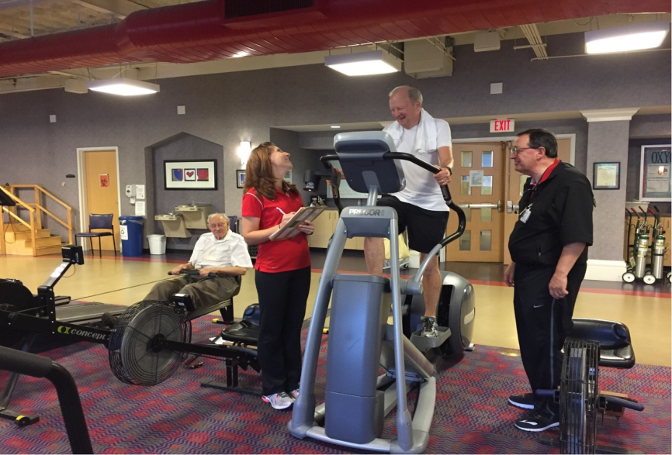
Expansion to Medical Fitness
Primary Prevention
Patients with diagnoses not covered by insurance
  A-fib
  Any risk factors
    Familial hypercholesteromemia
    Hypertension
    Diabetes
  Pulmonary
  Cancer
  Heart Failure (HFpEF)
  Stroke

Slide 38

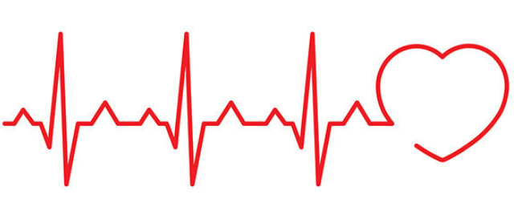
Cardiac Rehab for HF Patients
Opportunities:
  Based on 2017 data, HF patients are under-referred to Cardiac Rehab
  Work with heart failure team to increase referrals to both Cardiac and Pulmonary rehab
  Develop report data to track/support benefits for heart failure patients
Solutions:
  New telemetry systems are being installed in all 8 Cardiac Rehab locations by end of 2018, integrated with Epic
  Patients with EF > 35% can now be invited into Cardiac Rehab Medical Fitness Program, offered at PMC, RMC and MMC (October 1, 2018). **PIF Grant

Slide 39

Empowerment
Update on the science of atherosclerosis
Medical economics is driving change and helping us
Tell our stories
  Pull your program’s data
    Referrals
    Participation
    Cost savings to our healthcare systems
Our future is bright!
Notes:
Lyon Diet

Slide 40



