Slide 1
Diabetes Education and the Cardiac/Pulmonary Rehab Patient

Slide 2
General Statistics
Diagnosed and undiagnosed diabetes in the United States
Total: 29.1 million people or 9.3% of the population have diabetes.
Diagnosed: 21.0 million people.
Undiagnosed: 8.1 million people (27.8% of people with diabetes are undiagnosed).
all ages, 2012
CDC National Diabetes Statistics Report 2014

Slide 3
Cardiac Rehab Patients
According to various reports: 25-27% of patient’s entering Cardiac Rehab also carry the diagnosis of diabetes
The proportion of patients with a major cardiac event and have diabetes has increased
What does that mean for you?
Notes:
More diabetes in class. Unique opportunity to assist those diagnosed or identifying those at risk. Close contacts (2-3 times per week) helps to reinforce core self care behaviors.

Slide 4
Self Care Behaviors

Slide 6
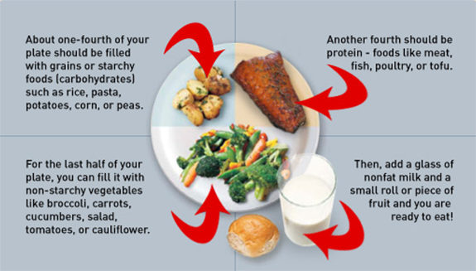

Slide 7
This is why they are here
Points to remember for diabetes:
Exercise helps the body use insulin better (the underlying problem in Type 2 diabetes)
Exercise helps the body use insulin better (risk for hypoglycemia – up to 24 hours later)
May need to adjust class or medications to exercise safely

Slide 8
Who needs to monitor?
When do we need to monitor?
What labs do we look at?
Notes:
Depends on Medication

Slide 9
Let’s look at this in a moment.
Notes:
PTR: Patients need to keep taking their medications and know why.

Slide 10
Goal Setting
When to call PCP
How to treat hypoglycemia
What is the plan for after Cardiac Rehab

Slide 11
Head to Toe Risks
Notes:
Eye Problems: Leading cause of new cases of blindness (20-74 yoa)
Teeth: 1/3 of patients have severe periodontal disease
Risk for Stroke: 2-4 times higher
Heart Disease Death Rates: 2-4 times greater
Kidney: Leading cause of kidney failure
Nerves: 60-70% have mild to severe forms of nervous system damage (Peripheral and autonomic)
Amputations: 60% of nontraumatic lower-limb amputations

Slide 12
Depression and Diabetes are highly correlated
Chronic disease problem
Family Support
Emotional Stress
Remind patients that frustration, anxiety, anger or sadness or common and normal

Slide 13
Medication Review
13 different classes of diabetes medications!!
Notes:
• Inadequate Postprandial Glucose Control
• Significant Weight Gain
• Excessive Glucose Fluctuations
• Excessive Appetite
• Poor Satiety
• Excess Hepatic Glucose Release
• Impaired Gastric Emptying
• Clinical Inertia (Failure to Intensify Therapy)
Raskin P. Diabetes Metab Res Rev 2013; 29:347-56.

Slide 14
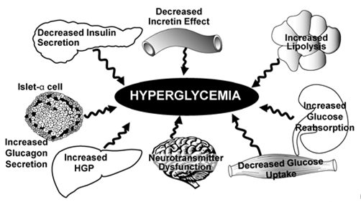

Slide 15
Medications that cause hypoglycemia
Sulfonylureas
Secretagogues
Glyburide (Micronase)
Glipizide (Glucotrol)
Glimepiride (Amaryl)
Repaglinide (Prandin)
Nateglinide (Starlix)

Slide 16
Medications that cause hypoglycemia
Insulins
Basal Insulin
Lantus
Levemir
(Degludec)
NPH
Prandial Insulin
Apidra
Humalog
Novolog
Humalog
R
Corrective Insulin
Same as Prandial, but used differently
U-500
Mix Insulin
Novolog/lin 70/30
Humalog/lin 75/25
Humalog/lin 50/50

Slide 17
Medication for Glucose Control - Orals
Metformin (Glucophage)
Metformin XR (Glucophage XR or Glumetza)
Many Combination Meds
Acarbose (Precose)
Miglitol (Glyset)
Biguanides
Alpha-Glucosidase Inhibitors

Slide 18
Medication for Glucose Control - Orals
Rosiglitazone (Avandia)
Pioglitazone (Actos)
Sitagliptin (Januvia)
Linagliptin (Tradjenta)
Saxagliptin (Onglyza)
Thiazolidinediones
DPP-4 Inhibitors

Slide 19
Medication for Glucose Control - Orals
SGLT-2 Inhibitors
How they work
Canagliflozin (Invokana)
Dapagliflozin (Farxiga)
Empagliflozin (Jardiance)
Sugar
Notes:
This medication acts as a diruetic.

Slide 20
Medications for Glucose Control – Injectables not Insulins
Liraglutide (Victoza)
Exenatide (Byetta)
Exenatide ER (Bydureon)
Albiglutide (Tanzeum)
Symlin
GLP-1 Antagonist
Amylin Replacement
Notes:
Others included:
Anti-obesity medications
Welchol

Slide 21
Resources and who needs them?
Notes:
Resources can be found all over the place.

Slide 22
Online Resources
www.diabeteseducator.org
www.diabetes.org
https://www.aacvpr.org/
https://www.aacvpr.org/CardiacRehabilitationPatients/tabid/503/Default.aspx
http://www.learningaboutdiabetes.org/

Slide 23
References
American Association of Diabetes Educators. AADE Guidelines for the Practice of Diabetes Self-Management Education and Training (DSME/T).Chicago, IL: American Association of Diabetes Educators; 2009.
American Diabetes Association. Clinical Practice Recommendations 2014. Diabetes Care: Vol 37; Supplement 1. pages S31-S33.
Balady GJ, Williams MA, et al; AHA/AACVPR Scientific Statement: Core Components of Cardiac Rehabilitation/Secondary Prevention Programs: 2007 Update. Circulation. 2007; 115: 2675-2682.
http://circ.ahajournals.org/content/115/20/2675
Colberg SR, Albright AL, Blissner BJ, et al; American College of Sports Medicine; American Diabetes Association. Exercise and Type 2 Diabetes: American Diabetes Association and American College of Sports Medicine: Joint Position Statement. Med Sci Sports Exerc. 2010; 42: 2282-2303.
Inzucchi, SE. Yale Diabetes Center. Diabetes Facts and Guidelins, 2011-12.
Lopez-Jimenez F, Kramer VC, et al; Recommendations for Managing Patients With Diabetes Mellitus in Cardiopulmonary Rehabilitation: An American Association of Cardiovascular and Pulmonary Rehabilitation Statement. Journal of Cardiopulmonary Rehabilitation and Prevention. 2011; 32: 101-112.

Slide 24
Questions?

